Slide 1



How to use Lemon oil

Slide 2

Use Lemon oil in a mouth rinse to soothe the mouth and throat
Use Lemon oil in a mouth rinse to soothe the mouth and throat

Slide 3
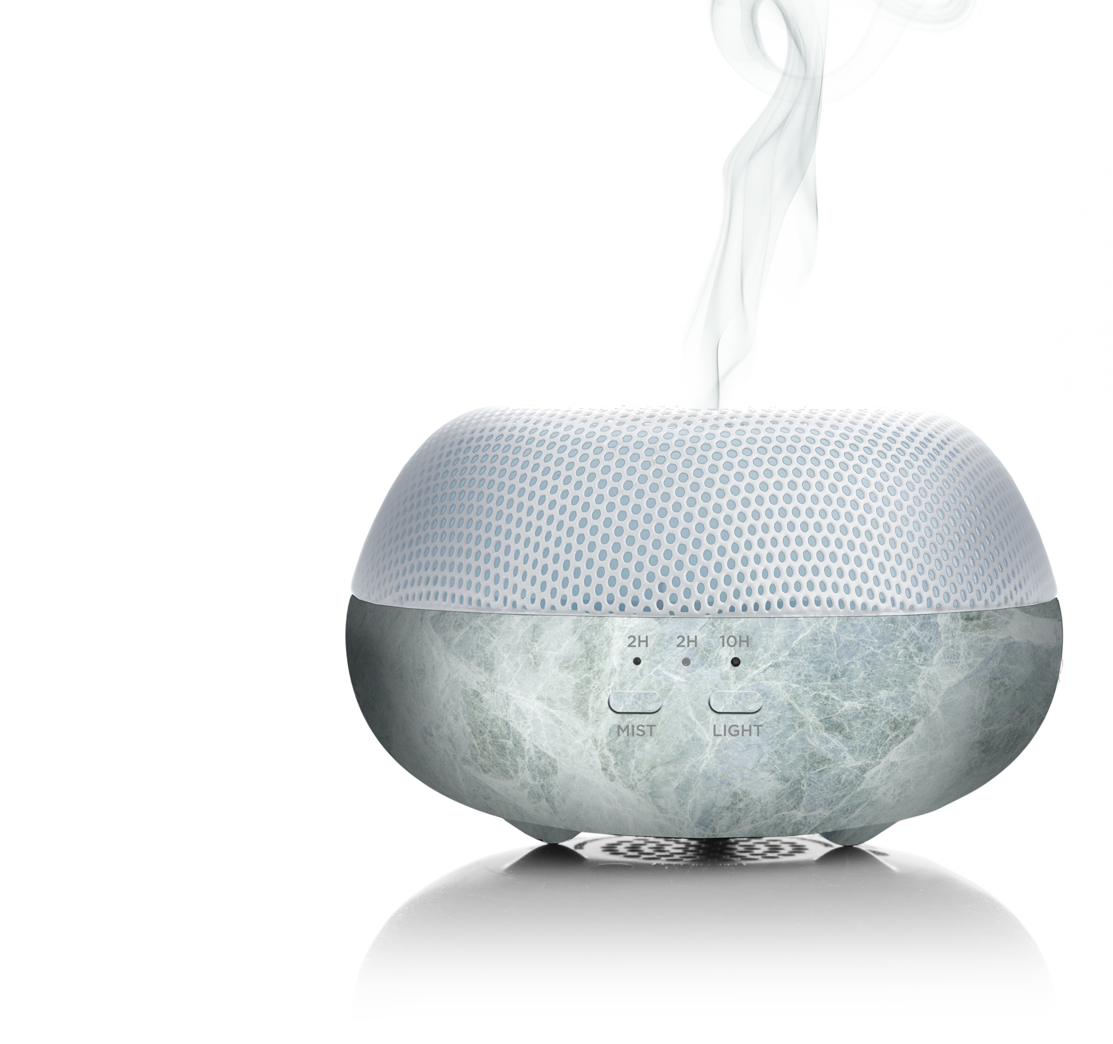

Diffuse Lemon oil to create an uplifting environment

Slide 4

Add Lemon oil to a spray bottle of water to clean tables, countertops, and other surfaces

Slide 5

Add Lemon oil
to enhance the flavor of water, desserts, and main dishes

Slide 6

Take Lemon oil internally to assist with seasonal respiratory discomfort*
* These statements have not been evaluated by the Food and Drug Administration.
This product is not intended to diagnose, treat, cure, or prevent any disease.

Slide 7

Put a few drops of Lemon oil on a rag to help remove sticky residue from surfaces

Slide 8


Click here to get your own bottle of Lemon oil

