Slide 1


Notes:
Welcome to Earning with doTERRA!
Today we’re diving into an exciting opportunity that’s truly unique and unmatched in the world of network marketing. We’ll walk through the many ways you can earn money through doTERRA’s compensation plan by sharing doTERRA products with friends, family, or anyone else who is looking for essential oils and foundational wellness products in their lives.
Whether you’re looking to earn right away, or build a sustainable, flexible business over time, there’s an opportunity for everyone.

Slide 2
Ways to
Earn
As a Wellness Advocate, there are many ways to earn with dōTERRA.
See dōTERRA Opportunity and Earnings Disclosure Summary at doterra.com/disclosure
Notes:
Let’s get to it! There are four main ways you can earn with doTERRA, and they fall into two main categories: commissions and bonuses. We are going to go step-by-step through these different earning opportunities.

Slide 3

Fast Start
Fast Start is designed to provide you with weekly income right away as you share dōTERRA® products.
Fast Start can be used as a weekly growth indicator for your business. The more people you introduce to dōTERRA products, the more your Fast Start will grow.
Notes:
First up: Fast Start. This commission can be earned weekly and is designed to provide you with income right away. As you start sharing your favorite products with others, and they purchase, you are quickly rewarded.

Slide 4


Paid to Enroller
Paid Weekly
Earn 20%, 10%, and 5% on CV
YOUR
ENROLLER’S
ENROLLER
5%
YOUR
ENROLLER
10%
20%
NEW MEMBER
ORDER
Results vary based on time, effort, and skill. Expenses may be incurred. For more information see the dōTERRA Opportunity and Earnings Disclosure Summary at doterra.com/disclosure.
See full details of Fast Start Commission in doTERRA Policy Manual, https://www.doterra.com/US/en/policy-manual
Notes:
When your new member joins doTERRA, you can earn 20% on their first order and any additional orders they place during their first 60 days. You qualify for Fast Start by keeping your own monthly order going.
And Fast Start pays out three levels to qualified members. This means that as your new members enroll their own new people, you can benefit and receive the 10% and 5% Fast Start product sales commissions.

Slide 5
FAST START
Example
NEW
MEMBER
YOU
YOUR
ENROLLER
YOUR ENROLLER’S
ENROLLER
200 Volume
Order
20% = $40
10% = $20
5% = $10
See full details of Fast Start Commission in doTERRA Policy Manual, https://www.doterra.com/US/en/policy-manual
Notes:
Let’s look at an example. Let’s say your new member places an enrollment order of 200 in commissionable volume in their first 60 days. You receive 20% of that order, which equals a Fast Start commission of $40. The person who introduced you to doTERRA would receive a 10% Fast Start commission of $20 and the person who introduced them to doTERRA would receive a 5% Fast Start commission, which equals $10. Imagine enrolling 2-4 people each week, and having those people bring in 2-4 people each week – you can see how Fast Start really adds up!

Slide 6

Power of 3
BONUS
The Power of 3 Bonus is designed to help you structure your business for effective customer support and long-term stability.
This Bonus is focused on new customer acquisition and retention. Effective customer support is essential for long-term growth.
See dōTERRA Opportunity and Earnings Disclosure Summary at doterra.com/disclosure
Notes:
Now, let’s look at the Power of 3 Bonus. Designed with growth in mind, this bonus guides you in structuring your business for reliable customer support and long-term stability. As you focus on supporting new customers and retaining those customers, you can unlock the Power of 3 bonus in your business.

Slide 7

How It
Paid to Sponsor
Paid Monthly
Earn $50, $250, or $1250
Paid to Sponsor
Paid Monthly
Earn $50, $250, or $1250
Works
To qualify for the $50 Power of 3 Bonus...
1
2
Order
Create
100+
500
Personal Rewards
Volume
in Rewards Volume
on your frontline
See full details of Power of 3 Bonus in doTERRA Policy Manual, https://www.doterra.com/US/en/policy-manual
Results vary based on time, effort, and skill. Expenses may be incurred. For more information see the dōTERRA Opportunity and Earnings Disclosure Summary at doterra.com/disclosure.
Notes:
The Power of 3 Bonus is paid out monthly and in set amounts of $50, $250, or $1250. To start, let’s talk about the $50 bonus.
To qualify for your $50 Power of 3 bonus, you need to meet two requirements each month: First, you need to place a personal Rewards order of at least 100 PV and second, you need to reach a minimum of 500 in Rewards volume on your frontline.

Slide 8
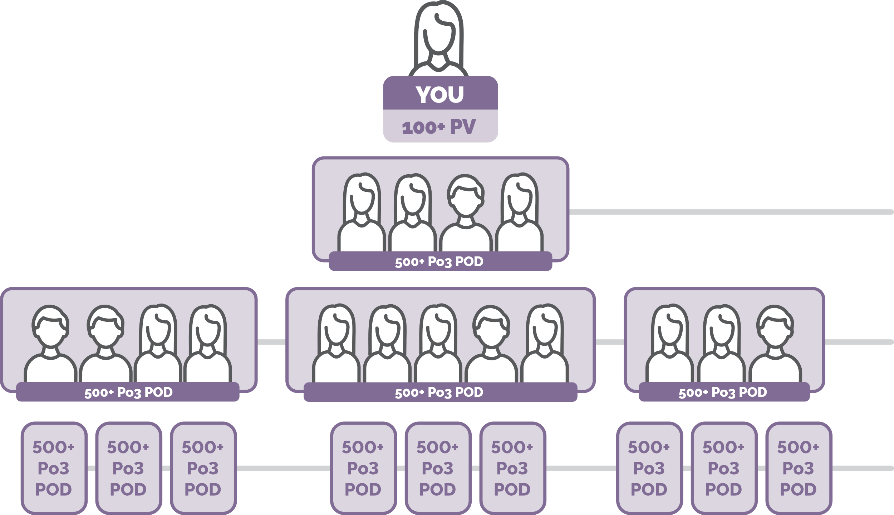
Paid to Sponsor
Paid Monthly
Earn $50, $250, or $1250
LEVEL 1 | $50
Order 100+ Personal Rewards Volume*
Create 500+ in Rewards Volume on your frontline
Must be volume ordered after their first month of enrollment, and at least 100 of the 500+ volume must be personally enrolled.
LEVEL 2 | $250
Earn your $50 AND
Help 3 people on your frontline earn their $50 Bonus
LEVEL 3 | $1,250
Earn your $50 AND
Help 3 people on your frontline earn their $250 Bonus
Results vary based on time, effort, and skill. Expenses may be incurred. For more information see the dōTERRA Opportunity and Earnings Disclosure Summary at doterra.com/disclosure.
Notes:
Let’s take a look at this visually. Here you can see that first requirement – placing your own personal Rewards order of 100+ PV. And here you can see the second requirement, creating 500 or more in Rewards volume from any number of people on your frontline. (Now, “frontline” simply means those who are on that first level right underneath you.) When you have an accumulation of at least 500 in Rewards volume on your frontline, we call this a “Pod”.
Keep in mind that at least 100 of this 500 Rewards volume needs to be from personally enrolled members, or in other words, people you personally introduce and sign up to doTERRA.
And that’s it! Once you meet these requirements, you can earn a $50 bonus. But that’s just the start. From here, you can help three people on your frontline create their Pod and now you can upgrade to the $250 bonus. That’s the power of duplication—educating your frontline to do what you’re doing and supporting them along the way.
Now let’s show you how you can earn an additional $1,000 a month. Keep the structure you have in place, and, take it down one more level, helping three people under each of them create their Pods as well. It’s all about duplication and helping your team share doTERRA products that they love and that have made a difference in their lives.

Slide 9
Power of 3
The Power of 3 Boost is designed to reward you for growing your team by doubling your $50 or $250 Bonus.
BOOST
POWER OF 3 BONUS + BOOST EARNING POTENTIAL
POWER OF 3 BONUS
400+
PGV
800+
PGV
1,200+
PGV
Earn Up To
Level 1 ($50)
$50
$100
Level 2 ($250)
$50
$250
$500
Level 3 ($1,250)
$50
$250
$500
$1,750
Results vary based on time, effort, and skill. Expenses may be incurred. For more information see the dōTERRA Opportunity and Earnings Disclosure Summary at doterra.com/disclosure.
Notes:
Alright, if you thought that was amazing, wait until you hear about the Power of 3 Boost. The Boost doubles your $50 or $250 Power of 3 Bonus! And this chart here shows us how. This middle section highlights a growth metric called Personal Growth Volume, or PGV for short. Let’s chat about this.

Slide 10
PERSONAL
GROWTH
VOLUME
The total amount of Rewards volume
in the current month from personally enrolled members who enrolled in the previous 12 months.
(PGV)
Notes:
Personal Growth Volume is a growth metric that can show you how your personal effort is growing. It is the total amount of Rewards volume in the current month from personally enrolled members who enrolled in the previous 12 months. Said differently, what we’re looking for is new volume coming in from Rewards orders from those you enrolled within the last year.

Slide 11


Jan ‘25
Feb ‘25
Mar ‘25
Apr ‘25
May ‘25
Jun ‘25
Jul ‘25
Jenna
Enrollment Date:
Jan 23, 2025
125 PV
125 PV
125 PV
200 PV
150 PV
150 PV
PERSONAL
GROWTH
VOLUME
Emily
Enrollment Date:
Feb 12, 2025
100 PV
125 PV
150 PV
125 PV
125 PV
Scott
Enrollment Date:
Mar 6, 2025
125 PV
125 PV
125 PV
125 PV
(PGV)
Eve
Enrollment Date:
Mar 21, 2025
100 PV
125 PV
100 PV
100 PV
Total Personal
Growth Volume
125
250
475
600
500
500
Notes:
This chart shows an example of how PGV is calculated using Rewards volume from the last 12 months. You’ll look at your personal enrollments and any volume from their doTERRA Rewards orders, and add up the total amount of volume for that month.
Use this text if there are additional questions: In this example, we have Jenna, Emily, Scott, and Eve. Let’s say Jenna enrolled in January. Her Rewards volume starts being calculated in February of 2025. Emily enrolled in February, and her Rewards volume starts being calculated in March of 2025. Scott and Eve both enrolled in March and their Rewards volume starts in April. What you’ll do is add up the total Rewards volume from those monthly orders, and you can see those total numbers here in the last row.
Your PGV will grow as you continue to introduce people to doTERRA products, help them see the power of essential oils in their lives, and find those products that become monthly staples in their home.

Slide 12
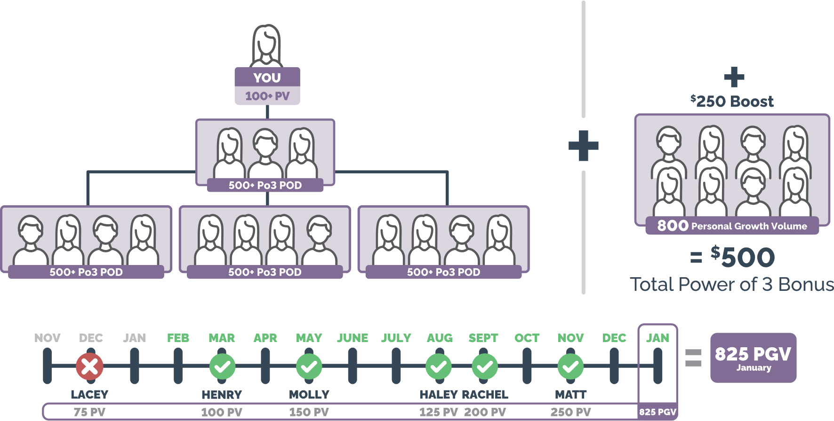
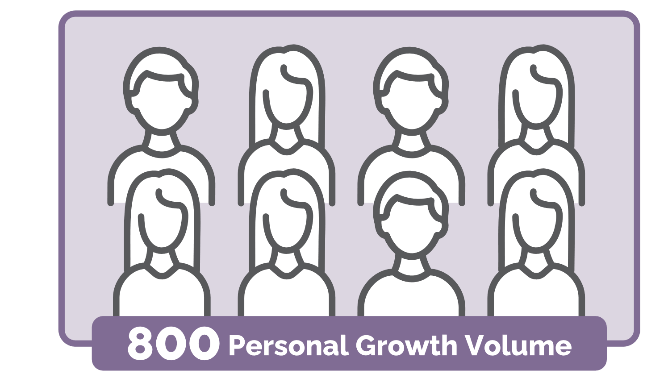
Power of 3
Earn $500 by qualifying for your Power of 3 $250 Bonus and your $250 Boost!
BOOST
$250 Bonus
$250 Boost
= $500
Total Power of 3 Earnings
Results vary based on time, effort, and skill. Expenses may be incurred. For more information see the dōTERRA Opportunity and Earnings Disclosure Summary at doterra.com/disclosure.
Notes:
If we look at this example, you can earn $500 by qualifying for the $250 Power of 3 Bonus and reaching a Personal Growth Volume of just 800 to achieve the $250 Power of 3 Boost. How incredible is that! How would an extra $500 make a difference for you?

Slide 13

Unilevel
Unilevel provides a way for Wellness Advocates to earn commissions based on ongoing product sales within their organization.
By offering product education, encouraging customer loyalty, and providing business support, you can strengthen your team and increase customer retention, leading to higher Unilevel earnings.
See full details of Unilevel Commission in doTERRA Policy Manual, https://www.doterra.com/US/en/policy-manual
Notes:
Alright, Unilevel. This commission is based on ongoing product sales and can be earned after a new member’s first 60 days. So, your customers who order consistently and love their tried and true doTERRA products will help support your Unilevel commissions on a monthly basis. As people under you order throughout the year, you earn a percentage on every order placed.

Slide 14
Unilevel
Paid to Sponsor
Paid Monthly
Earn 3–7% on CV
500
1,500
2,500
3,500
5,000
Results vary based on time, effort, and skill. Expenses may be incurred. For more information see the dōTERRA Opportunity and Earnings Disclosure Summary at doterra.com/disclosure.
Notes:
The more your team grows, the more Unilevel you can make. This is all about customer and business retention. We want to reward you for establishing and maintaining customers who love doTERRA.
To maximize your payout on Unilevel, the doTERRA compensation plan lets you earn the highest percentage on the lower levels, where the majority of your volume is. We want to support you to create a team and customer base that orders regularly and provides you with a stable and lasting income.

Slide 15
UNILEVEL
Example
Here’s how to qualify as an Executive member:
Personal Monthly Volume
Organizational Volume
3% Unilevel commission
on orders from your second level
100
2,000
5% Unilevel commission
(typically comes from your monthly Rewards order but can also be fulfilled by one-off orders)
(from sales within your organization)
on your third and fourth levels
Remember, this commission is about more than just those you bring in; it’s also about those your team brings in on your second, third, and fourth levels too!
Notes:
Let’s take a look at how this translates into rank qualifications. To qualify for the rank of Executive, you’d need a personal monthly volume of 100 (You’re probably recognizing this qualification is the same for a lot of these commission. The great thing is, the same order can keep you qualified for each of these bonuses and commissions). You’d also need an organizational volume of 2,000 from sales within your organization. If you meet these requirements, you’d qualify as an Executive and would be eligible to earn three levels of Unilevel commission. As you reach higher ranks in doTERRA, your opportunities for income continue to grow, based on team size and customer volume. Remember, Unilevel is about more than just those you bring in; it’s also about those your team brings in.

Slide 16

Pools
Results vary based on time, effort, and skill. Expenses may be incurred. For more information see the dōTERRA Opportunity and Earnings Disclosure Summary at doterra.com/disclosure.
Pools recognize and incentivize top-performing leaders. These Pools provide additional bonuses to Wellness Advocates who achieve specific rank and enrollment requirements during a given month.
Be rewarded with a percentage of global sales, regardless of where you’re building your dōTERRA business.
See full details of Pools in doTERRA Policy Manual, https://www.doterra.com/US/en/policy-manual
Notes:
Let’s talk about Pools. Pools are set up as an additional reward to incentivize top-performing leaders. As you continue to grow and reach new ranks, you can earn from these pools.

Slide 17
Pools
Paid monthly to reward leadership: 8% of company volume divided among leadership ranks.
1.50%
2%
1.50%
1%
1%
1%
Premier,
Silver, and
Gold
Silver, Gold,
and
Platinum
Platinum+
ranks
Diamonds
Presidential
Diamonds
Blue
Diamonds
Notes:
Pools are paid monthly, and doTERRA takes 8% of their global company volume and divides it among six different pools. Every rank, Premier and above, benefits from worldwide doTERRA company volume, or sales.

Slide 18
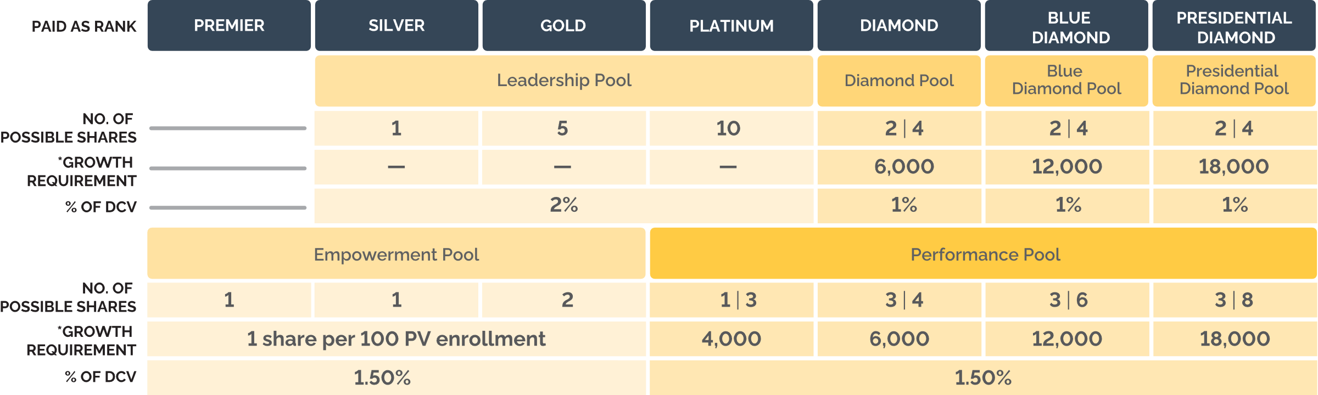
Paid to Ranks
Paid Monthly
Earnings vary based on dōTERRA
Company Volume (DCV)
Pools
Notes:
To go a little further into detail, here are the various pools a leader can earn shares in. You’ll notice that certain ranks can sometimes earn from multiple pools. Let’s go into a few of these.

Slide 19
Paid to Ranks
Paid Monthly
Earnings vary based on dōTERRA
Company Volume (DCV)
EMPOWERMENT
Pool
PAID AS RANK
PREMIER
SILVER
GOLD
Empowerment Pool
NO. OF
POSSIBLE SHARES
1
1
2
*GROWTH
REQUIREMENT
1 share per 100 PV enrollment
% OF DCV
1.50%
Notes:
Let’s start with the Empowerment Pool. Members who achieve the ranks of Premier or Silver earn one share from this pool when they achieve rank and enroll one member with 100 PV or more. Golds are eligible to earn up to two shares from this pool – one for each new member they enroll with 100 PV or more that month.

Slide 20

PREMIER
Example
YOU
PERSONALLY
ENROLLED MEMBER
1 Share
~$190
From Empowerment Pool
(1.50% DCV)
PREMIER
100+ PV
ENROLLMENT
ORDER
*shares vary month to month
Results vary based on time, effort, and skill. Expenses may be incurred. For more information see the dōTERRA Opportunity and Earnings Disclosure Summary at doterra.com/disclosure.
Notes:
Here's an example based on the rank of Premier. Each month you achieve the rank of Premier, and personally enroll one member with an enrollment order of 100+ PV, you are eligible to receive one share in the Empowerment Pool.

Slide 21
Paid to Ranks
Paid Monthly
Earnings vary based on dōTERRA
Company Volume (DCV)
LEADERSHIP
Pool
PAID AS RANK
SILVER
GOLD
PLATINUM
Leadership Pool
NO. OF
POSSIBLE SHARES
1
5
10
*GROWTH
REQUIREMENT
% OF DCV
2%
Notes:
Here we have the Leadership Pool. The Leadership Pool rewards the ranks of Silver through Platinum, just for qualifying for rank each month.

Slide 22
GOLD
Example
5 Shares
~$675
From Leadership Pool
(2% DCV)
YOU
2 NEW
MEMBERS
GOLD
100 PV
ENROLLMENT
ORDERS
2 Shares
~$380
From Empowerment
Pool (1.50% DCV)
*shares vary month to month
Remember: If you achieve the rank of Gold and one of your personally enrolled members achieves the rank of Elite for the first time, you will receive one extra share from the Leadership Pool.
Results vary based on time, effort, and skill. Expenses may be incurred. For more information see the dōTERRA Opportunity and Earnings Disclosure Summary at doterra.com/disclosure.
Notes:
For example, if you achieve the rank of Gold, you’ll receive 5 shares from the Leadership Pool. Additionally, if you enroll 2 members with enrollment orders of 100+ PV, you’ll also receive 2 shares from the Empowerment Pool. That’s a total of 7 shares!

Slide 23
Paid to Ranks
Paid Monthly
Earnings vary based on dōTERRA
Company Volume (DCV)
PERFORMANCE
Pool
PAID AS RANK
PLATINUM
DIAMOND
BLUE
DIAMOND
PRESIDENTIAL
DIAMOND
Performance Pool
NO. OF
POSSIBLE SHARES
1 | 3
3 | 4
3 | 6
3 | 8
*GROWTH
REQUIREMENT
4,000
6,000
12,000
18,000
% OF DCV
1.50%
Notes:
Alright, let’s take a look at the Performance Pool. This pool is specifically for the ranks of Platinum through Presidential Diamond.
When you achieve one of these ranks, you qualify to earn the number of shares shown here on the left. Now, if you meet the growth requirement shown for that rank, you are eligible to receive the higher number of shares shown here on the right. We’ll talk about this growth requirement in just a moment, so hang tight.

Slide 24
DIAMOND
Example
4 Shares
~$1,960
From Diamond Pool
(1% DCV)
YOU
TGV
Requirement
DIAMOND
6,000
4 Shares
~$1,360
From Performance
Pool (1.50% DCV)
*shares vary month to month
Remember: If you achieve the rank of Diamond and one of your personally enrolled members achieves the rank of Premier for the first time, you will receive one extra share from the Diamond Pool.
Results vary based on time, effort, and skill. Expenses may be incurred. For more information see the dōTERRA Opportunity and Earnings Disclosure Summary at doterra.com/disclosure.
Notes:
Here’s an example of a Diamond-ranked leader. If you achieve the rank of Diamond, and meet this growth metric requirement called TGV, you will receive 4 shares in the Diamond Pool and 4 shares from the Performance Pool. The best part about this is that you can qualify for shares in multiple pools as you continue to grow your team.

Slide 25
TEAM
GROWTH
VOLUME
The total amount of volume in the current month from team members who enrolled or reactivated in the previous 12 months, within a defined number of sponsor levels (determined by your rank).
(TGV)
Notes:
Alright, let me explain this growth metric. Team Growth Volume (also referred to as TGV) is defined as the total amount of volume in the current month from team members who enrolled or reactivated in the previous 12 months. Now, this volume is calculated within a defined number of sponsor levels, which is determined by your rank.

Slide 26



TEAM GROWTH VOLUME
(TGV)
All volume in the current month coming from team members who enrolled or reactivated in the previous 12 months.
Level 1
Volume
500
Anna
Enrollment Date:
Jan 2024
Jenna
Enrollment Date:
Oct 2024
Ellie
Enrollment Date:
Nov 2024
Scott
Enrollment Date:
Feb 2024
Level 2
Volume
1,000
Ben
Enrollment Date:
Mar 2024
Casey
Enrollment Date:
Apr 2024
Hayley
Enrollment Date:
Sep 2024
Natalie
Reactivated Date:
Oct 2024
Kate
Enrollment Date:
Jan 2025
1,500
Level 3
Volume
Drew
Enrollment Date:
Dec 2023
Alisa
Enrollment Date:
Aug 2024
Eve
Enrollment Date:
Sep 2024
Ella
Enrollment Date:
Feb 2024
Mike
Enrollment Date:
Mar 2024
Brianna
Reactivated Date:
Nov 2024
TOTAL
TGV
JAN 2025
3,000
*Up to 7 levels based on rank
Notes:
This example helps show how Team Growth Volume is calculated. We’re only showing volume on levels 1-3 here, but keep in mind that volume can be calculated up to 7 levels, depending on rank.
Use this text if there are additional questions: Those with red X’s on them don’t count towards TGV – let’s talk about why. Kate’s volume doesn’t count because she was enrolled in the same month we’re calculating volume for. And Drew’s volume doesn’t count because his enrollment date is more than 12 months ago. Remember, for TGV we are looking at volume in the current month from those who enrolled or reactivated in the previous 12 months.

Slide 27
Why TGV Matters
Remember, reaching Team Growth Volume targets helps you maximize your earnings in Unilevel and Pools.
RANK
SPONSOR
TREE LEVELS
TEAM GROWTH
VOLUME
UNLOCK WITH GROWTH METRIC
ELITE
3
300*
4th and 5th levels
PREMIER
4
400
5th and 6th levels
Unilevel
SILVER
5
500
6th and 7th levels
GOLD
6
600
6th and 7th levels
PLATINUM
7
4,000
Performance Pool
DIAMOND
7
6,000
Performance & Diamond Pools
Pools
BLUE DIAMOND
7
12,000
Performance & PD Pools
PRESIDENTIAL DIAMOND
7
18,000
Performance & PD Pools
Wellness Advocates’ Team Growth Volume (TGV) will be determined by their paid rank.
*For Elites, 100 of the 300 TGV must be personally enrolled.
Quick reference that highlights
  What PGV/TGV impacts
  Which ranks it matters for
Notes:
Why does TGV matter? It helps you maximize your earnings in both Unilevel and Pools. By meeting the Team Growth Volume requirement for Unilevel, you can ensure commission earnings on deeper levels, where you are able to earn a higher percentage of commission. And, when you meet Team Growth Volume requirements for the Pools, you can tap into additional shares.
As you’re naturally growing and continuing to bring people in, and helping your team to do the same, these growth metrics can naturally be met.

Slide 28


A Business that Fits Your Life
Notes:
There you have it, the doTERRA Compensation Plan. You can see from what we’ve talked about that there are multiple different ways to earn, depending on your lifestyle and how invested you choose to be. There is something for everyone, whether you want to start slow or you’re ready to dive right in.

Slide 29
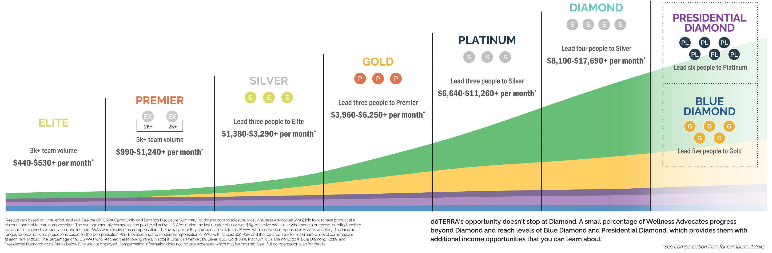
Discover the Possibilities
Notes:
I want to take a minute to highlight the incredible opportunity that lies ahead. This rank spread shows what’s possible when you choose to grow with doTERRA.
PROMPT: Opportunity to compliantly share your personal experience as a Wellness Advocate here.

Slide 30
SHARE. EARN. THRIVE.
SHARE. EARN. THRIVE.
Your path to $500 starts here!
Your path to $500 starts here!
YOU
Enrolled by you
100+ PV
Get four people started with the Foundational Wellness Bundle
Earn $100
Share with three more people and earn $500
500+ Po3 POD
500+ Po3 POD
Teach three
people to do
the same
Earn $300
500+ Po3 POD
500+ Po3 POD
500+ Po3 POD
Results vary based on time, effort, and skill. Expenses may be incurred. For more information see the dōTERRA Opportunity and Earnings Disclosure Summary at doterra.com/disclosure.
Notes:
If you’re not sure how much time, effort, and energy you want to put in, doTERRA has an amazing opportunity to earn $500 with products that help you personally live a healthy lifestyle and at the same time encouraging others to do the same.
You start by subscribing to the Foundational Wellness Bundle. Then, help four other people you care about subscribe too – this will give you $100. Now, when you help three of those four people do the same thing and keep enrolling, you earn $500!

Slide 31
This Opportunity Fits Your Lifestyle—
not the other way around!
Notes:
If you’re worried you don’t have enough sales experience, it’s okay! Just share what you love and interest will spread. You get a paycheck when the conversations you’re already having turn into new customers.
PROMPT: Opportunity to share a personal experience or testimonial about the doTERRA business.
Are you ready to get out there and share what you love? Can you see how earning with doTERRA can fit into your lifestyle? Whether you’re looking to pay for dance classes, cover a car payment, or even a house payment, doTERRA has a place for you. If you have questions about anything we’ve talked about today, let’s chat! I’m here to help you work towards the life you want.

Slide 32
ADDITIONAL
SLIDES

Slide 33


Paid to Enroller
Paid Weekly
Earn 25%
Retail Profit
Retail Profit is the simplest of the commission types. You simply need to have an active Wellness Advocate account to earn it.

Slide 34
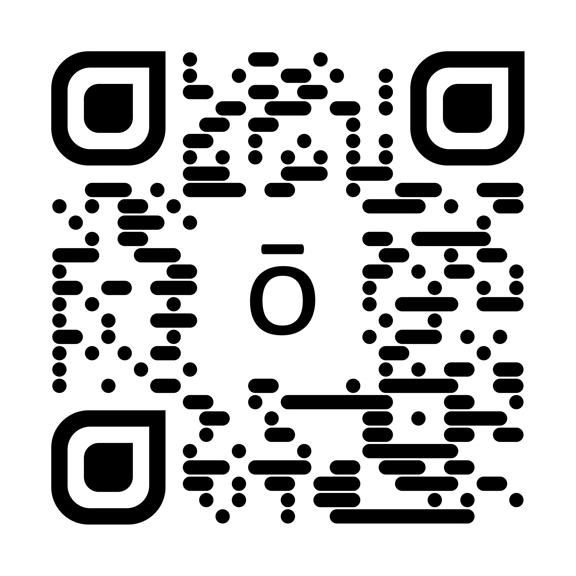
Earn $500 with Power of 3 Bonus and Boost
By helping just 4 people get started with the Foundational Wellness Bundle on dōTERRA Rewards, you’ll earn $100.
Teach 3 people to do the same,
and help 3 more people get
started, to earn $500 each month—without pressure, complicated sales tactics, or rigid schedules.
Path to $500

Slide 35



By participating, you unlock additional earning potential through commissions and bonuses like Fast Start, Power of 3, and Unilevel. Consistently placing a monthly Rewards order of at least 100 PV helps you meet volume and growth requirements, improve customer retention, and set yourself up for long-term success.
Helping your customers become loyal product users is one of the best things you can do for your business

