Slide 1
Using Reward Points on Your Loyalty Order (LRP)
Learn how to process a Loyalty Order (LRP) using your Reward Points.

Slide 2
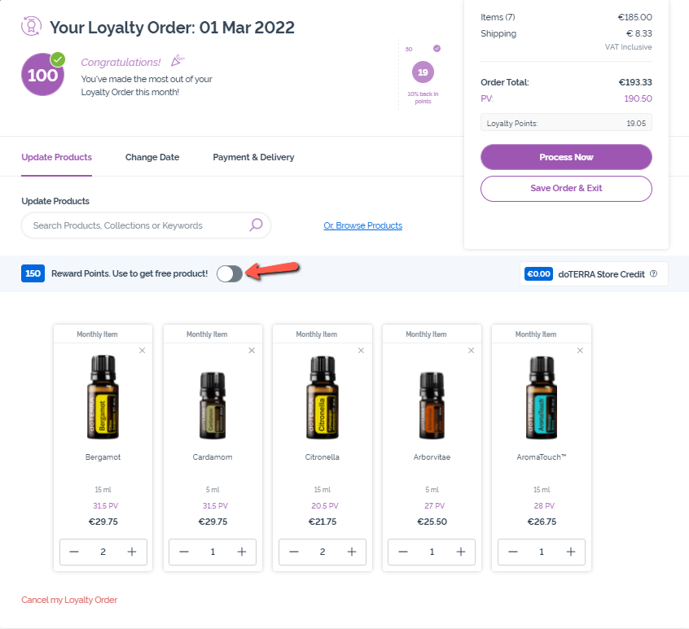
Using Reward Points – Enabling Point Usage
To use Reward Points on your order, click on the toggle.

Slide 3
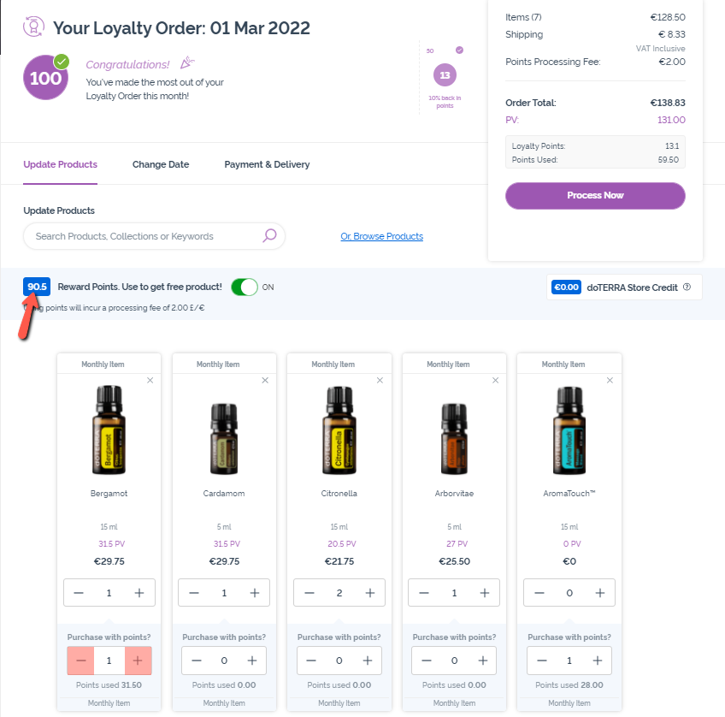
Using Reward Points – Apply Reward Points to Products
Choose which products you would like to use Reward Points on by using the “-/+” icons under “Purchase with points?”.
As you apply Reward Points, the total number of Reward Points available will adjust in the blue box next to the toggle.

Slide 4
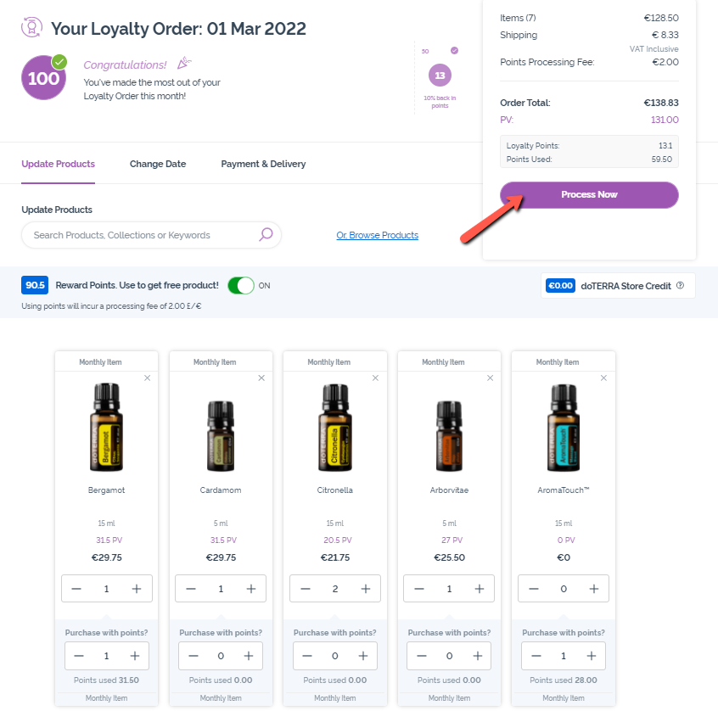
Using Reward Points – Process Now
Make sure to select “Process Now”. Orders using Reward Points cannot be saved and processed at a later date.
Note: All orders using Reward Points have a €/£ 2 (VAT exclusive) processing fee.

