Slide 1
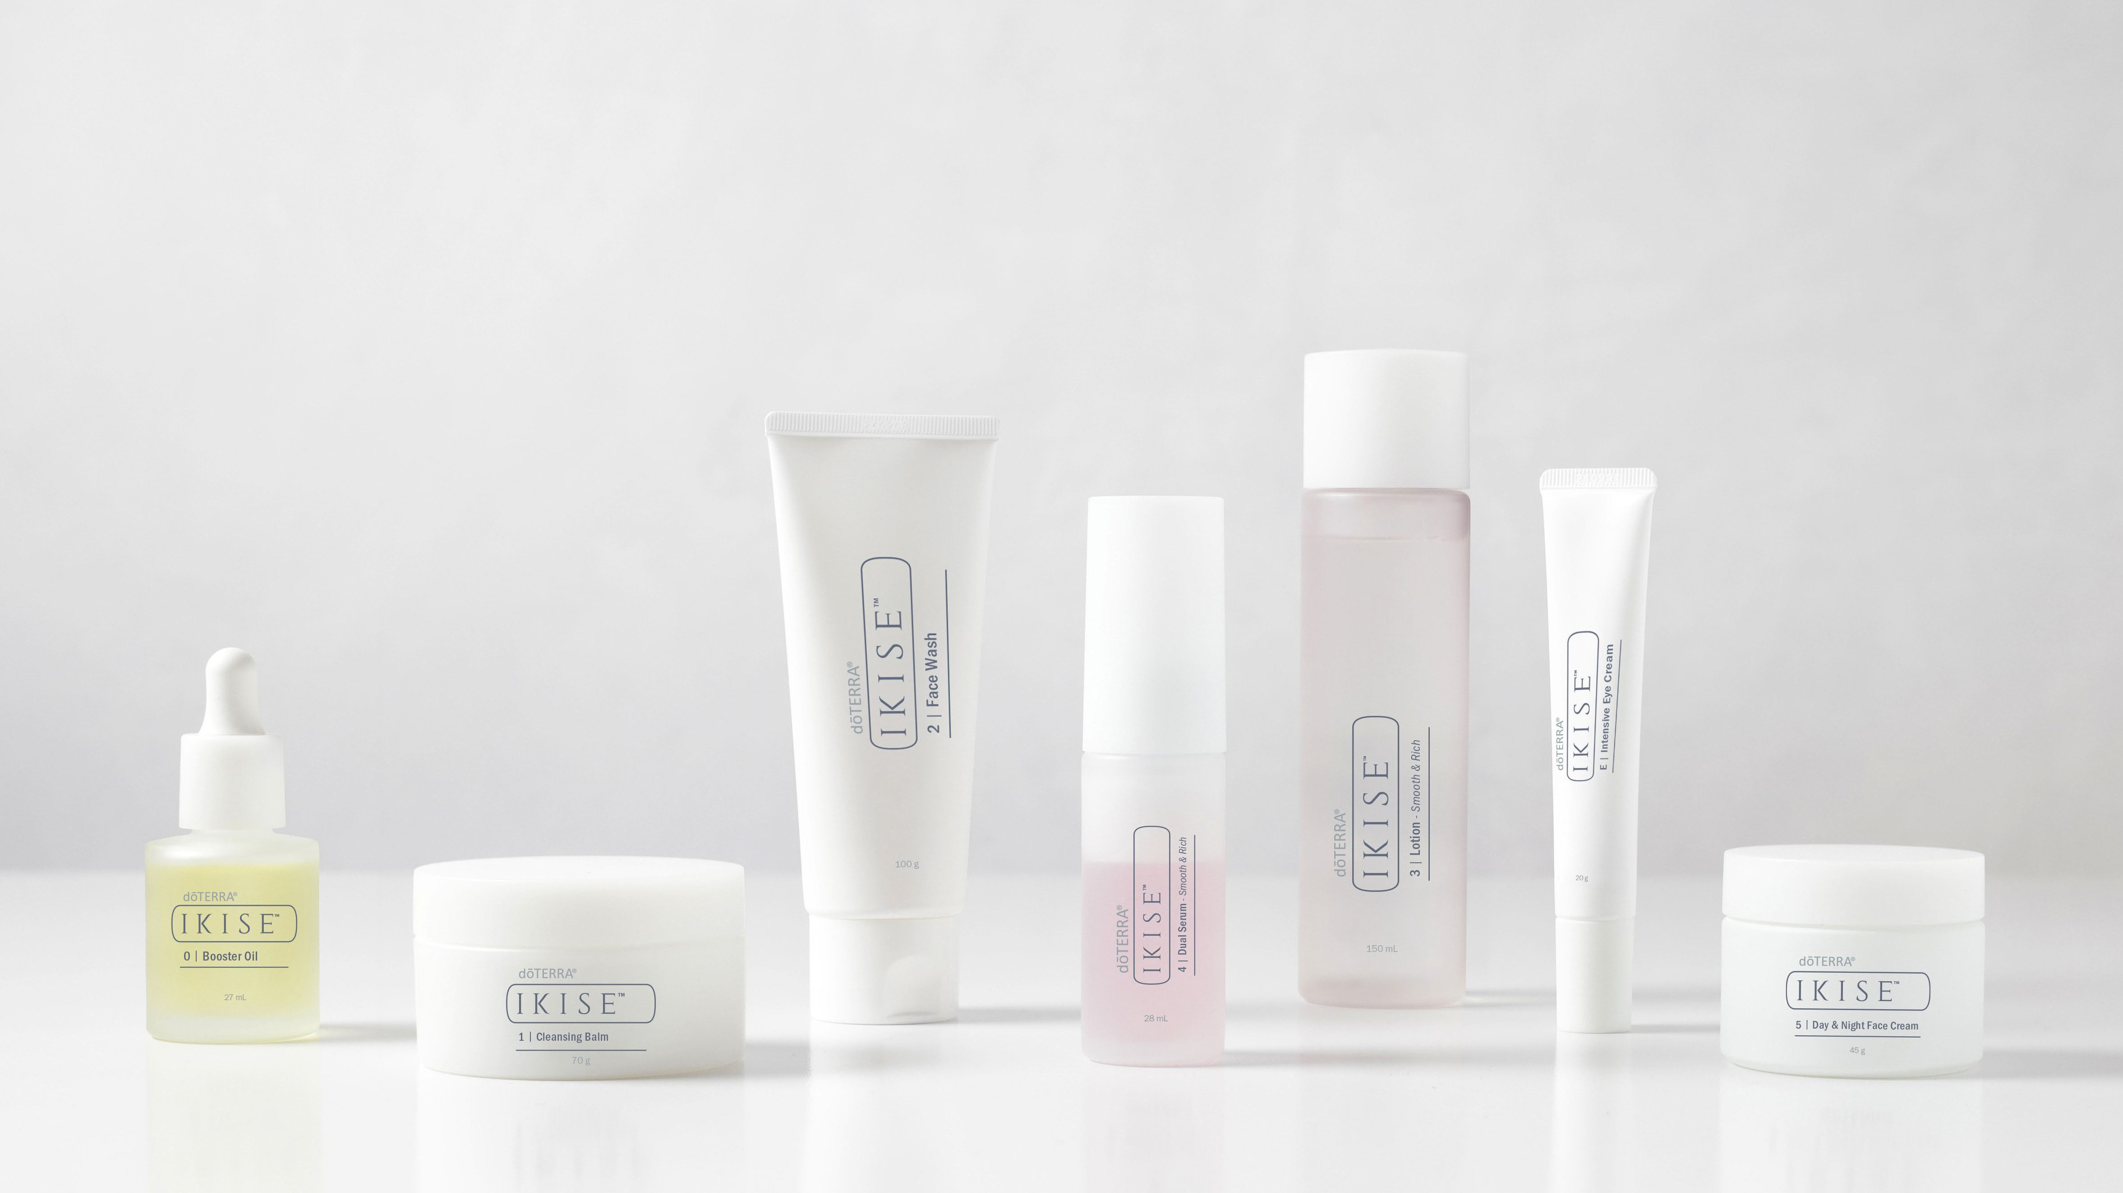
Where tradition meets innovation with dōTERRA® CPTG® essential oils.

Slide 2
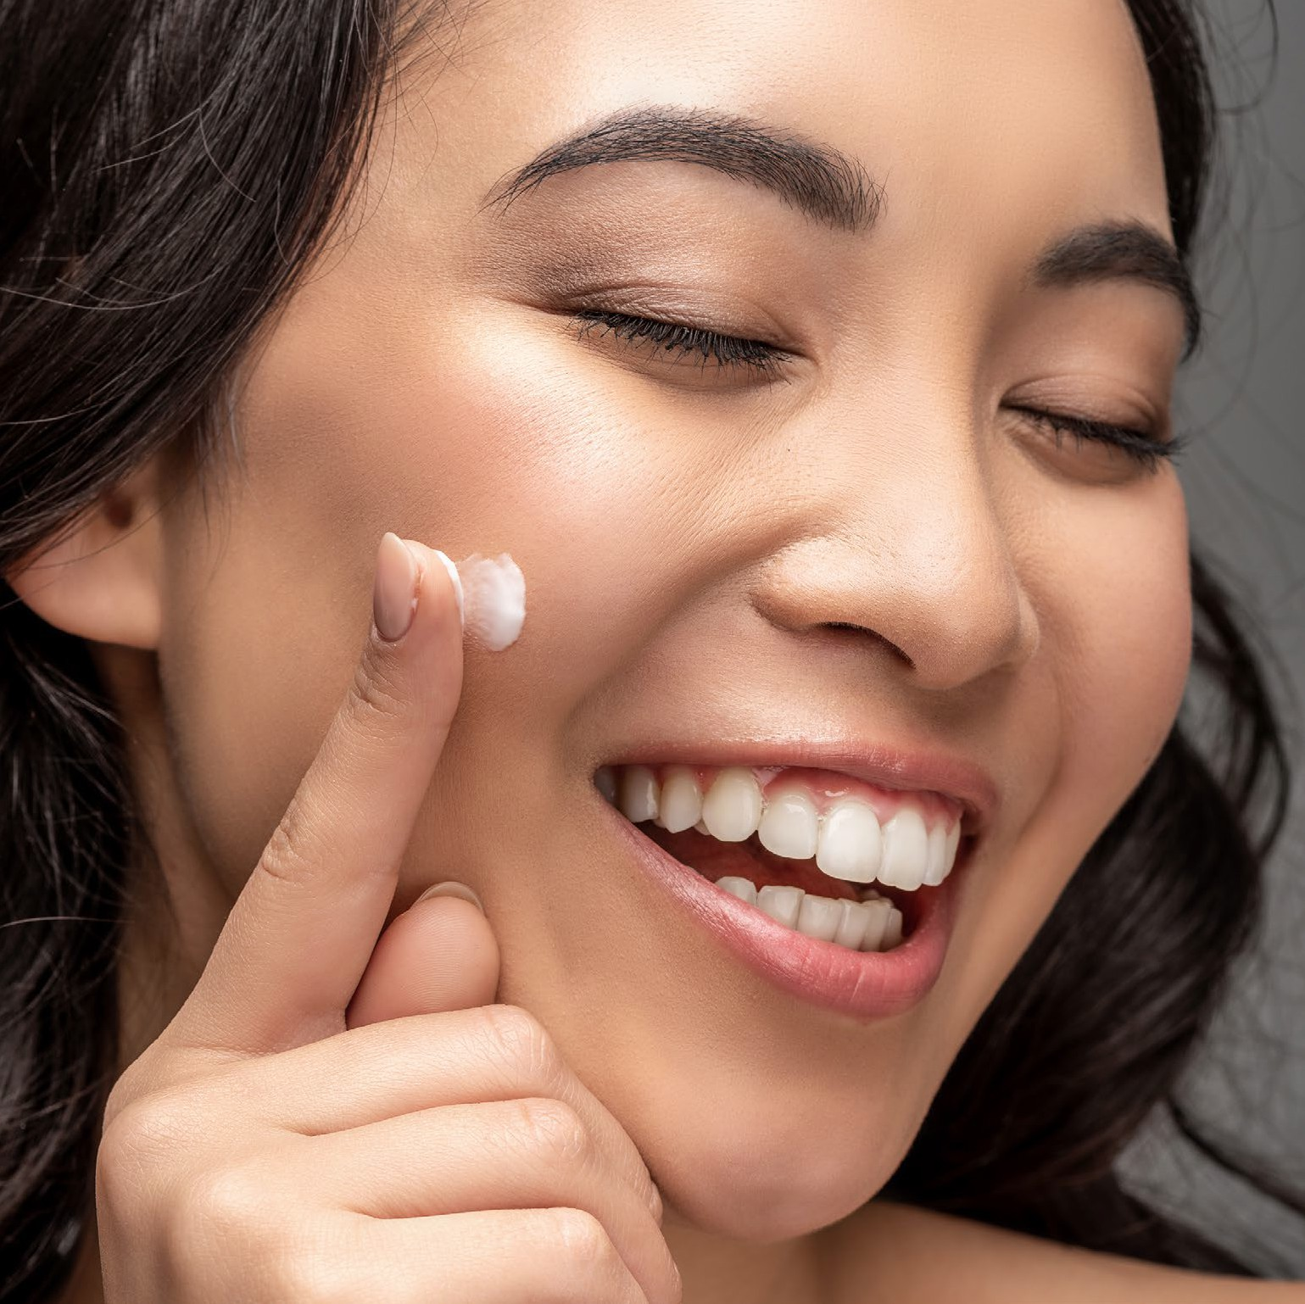



Love Your Skin from the Outside In
In Japanese culture, the skin is regarded not merely as a protective barrier, but as a vital organ that reflects overall health and well-being.
It is carefully nourished with great emphasis placed on gentle skincare rituals, and the use of natural yet powerful ingredients.
IKISE™ is a word born from Japanese influence, meaning ‘from pure essential oils.’
Notes:
Are you ready to have the best skin of your life? Raise of hands—who wants low tox, powerful skincare that supports you ageing in the right way for you?

Slide 3
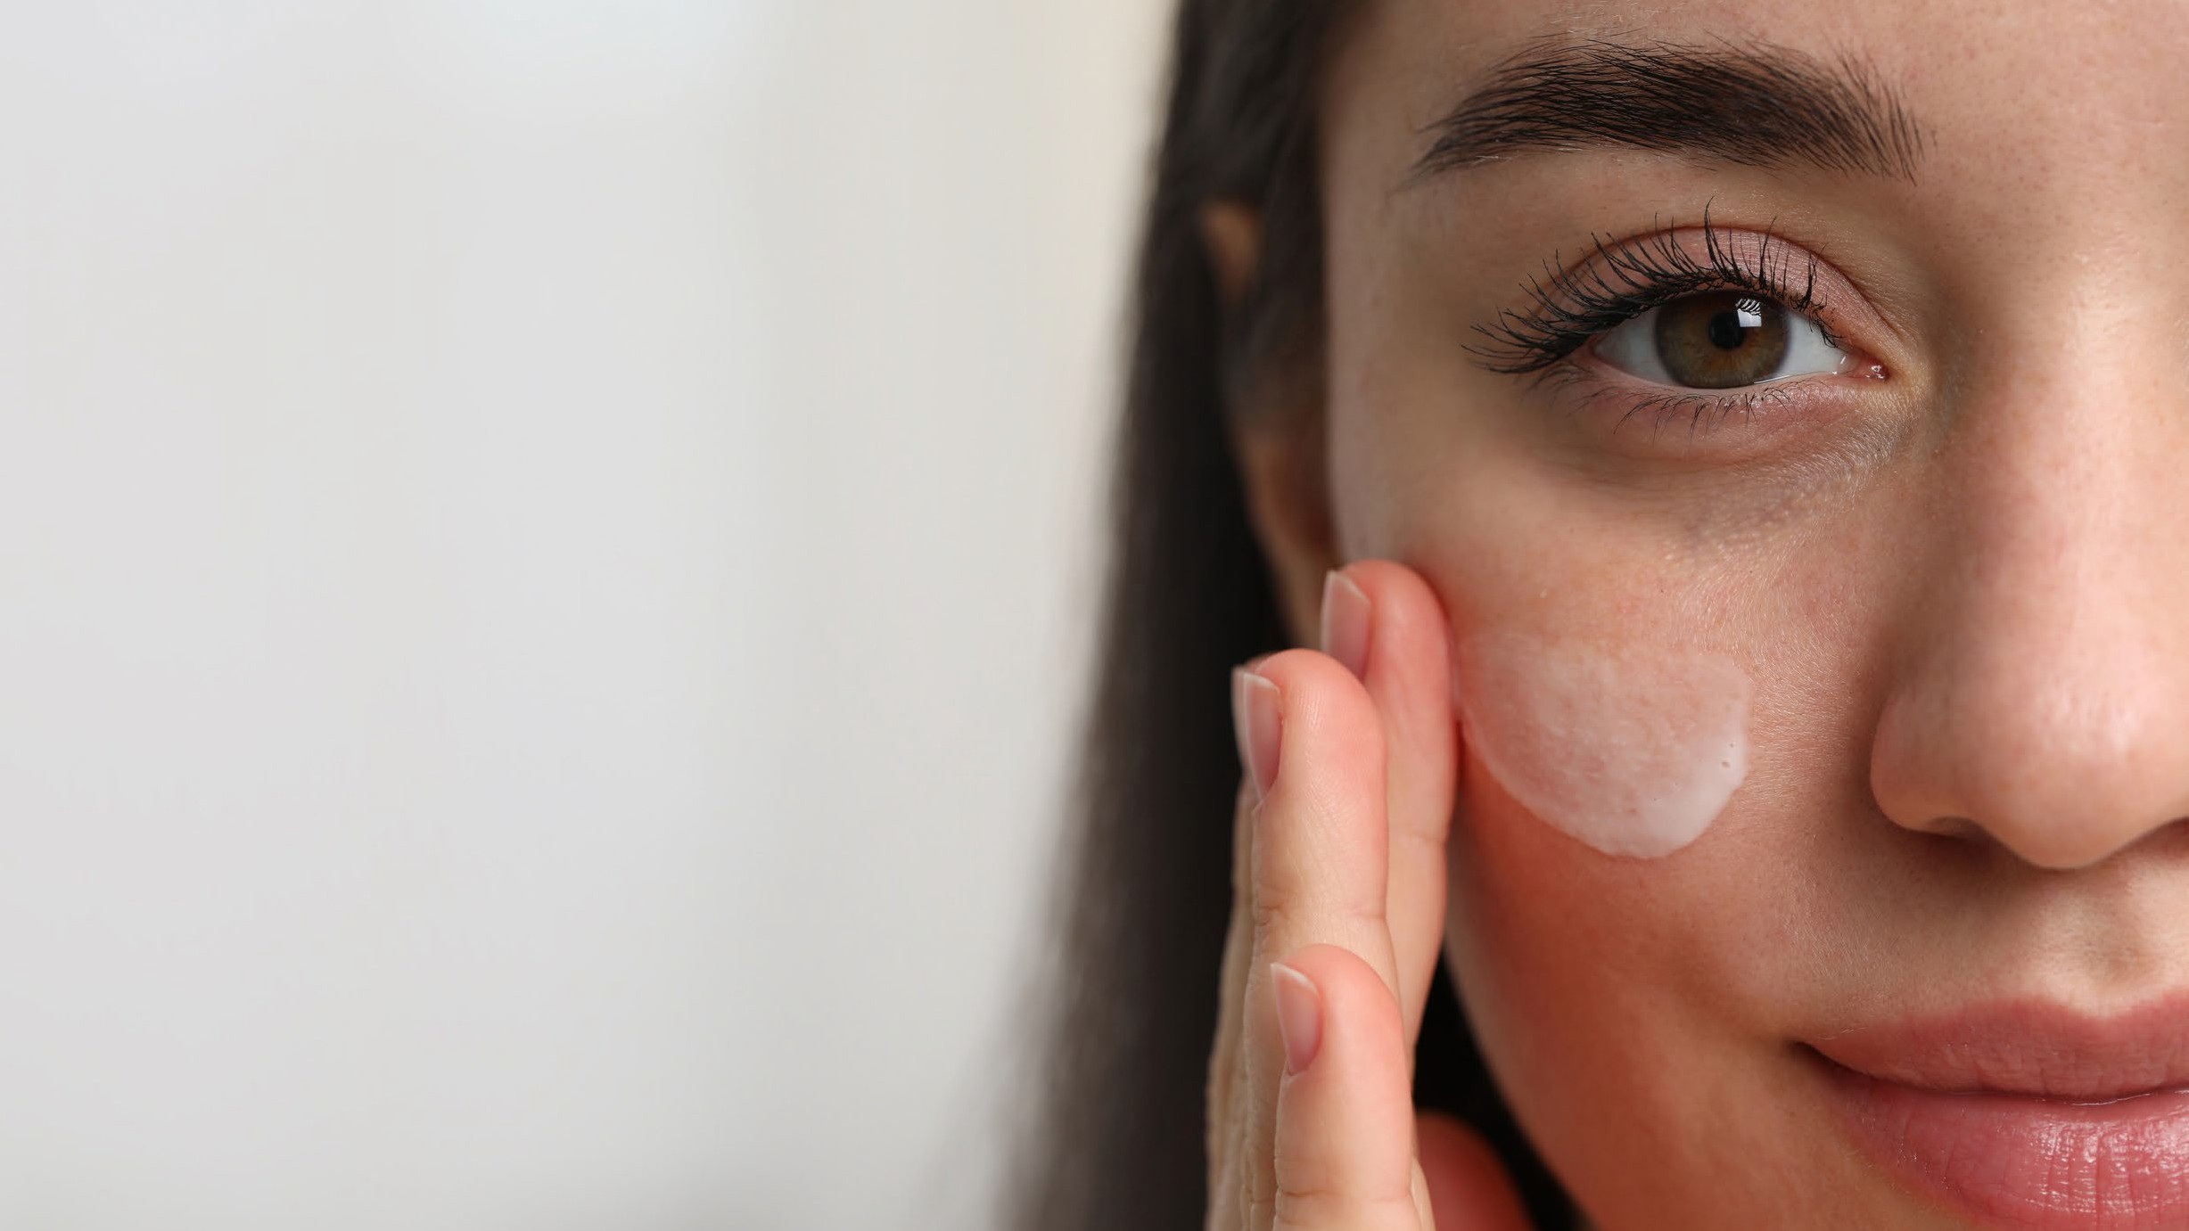
Goals for Today
Discover how to naturally support glowing, resilient skin
Understand why what we put on our skin truly matters
Learn about toxic load and how it affects overall wellness
Create your own personalised, effective skin ritual
Notes:
GOALS FOR TODAY
• Discover how to naturally support glowing, resilient skin
• Understand why what we put on our skin truly matters
• Learn about toxic load and how it affects overall wellness
• Create your own personalised, effective skin ritual

Slide 4
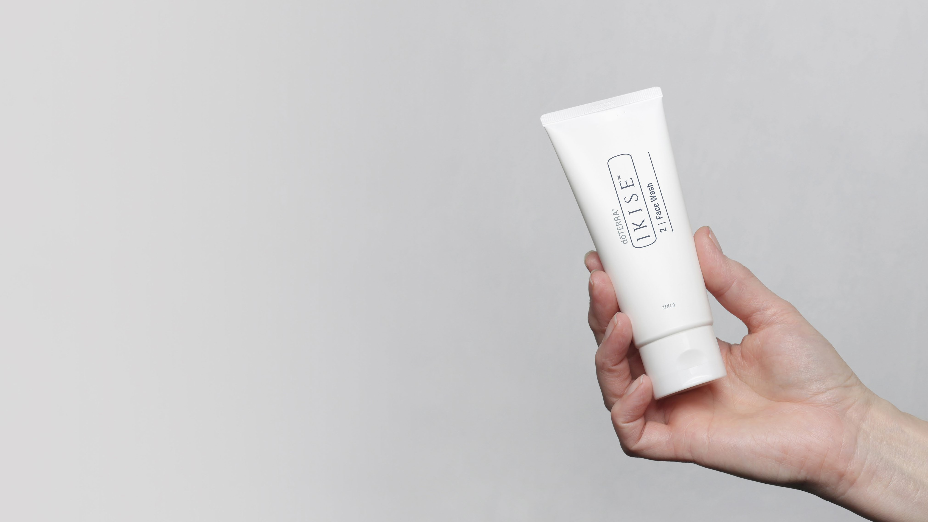
What is IKISE?
Welcome to the new era of skincare, where high-performance results meet holistic wellness.
IKISE™ is a skincare collection inspired by Japan’s timeless beauty rituals, formulated with cutting-edge natural ingredients like humic shale and CPTG® essential oils.
This is skincare designed to nourish your skin’s natural vitality. Not to fight age, but to support you in ageing better.
Notes:
WHAT IS IKISE™?
Welcome to the new era of skincare—where high-performance results meet holistic wellness.
IKISE™ is a skincare collection inspired by Japan's timeless beauty rituals, formulated with cutting-edge natural ingredients like humic shale and CPTG® essential oils.
This is skincare designed to nourish your skin’s natural vitality. Not to fight age, but to support you in ageing better.

Slide 5

What makes IKISE™different?
Notes:
IKISE™ is created for those who want the best of both worlds—science and nature. It’s high-performance skincare that’s also low-tox and consciously crafted.
With IKISE™, you no longer have to choose between purity and results.
But why does low-tox skincare matter? And what role do toxins actually play when it comes to our skin and overall wellness?
Let’s take a closer look…

Slide 6
Toxin
Toxic Load
Sum of toxic substances accumulated within your body, and the burden they place on organs at any given time.
Any substance that places undue stress on the body.
Notes:
WHAT IS A TOXIN?
A “toxin” is any substance that places undue stress on the body.
WHAT IS TOXIC LOAD?
Everyday exposures—like stress, pollution, synthetic ingredients, and poor diet—can accumulate in the body over time. This buildup is referred to as “toxic load.”

Slide 7
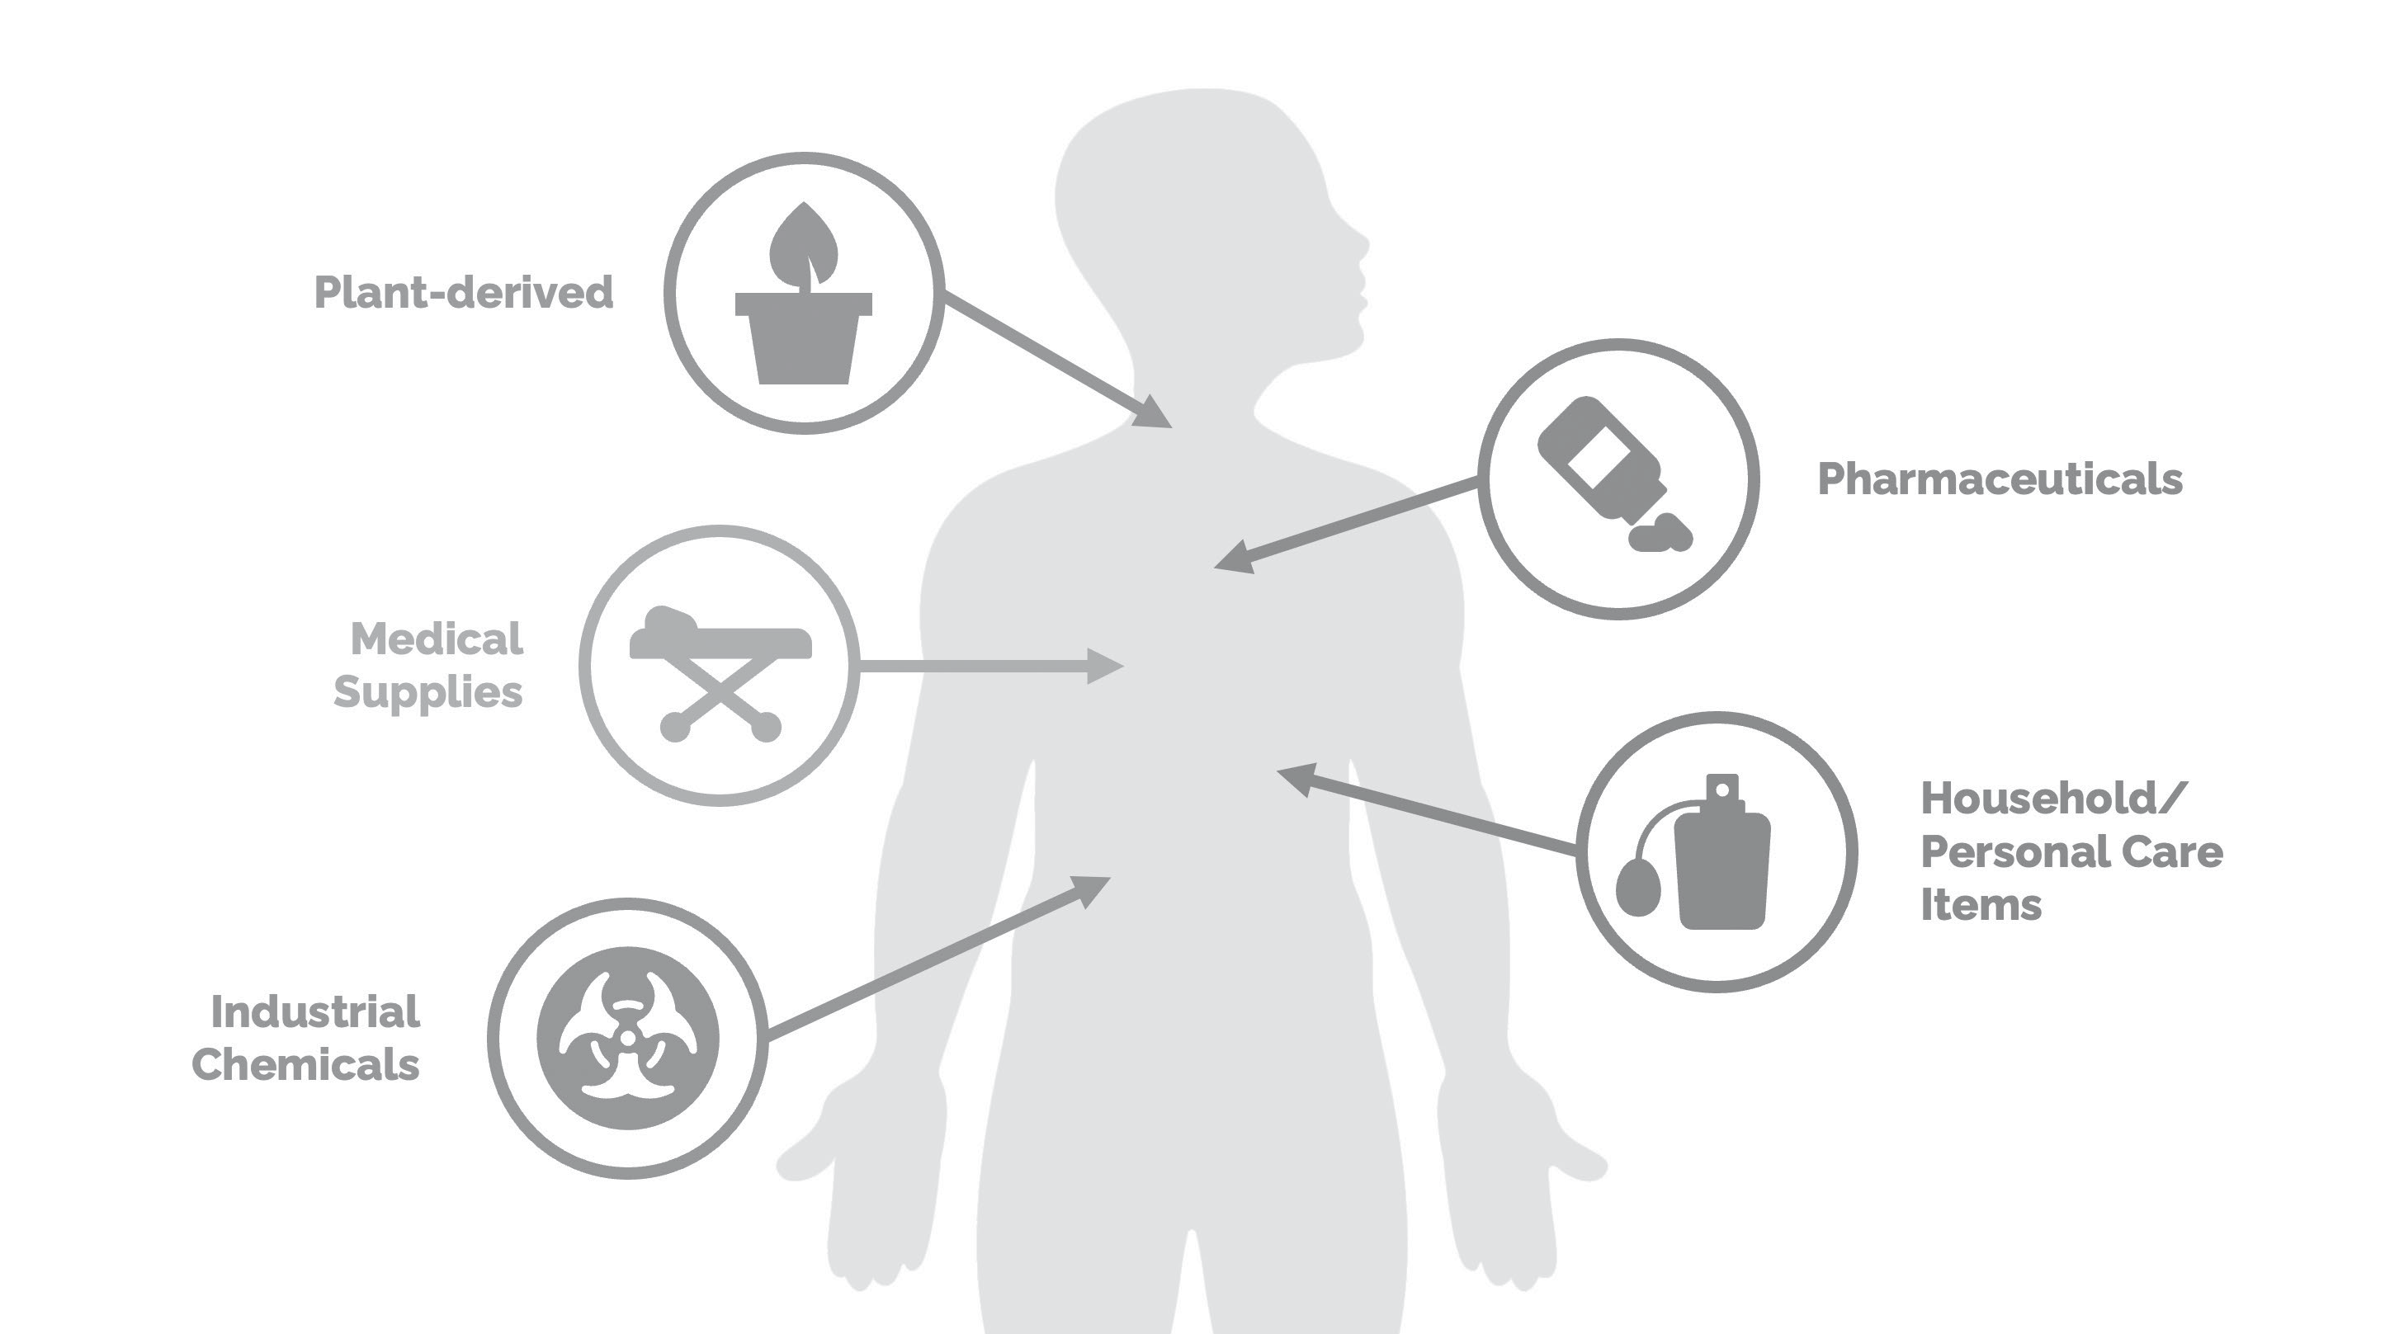
Notes:
WHAT PRODUCTS CONTRIBUE TO TOXIC LOAD?
There are more than 1,000 identified Endocrine Disrupting Chemicals (EDCs)—and they typically fall into five main categories:
• Plant-derived compounds
• Medical supplies and equipment
• Industrial chemicals
• Pharmaceutical products
• Household, personal care, and consumable items — WE WILL FOCUS ON PERSONAL CARE PRODUCTS TODAY

Slide 8

Daily Exposures
Women use an average of 12 personal care products that contain more than 160 chemicals.
Men use an average of
6 personal care products that have more than 85 chemicals.
Notes:
Did you know…
On average, women use 12 personal care products daily, exposing themselves to over 160 unique chemicals.
Men aren’t exempt—the average man uses 6 products, containing more than 85 chemicals.
Meanwhile, over 40 countries have banned 1,400 harmful chemicals in cosmetics and personal care.
So where does that leave us?
It means many of us are unknowingly exposed to endocrine-disrupting chemicals every single day—just by following our normal routines.
And most people have no idea… or don’t know where to begin making changes.

Slide 9

60% of what you
put on your skin is absorbed into your blood stream.
Notes:
Research shows that up to 60% of what we apply to our skin can be absorbed directly into our bloodstream. That means every product we use matters.
From skincare and oral care to hair care, we’re exposing ourselves—and our families—to dozens of chemicals daily. Over time, this can contribute to allergies, hormonal imbalances, reproductive challenges, and even more serious health concerns.
But here’s the good news: you have a choice.
That’s where IKISE™ comes in—a skincare range designed to nurture, not burden, your body. It's low-tox, high-performance, and powered by the best of nature and science.

Slide 10
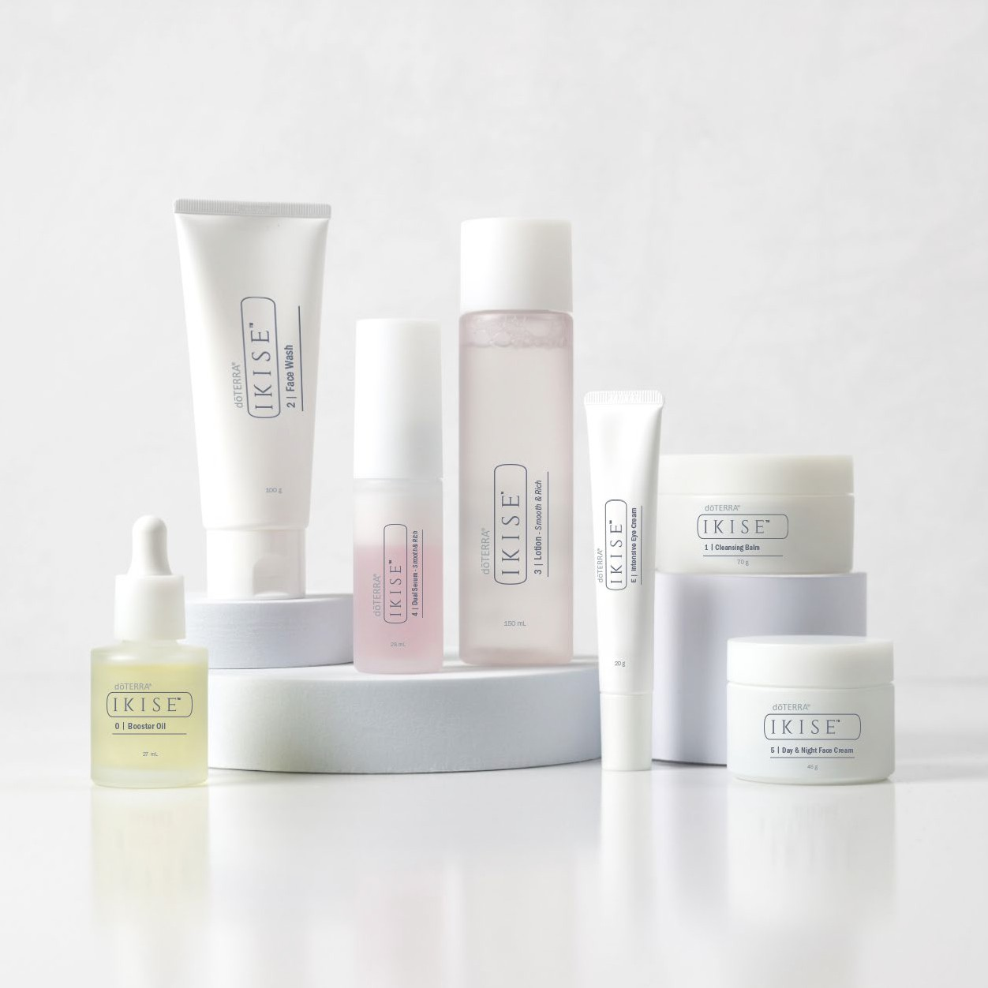
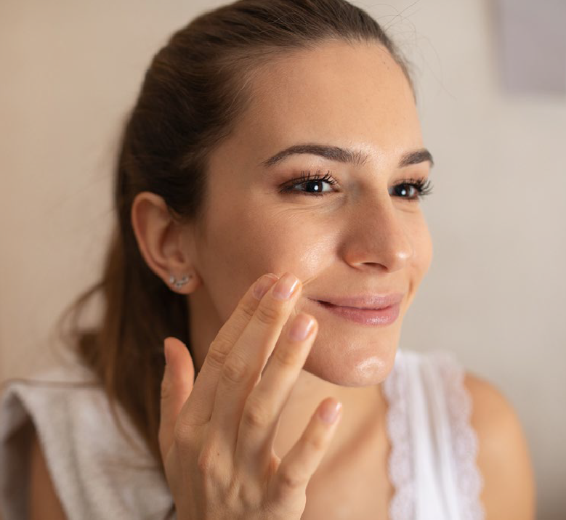
Welcome to the new era of skincare, where high-performance results meet holistic wellness.
dōTERRA IKISE™ is a skincare collection inspired by Japan’s timeless beauty rituals, formulated with cutting-edge, natural ingredients and a unique combination of Humic Shale Minerals and CPTG® essential oils for optimal absorption. This is skincare designed to nourish your skin’s natural vitality.
Not to fight age, but to support you in ageing better.
dōTERRA IKISE™ is crafted for individuals who value both science and nature, who want low-tox powerful skincare that performs.
With dōTERRA IKISE™, you no longer have to choose between purity and results.
​What Makes dōTERRA
IKISE Different?​
Rooted in Japanese skincare
layering principles.​
Powered by CPTG essential
oils and proven actives.​
Targets hydration, firmness,
brightness and texture.​
Free from toxins, synthetic fragrances and fillers.​
Notes:
WHAT IS IKISE™?
• IKISE™ represents a new standard in skincare - where performance meets purity.
• Inspired by Japanese beauty rituals, this range supports your skin’s natural vitality. It’s not about fighting age, but ageing better.
• Powered by CPTG® essential oils and proven natural actives, IKISE™ delivers visible results - hydration, brightness, firmness, without toxins or synthetic fillers.
WHAT MAKES IT DIFFERENT?
• Rooted in Japanese skincare principles.
• Clean, conscious, and effective.
• You no longer have to choose between wellness and results.

Slide 11
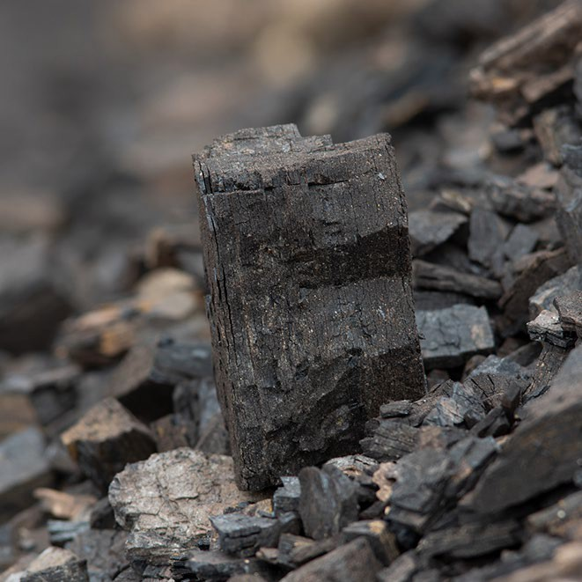






What is Humic Shale and Why It Matters in Skincare
Humic Shale is a natural, mineral-rich substance derived from ancient organic matter (plant material) that’s been compressed over millions of years in the earth. It’s typically found in clay or shale deposits and is used in wellness and skincare for its absorption, detoxifying and remineralising properties.
Key Skin Benefits of Humic Shale:
Mineral-Rich Nourishment: Contains trace minerals like magnesium, calcium, and iron that help restore depleted skin.
Detoxification: Binds to impurities and toxins, supporting a clearer, more refreshed-looking complexion.
Supports Cell Renewal: May enhance skin turnover and improve clarity through its unique nutrient profile.
Balances the Skin: Can help calm inflammation and improve texture.
Notes:
One of IKISE™’s standout hero ingredients is Humic Shale - a rare, mineral-rich compound derived from ancient plant matter that delivers powerful skin benefits.
• Mineral-Rich Nourishment: Packed with trace minerals like magnesium, calcium, and iron to help replenish and revitalise depleted skin.
• Detoxification: Binds to impurities and toxins, supporting a clearer, more refreshed-looking complexion.
• Supports Cell Renewal: Its unique nutrient profile may help boost skin turnover, revealing a fresher, more radiant complexion.
• Skin Balance: Known to calm visible inflammation, support a healthy skin microbiome, and improve overall texture and tone.

Slide 12

Understanding the Natural Origin Index:
What ISO 16128 Means for Your Skincare
When you see “ISO 16128 compliant” on an ingredient or product, it means it meets a global clean beauty standard for how natural a skincare ingredient truly is.
The Natural Origin Index is a scale from 0 to 1 that tells you how much of an ingredient comes from natural, renewable sources like plants
or minerals, with 1.0 meaning 100% naturally derived. Ingredients that are compliant are not only sourced responsibly but processed in ways that are kind to both your skin and the planet.
This matters because not all “natural” claims are created equal. ISO 16128 helps ensure transparency, traceability, and eco-conscious formulation.
Notes:
What is the Natural Origin Index?
• ISO 16128 is a global clean beauty standard that shows how natural an ingredient really is.
• It uses a scale from 0 to 1 - 1.0 means the ingredient is 100% naturally derived from sources like plants or minerals.
• It also ensures ingredients are processed in a way that’s safe for your skin and better for the planet.
• This standard helps cut through vague “natural” claims by providing clear, trusted guidelines.
• It’s about transparency, sustainability, and knowing what’s really in your skincare.

Slide 13
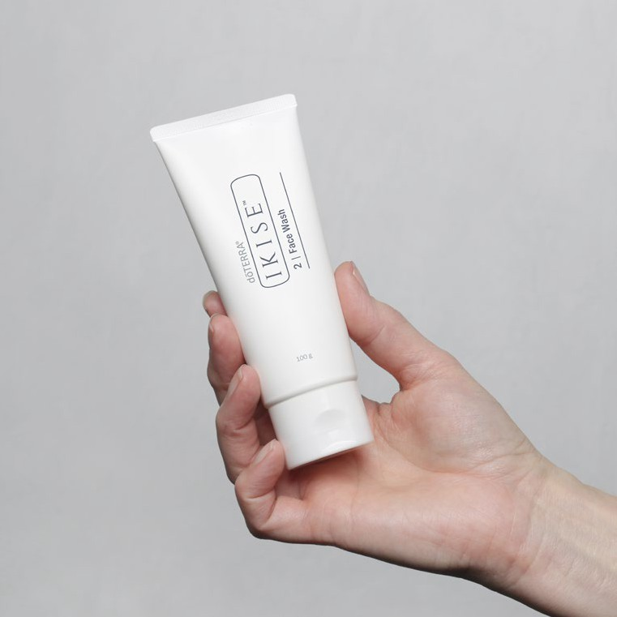
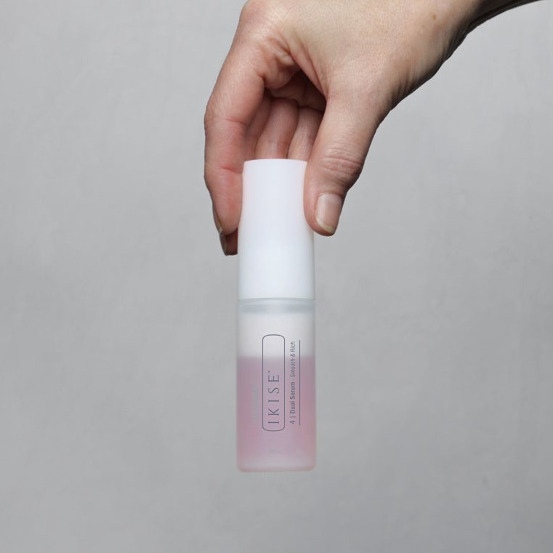
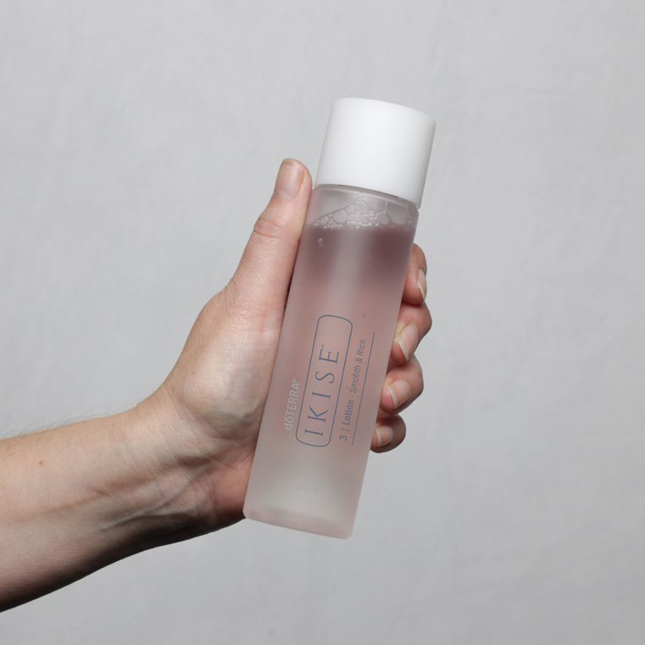
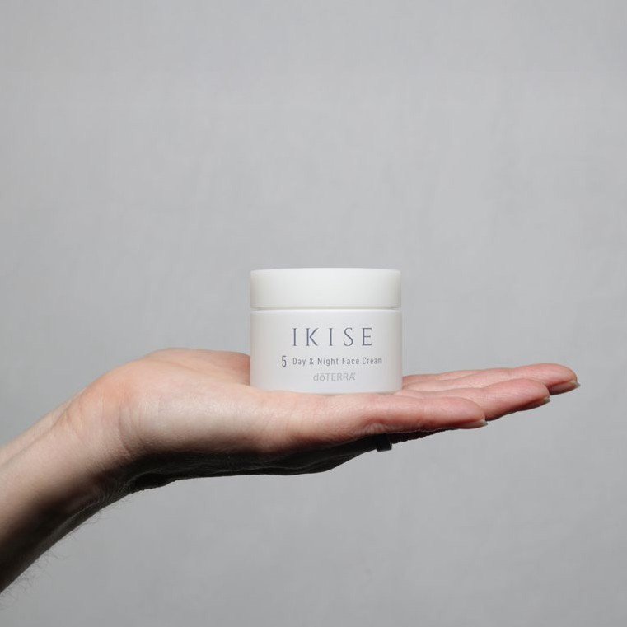
Create Your dōTERRA IKISE Skin Ritual
CLEANSE
TREAT
Step 1: Face Wash
A gentle cleanser that lifts impurities and rebalances the skin. Infused with Lime, Litsea & Petitgrain, and coconut-derived ingredients to leave skin soft and fresh.
Step 3: Smooth & Rich Dual Serum Two serums in one. Shake to blend exfoliating (PHA) and brightening (Frankincense + Vitamin C) powers to leave skin radiant and visibly smoother.
HYDRATE & PREP
SEAL & PROTECT
Step 2: Smooth & Rich Lotion
Hydration meets skin preparation.
This lightweight lotion layers beautifully to soften and allow deeper absorption of the next steps, featuring Niacinamide, Hyaluronic Acid and Gluconolactone.
Step 4: Day & Night Face Cream
Rich but never heavy, this cream seals in moisture. With Buntan and Copaiba essential oils and rich botanical waxes, it leaves skin feeling deeply nourished and silky smooth.
OPTIONAL ADD-ONS
Booster Oil
Use after washing for added glow. With Geranium essential oil to nourish and prime skin.
Cleansing Balm
Perfect as Step 0 in the evening. Removes makeup and pollution gently while brightening and balancing sebum.
Eye Cream
Apply last. Targets fine lines and puffiness with Rose essential oil, Copper Gluconate, and botanical extracts.
Notes:
The IKISE™ Skin Ritual is built on the timeless principles of Japanese skincare, where each step is designed to feed, nourish, and honour the skin—never strip or overwhelm it.
There are four simple yet purposeful steps:
Cleanse – Gently lift away impurities while respecting the skin’s barrier.
2. Hydrate & Prep – Layer in moisture and create the perfect canvas for active ingredients.
3. Treat – Deliver targeted ingredients for radiance, texture, and firmness.
4. Seal & Protect – Lock in hydration and shield the skin with a soft, nourishing veil.
This ritual isn’t just about skincare - it’s a moment of meditation, a way to start and end your day with intention. It's a form of simple, luxurious self-care that helps you reconnect to yourself while treating your skin to exactly what it needs.
It’s about slowing down, being present, and choosing products that work with your skin—not against it.

Slide 14
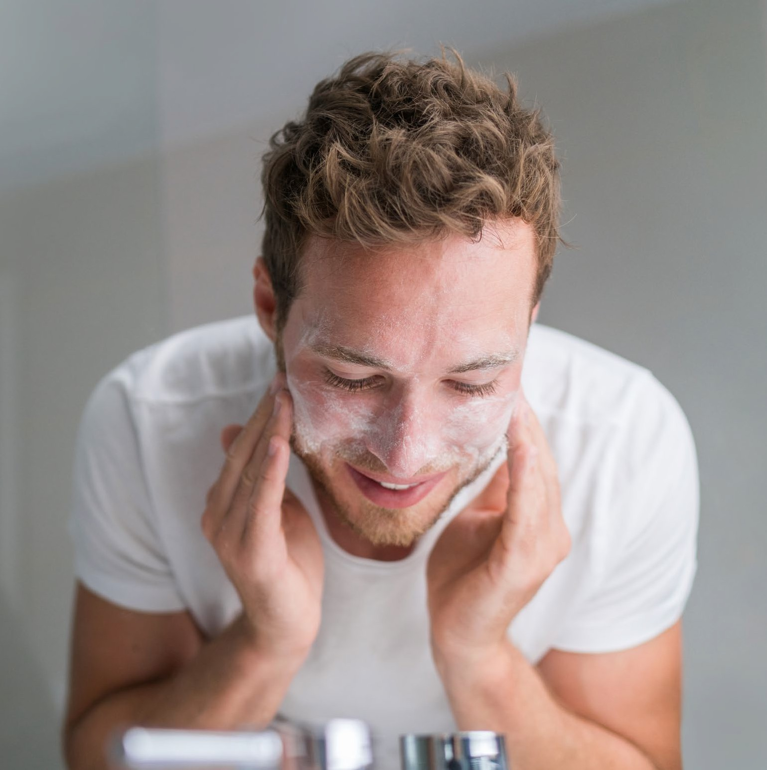







Skin Rituals by Skin Type
NORMAL SKIN
Face Wash►Booster Oil►Smooth & Rich Lotion►Smooth & Rich Dual Serum► Day & Night Face Cream
Cleansing Balm►Face Wash►Smooth & Rich Lotion►Smooth & Rich Dual Serum► Day & Night Face Cream + Intensive Eye Cream
Weekly: Use Booster Oil for a glow boost in the PM before Smooth & Rich Lotion.
DRY SKIN
Face Wash►Booster Oil►Smooth & Rich Lotion►Smooth & Rich Dual Serum► Day & Night Face Cream
Cleansing Balm►Face Wash►Smooth & Rich Lotion►Smooth & Rich Dual Serum► Day & Night Face Cream + Intensive Eye Cream
Tip: Layer Smooth & Rich Lotion twice for intense hydration.
COMBINATION SKIN
Face Wash►Smooth & Rich Lotion►Smooth & Rich Dual Serum►Day & Night Face Cream Cleansing Balm►Face Wash►Smooth & Rich Dual Serum►Day & Night Face Cream
Tip: Booster Oil on dry zones only before Smooth & Rich Lotion.
Notes:
This is just a guide - a starting point to help you understand how the IKISE™ range can be tailored to your skin.
• You don’t need to follow it rigidly. Think of it as a flexible ritual you can dip in and out of depending on what your skin needs that day.
• For example, if your skin’s feeling dry, you might add in an extra layer of the Smooth & Rich Lotion or use the Booster Oil at night - even if that’s not your usual routine.
• Or, if you’re short on time in the morning, keep it simple and come back to the full ritual when you can.
• The real beauty here is that every product is designed to work beautifully together - so you can customise your ritual to suit your skin type, your lifestyle, and the seasons.
• Whether your skin is normal, dry, or combination, this guide gives you a foundation to build on, so your skincare feels supportive, not overwhelming.

Slide 15
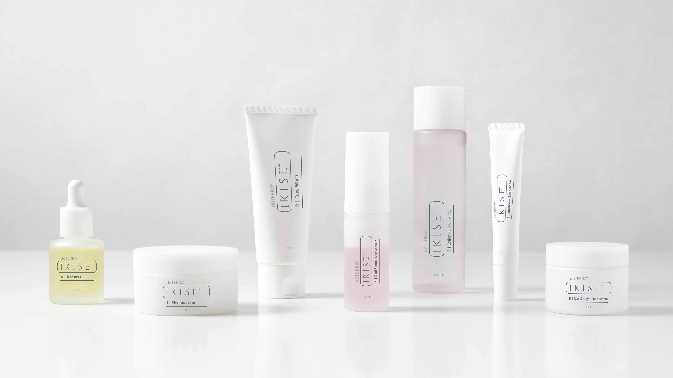
The IKISE™ Range
Notes:
Now it's time to meet the range…

Slide 16
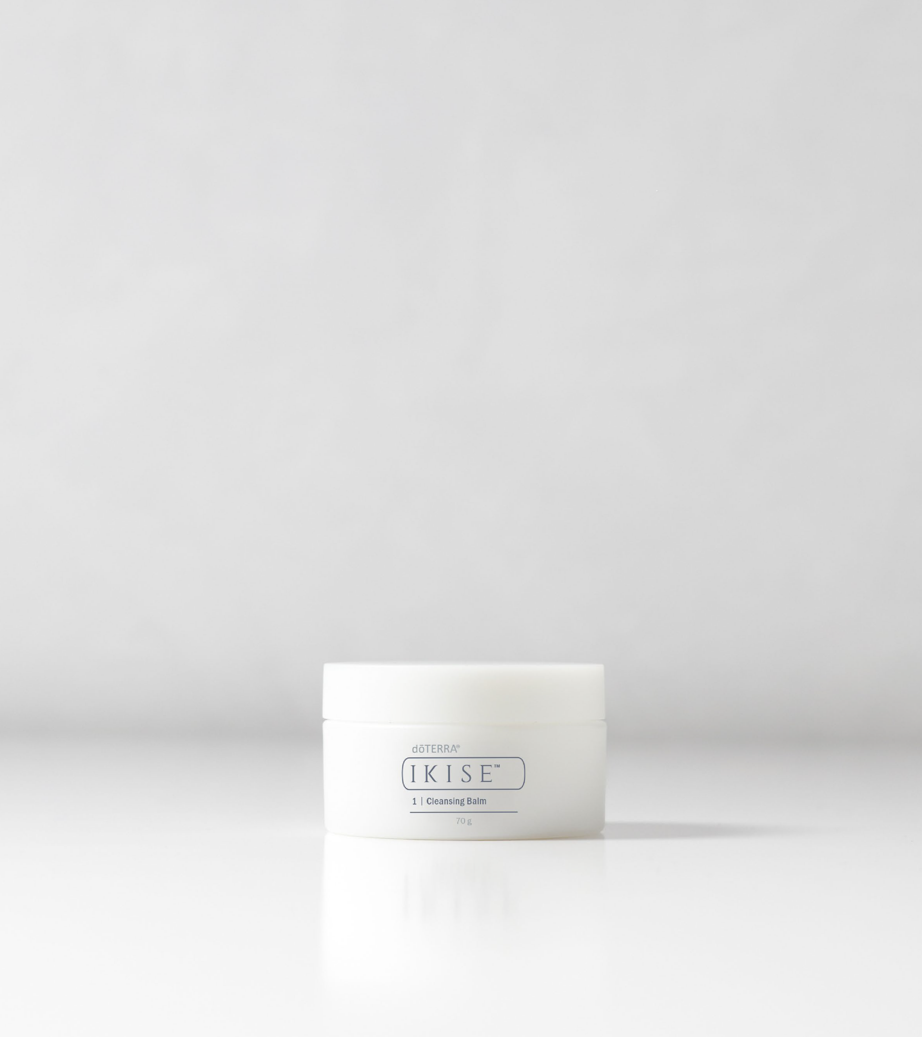
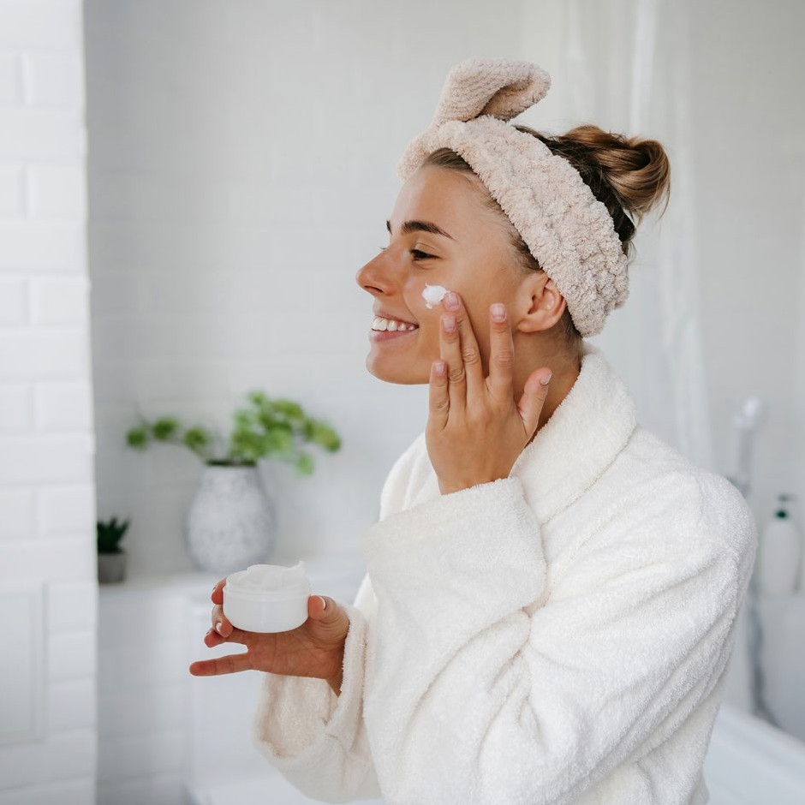
Step 1 Natural Origin Index 100%
Key Ingredients:
Beeswax
Sunflower Seed Wax
Lime Essential Oil
Litsea Essential Oil
Petitgrain Essential Oil
Ascorbic C (Vitamin C)
Ascorbyl Glucoside (Natural Vitamin C derivative)
What It Does:
Cleansing Balm
Purpose: Gently remove makeup, sunscreen, and impurities while nourishing the skin.
Beeswax and Sunflower Seed Wax protect and soften the skin barrier.
Vitamin C and Lime essential oil brighten and refresh.
Transforms into a light milk when water is added, rinsing away cleanly.
Leaves skin soft, cushioned, and replenished.
Tips & Tricks
Massage onto dry skin, emulsify with water, and rinse.
Ideal for the first cleanse in a double-cleansing routine.
Gently dissolves makeup and impurities from the skin.
Safe for eyelash extensions.
Notes:
This is your first step in the cleansing ritual, designed to gently melt away makeup, sunscreen, and impurities without stripping the skin.
• It has a 100% Natural Origin Index and is packed with nourishing ingredients like Beeswax, Sunflower Seed Wax, and brightening essential oils like Lime and Litsea.
• As you massage it onto dry skin, it begins to soften and nourish. Once you add water, it transforms into a light milk that rinses away cleanly, leaving your skin soft, cushioned, and replenished.
• It’s ideal for the first step in a double-cleansing routine and gentle enough for daily use.
• A great bonus: it’s also safe to use on eyelash extensions, making it a perfect choice for those who want a thorough but gentle cleanse without compromising lash wear.
• This balm makes cleansing feel luxurious, while protecting and nourishing your skin at the same time.

Slide 17
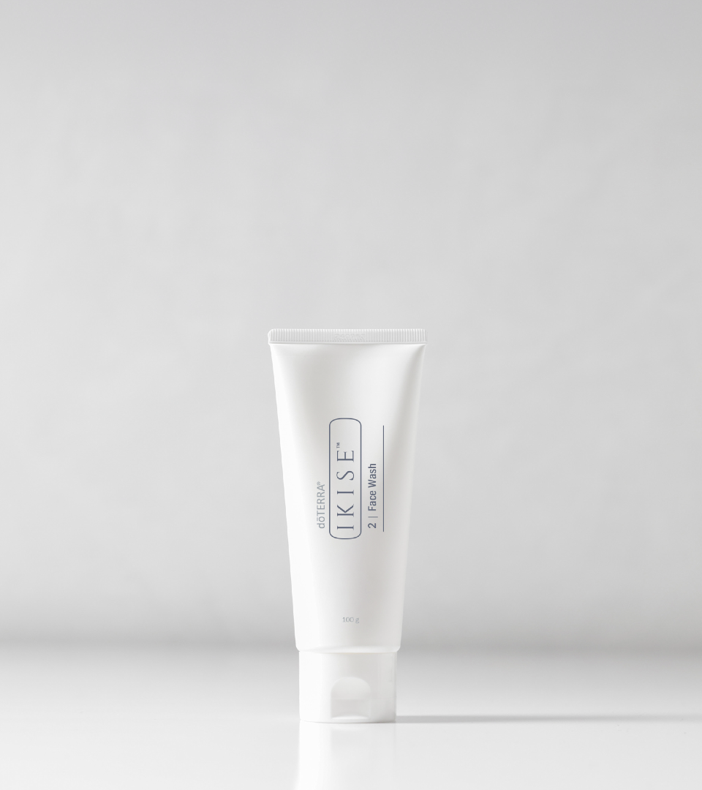
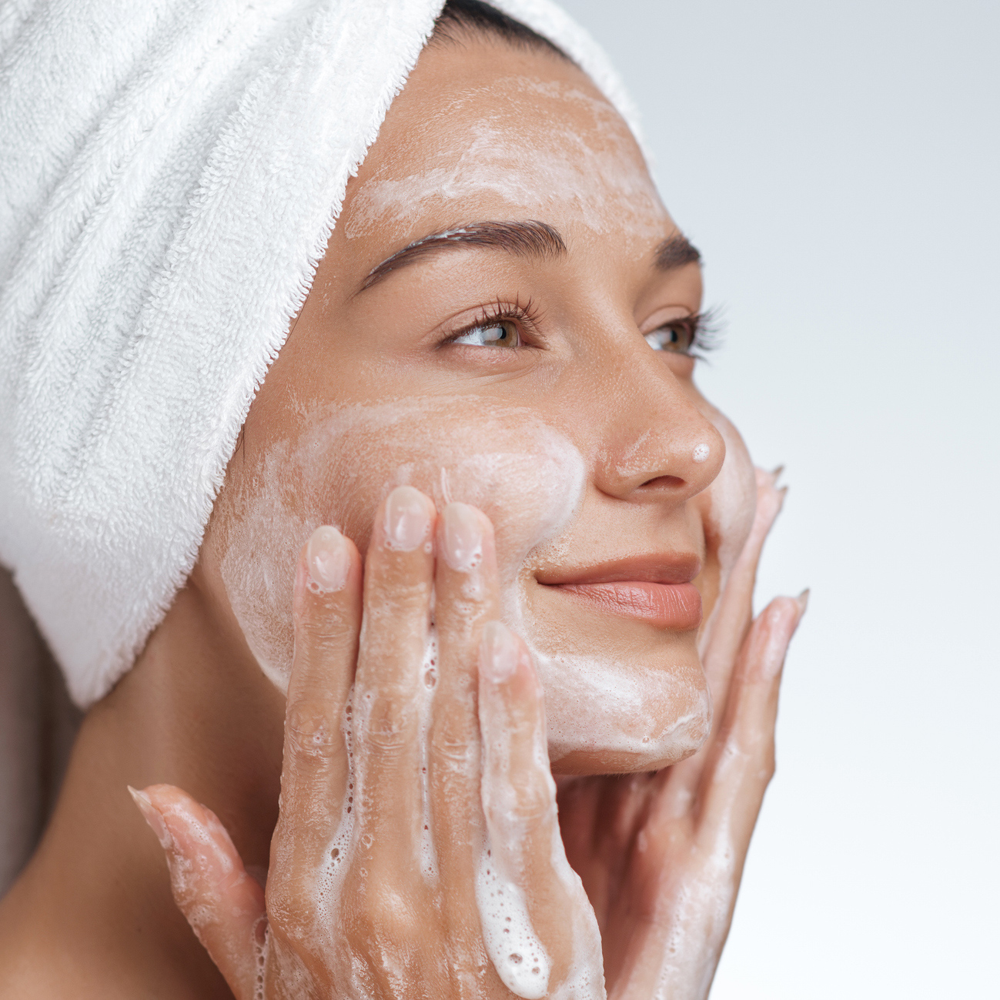
Key Ingredients:
Glycerin
Lauric Acid
Litsea + Lime essential Oil
Coconut Derived Cleansers
Petitgrain Essential Oil
Jojoba Oil
Hyaluronic Acid
Ascorbic C (Vitamin C)
Ascorbyl Glucoside (Natural Vitamin C derivative)
Step 2 Natural Origin Index 99%
What It Does:
Face Wash
Gentle foaming cleanser with Lauric Acid removes impurities while being kind to skin.
Vitamin C helps brighten and even tone.
Petitgrain, Lime & Litsea essential oils support clarity and freshness.
Glycerin helps maintain hydration during cleansing.
Prepares skin for optimal product layering.
Purpose: Gently Refreshing daily cleanser that gently purifies and rebalances.
Tips & Tricks
Use morning and night, especially after Cleansing Balm.
Massage in circular motions with lukewarm water.
Rinse thoroughly and pat dry.
A little goes a long way, just a small amount creates a rich, gentle foam.
Add a drop of Booster oil to the cleanser if you have dry skin for extra moisture.
Notes:
This is your daily cleanser - gentle, refreshing, and ideal for morning and night.
• It helps remove impurities with Lauric Acid, while Vitamin C and essential oils brighten and refresh.
• Glycerin and Hyaluronic Acid keep skin hydrated during the cleanse.
• Use after the Cleansing Balm for a complete double-cleanse.
• A small amount creates a rich, gentle foam - massage in and rinse well.
• Preps your skin beautifully for the next steps in the ritual.

Slide 18
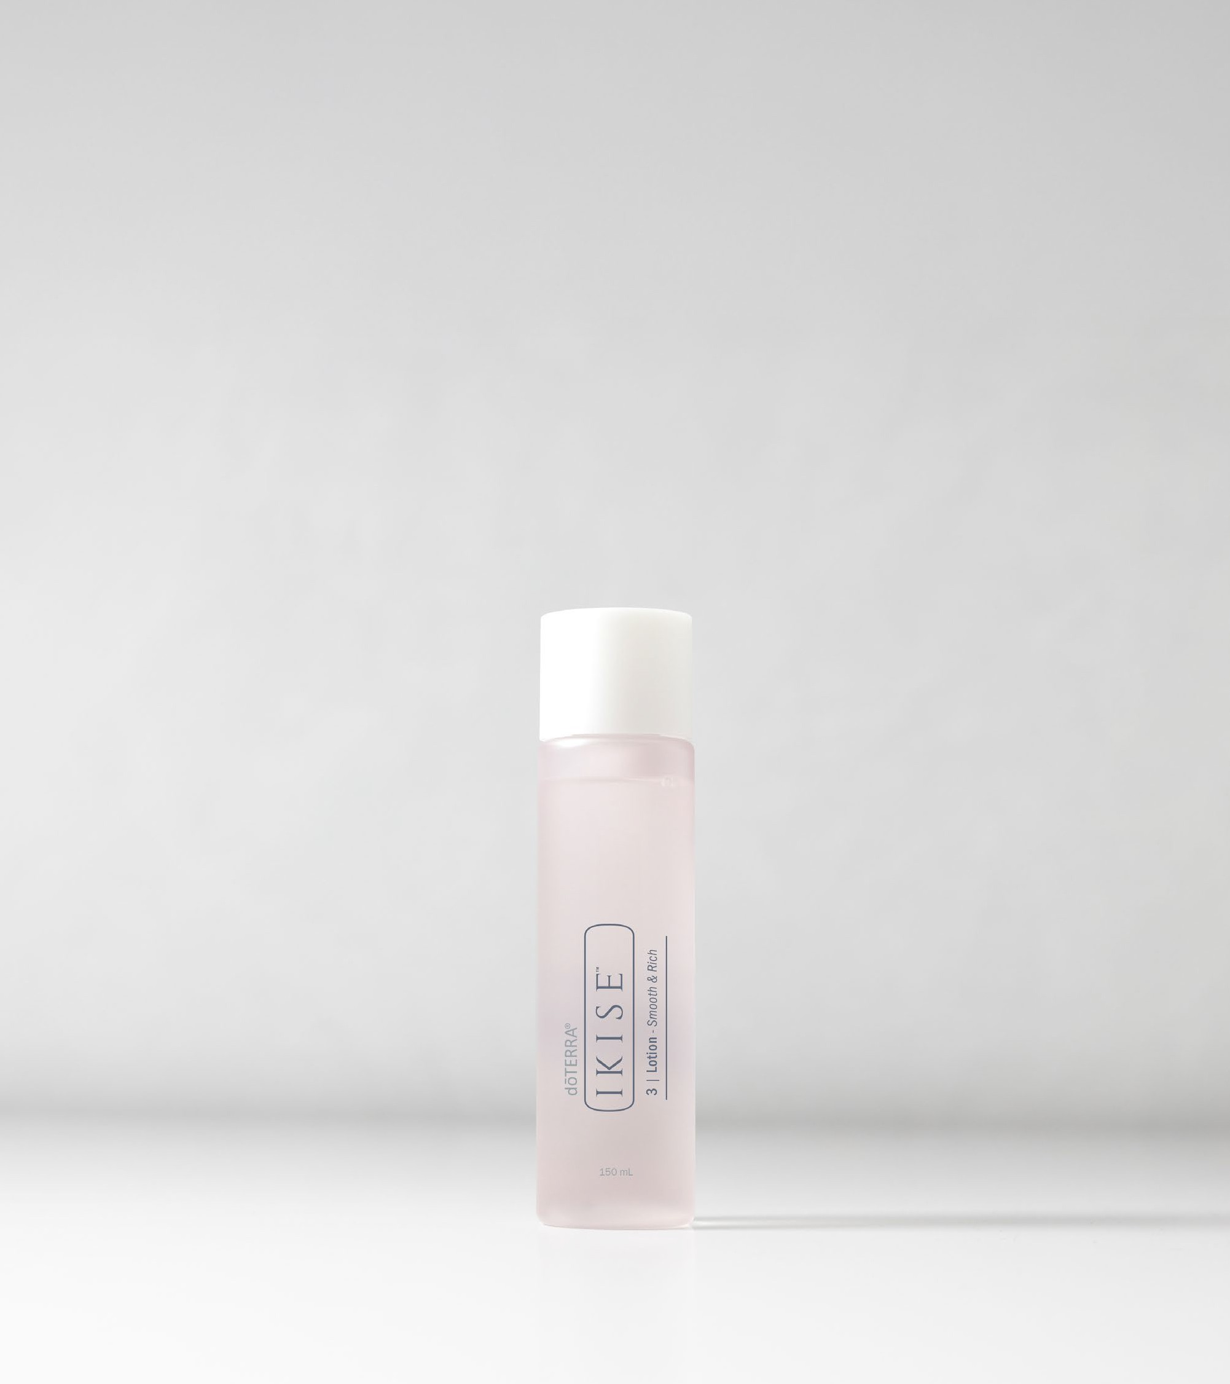
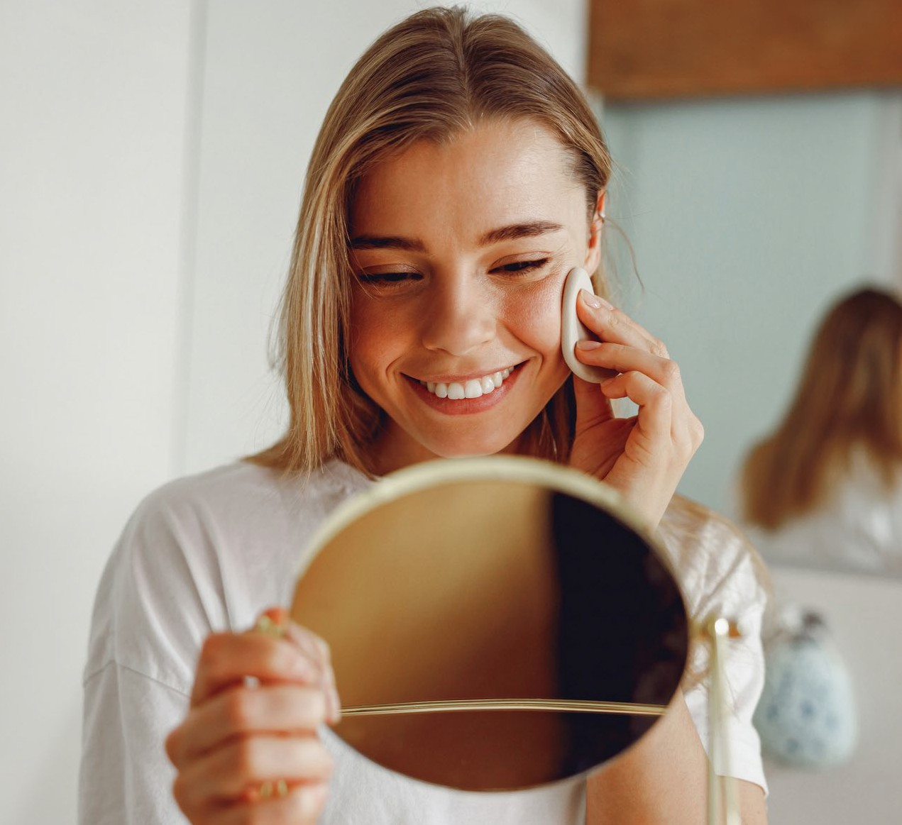
Step 3 Natural Origin Index 94%
Key Ingredients:
Niacinamide
Glycerin
Gluconolactone [PHA]
Frankincense Essential Oil
Zinc Gluconate Copper Gluconate
Humic Shale
Ascorbic C (Vitamin C)
Ascorbyl Glucoside(Natural Vitamin C derivative)
What It Does:
Smooth & Rich Lotion
Purpose: Deeply hydrate, tone, and prepare skin for treatment.
Glycerin and Hyaluronic Acid draw in moisture and plump the skin.
Niacinamide helps refine pores and improve tone.
Vitamin C brightens and supports a healthy glow.
Frankincense essential oil promotes skin rejuvenation.
Enhances absorption of following products.
Tips & Tricks
Pat into skin with hands or apply with a cotton pad as you would toner.
Layer 2–3 times for added hydration.
Use chilled for a refreshing toning boost.
Notes:
This lotion is like a liquid treatment toner/essence - designed to deeply hydrate, tone, and prep your skin for what comes next.
• It combines humectants like Glycerin and Hyaluronic Acid to draw in moisture, plus Niacinamide and Vitamin C to refine pores and brighten.
• Frankincense essential oil supports skin rejuvenation and calm.
• You can pat it in with your hands or apply it like a toner with a cotton pad.
• For an extra hydration boost, layer it 2–3 times.
• It’s a beautiful reset step that leaves your skin plump, glowing, and ready for your serums or creams.

Slide 19
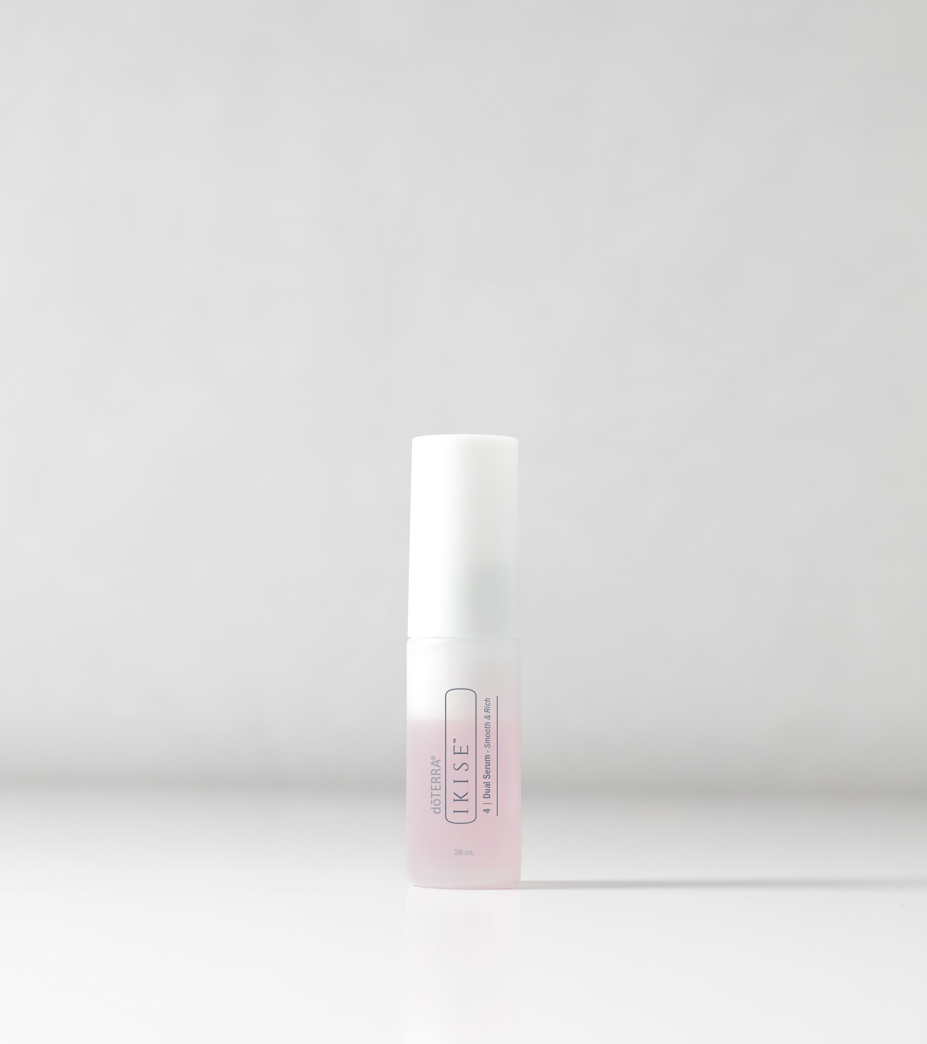
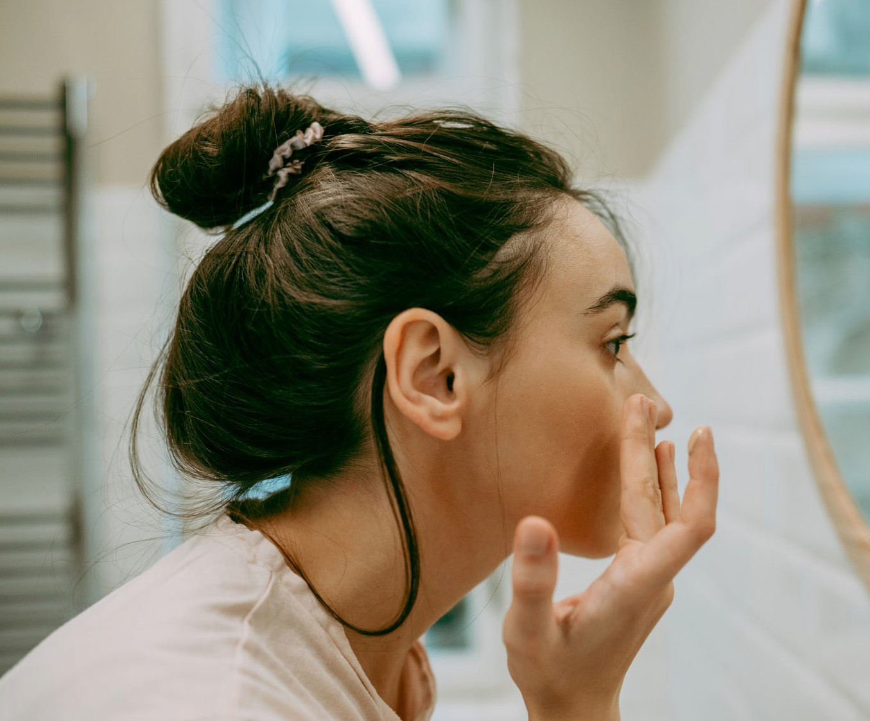
Step 4
Key Ingredients:
Zinc Gluconate
Hyaluronic Acid
Copper Gluconate
Squalane
Niacinamide
Gluconolactone [PHA]
Frankincense Essential Oil
Humic Shale
Ascorbic Acid (Vitamin C)
Ascorbyl Glucoside (Natural Vitamin C derivative)
Understanding the Natural Origin Index:
What ISO 16128 Means for Your Skincare
What It Does:
Natural Origin Index 91%
Vitamin C brightens skin and boosts radiance.
Niacinamide and PHA (Gluconolactone) refine skin texture and tone.
Hyaluronic Acid deeply hydrates and smooths fine lines.
Frankincense essential oil supports skin regeneration and firmness.
Shake to activate bi-phase formula (essence + oil).
Smooth & Rich Dual Serum
Purpose: Deliver powerful age-supportive and glow-enhancing benefits.
Tips & Tricks
Shake well before use.
Press gently into skin.
Use morning and night for best results.
Layer with Booster Oil for dry skin.
The pink colour of the Dual Serum is due to Cyanocobalamin (Vitamin B12), which also helps soothe redness and irritation in the skin
Notes:
This is your glow-boosting, age-supportive step - combining hydration, brightening, and gentle renewal in one.
• It’s a bi-phase formula - part essence, part oil - so give it a good shake before use to activate it.
• Vitamin C and Niacinamide help brighten and refine skin tone, while Hyaluronic Acid deeply hydrates and smooths.
• PHAs offer gentle exfoliation to renew and soften texture, and Frankincense supports firmness and regeneration.
• Use morning and night and press it gently into the skin.
• For dry skin, it pairs beautifully with Booster Oil.
• Bonus: that soft pink colour comes from Vitamin B12, which also helps calm redness.

Slide 20
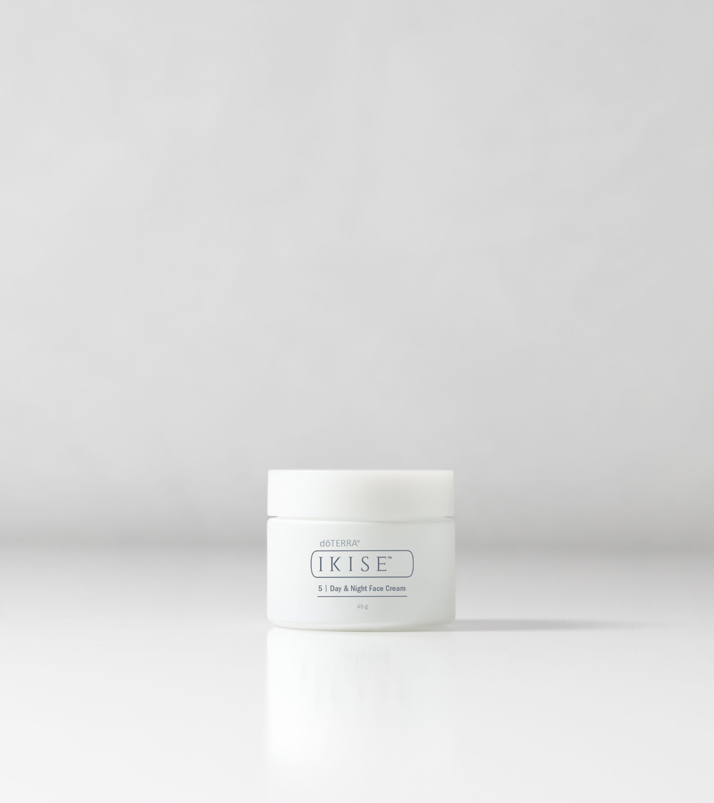
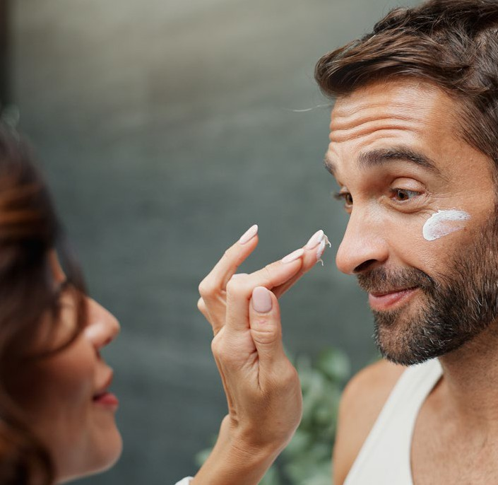
Step 5 Natural Origin Index 99%
Key Ingredients:
Glycerin
Squalane
Meadow Seed Oil
Beeswax
Buntan Essential Oil
Gluconolactone [PHA]
Niacinamide
Zinc Gluconate
Copper Gluconate
Humic Shale
Copaiba Essential Oil
Ascorbic C (Vitamin C)
Ascorbyl Glucoside (Natural Vitamin C derivative)
SUtnedpeOrsNtaaturanl OdriginiInndegx 99%the BNoaotusrtaelr OOriilgin Index:
What ISO 16128 Means for Your Skincare
What It Does:
Day & Night Face Cream
Purpose: Seal in hydration and protect the skin barrier for all-day radiance.
Squalane and Meadow Seed Oil provide lightweight, long-lasting hydration.
Buntan and Copaiba essential oils calm and support skin balance.
Vitamin C and Vitamin E offer antioxidant protection and help even skin tone.
Creates a moisture barrier while promoting elasticity and glow.
Tips & Tricks
Apply after Dual Serum both morning and night.
Warm between fingers and press into skin.
Add Booster Oil for extra richness when your skin needs a little extra love.
Citrus essential oils:
Citrus essential oils may contain compounds called furocoumarins, which can make the skin more sensitive to UV light.
However, furocoumarin-free Buntan Essential Oil, used in the Day & Night Face Cream, has had those compounds removed.
This means:
It won’t cause photosensitivity, even when used during the day.
It’s safe for sun exposure, making it ideal in daytime skincare without needing to worry about reactions or avoiding sunlight.
Notes:
This is your final step - designed to seal in hydration, protect the skin barrier, and deliver long-lasting glow.
• It features lightweight hydrators like Squalane and Meadow Seed Oil, along with antioxidant-rich Vitamin C and E for even tone and skin resilience.
• Buntan and Copaiba essential oils help calm and balance the skin.
• Despite containing citrus, the Buntan oil used here is furocoumarin-free, so it’s safe for daytime use and sun exposure.
• Use it morning and night after the Dual Serum. Warm between your fingers and press into the skin.
• Add a drop of Booster Oil for extra nourishment on dry or sensitive days.

Slide 21
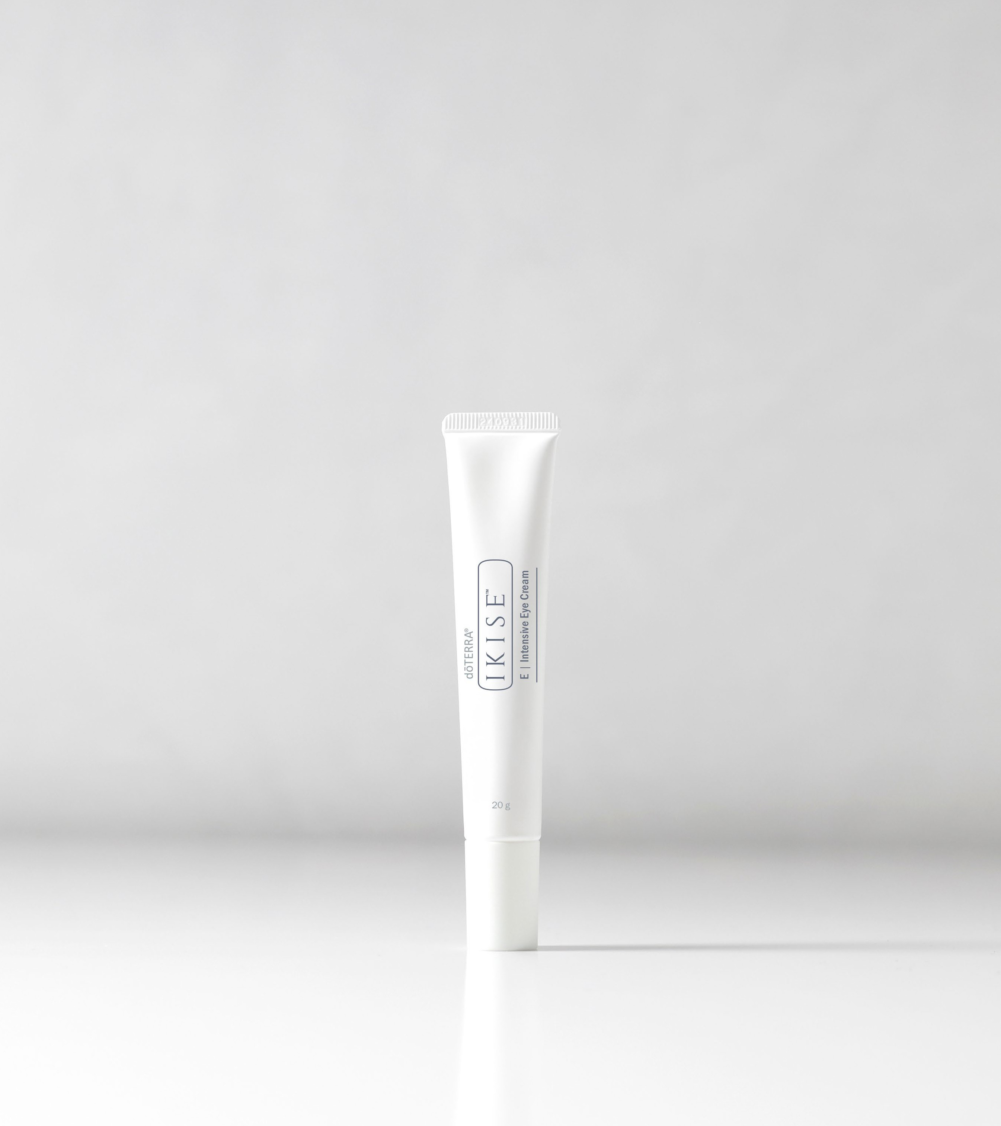
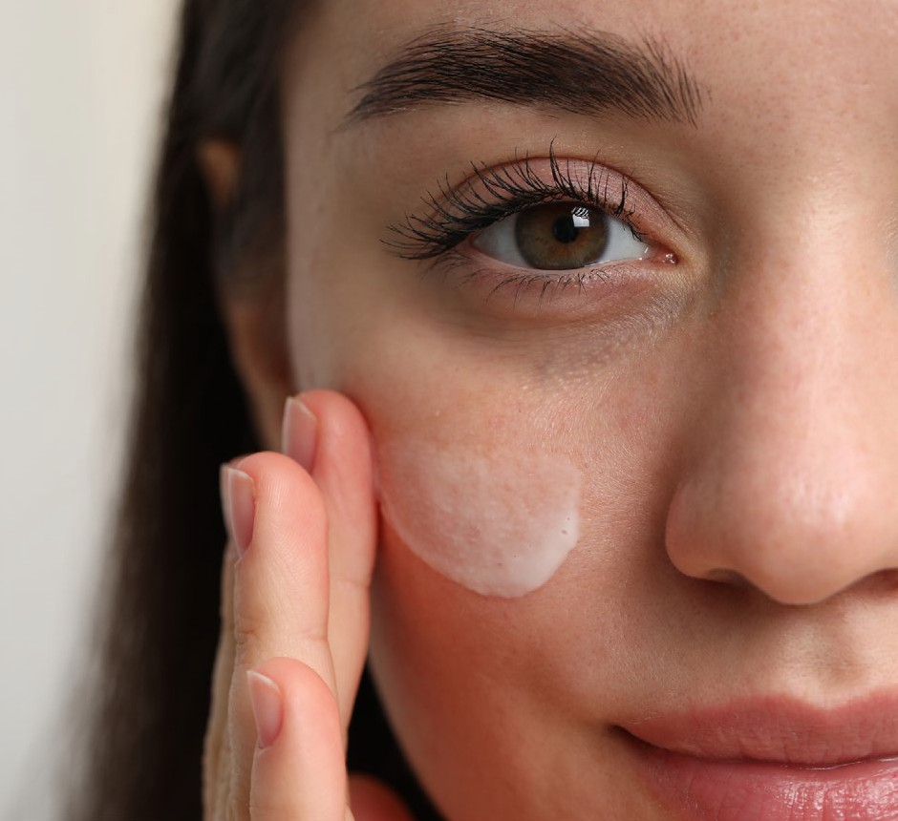
Step E Natural Origin Index 93%
Key Ingredients:
Glycerin
Squalane
Beeswax
Shea Butter
Rose Essential Oil
Zinc Gluconate
Copper Gluconate
Arnica
Ascorbic C (Vitamin C)
Ascorbyl Glucoside (Natural Vitamin C derivative)
What It Does:
Eye Cream
Copper and Zinc Gluconate support elasticity and reduce the appearance of fine lines.
Rose essential oil helps hydrate and brighten.
Squalane and Beeswax offer soothing moisture without heaviness.
Arnica calms puffiness and reduces signs of fatigue.
Purpose: Refresh and rejuvenate the delicate eye area.
Tips & Tricks
Tap gently with your ring finger around the orbital bone.
Store in the fridge for extra de-puffing effect.
Use under makeup for a smoother finish.
Apply to smile lines as a brightening boost.
Notes:
This step is all about refreshing and rejuvenating the delicate eye area.
• It's formulated with Copper and Zinc Gluconate to support elasticity and reduce the look of fine lines.
• Rose essential oil brightens, while Arnica helps calm puffiness and signs of fatigue, perfect for tired eyes.
• Squalane, Beeswax, and Shea Butter deliver soothing moisture without feeling heavy.
• Tap gently around the orbital bone using your ring finger—morning and night.
• You can also keep it in the fridge for a de-puffing boost or apply under makeup for a smoother finish.
• For an extra glow, try it on smile lines too.

Slide 22
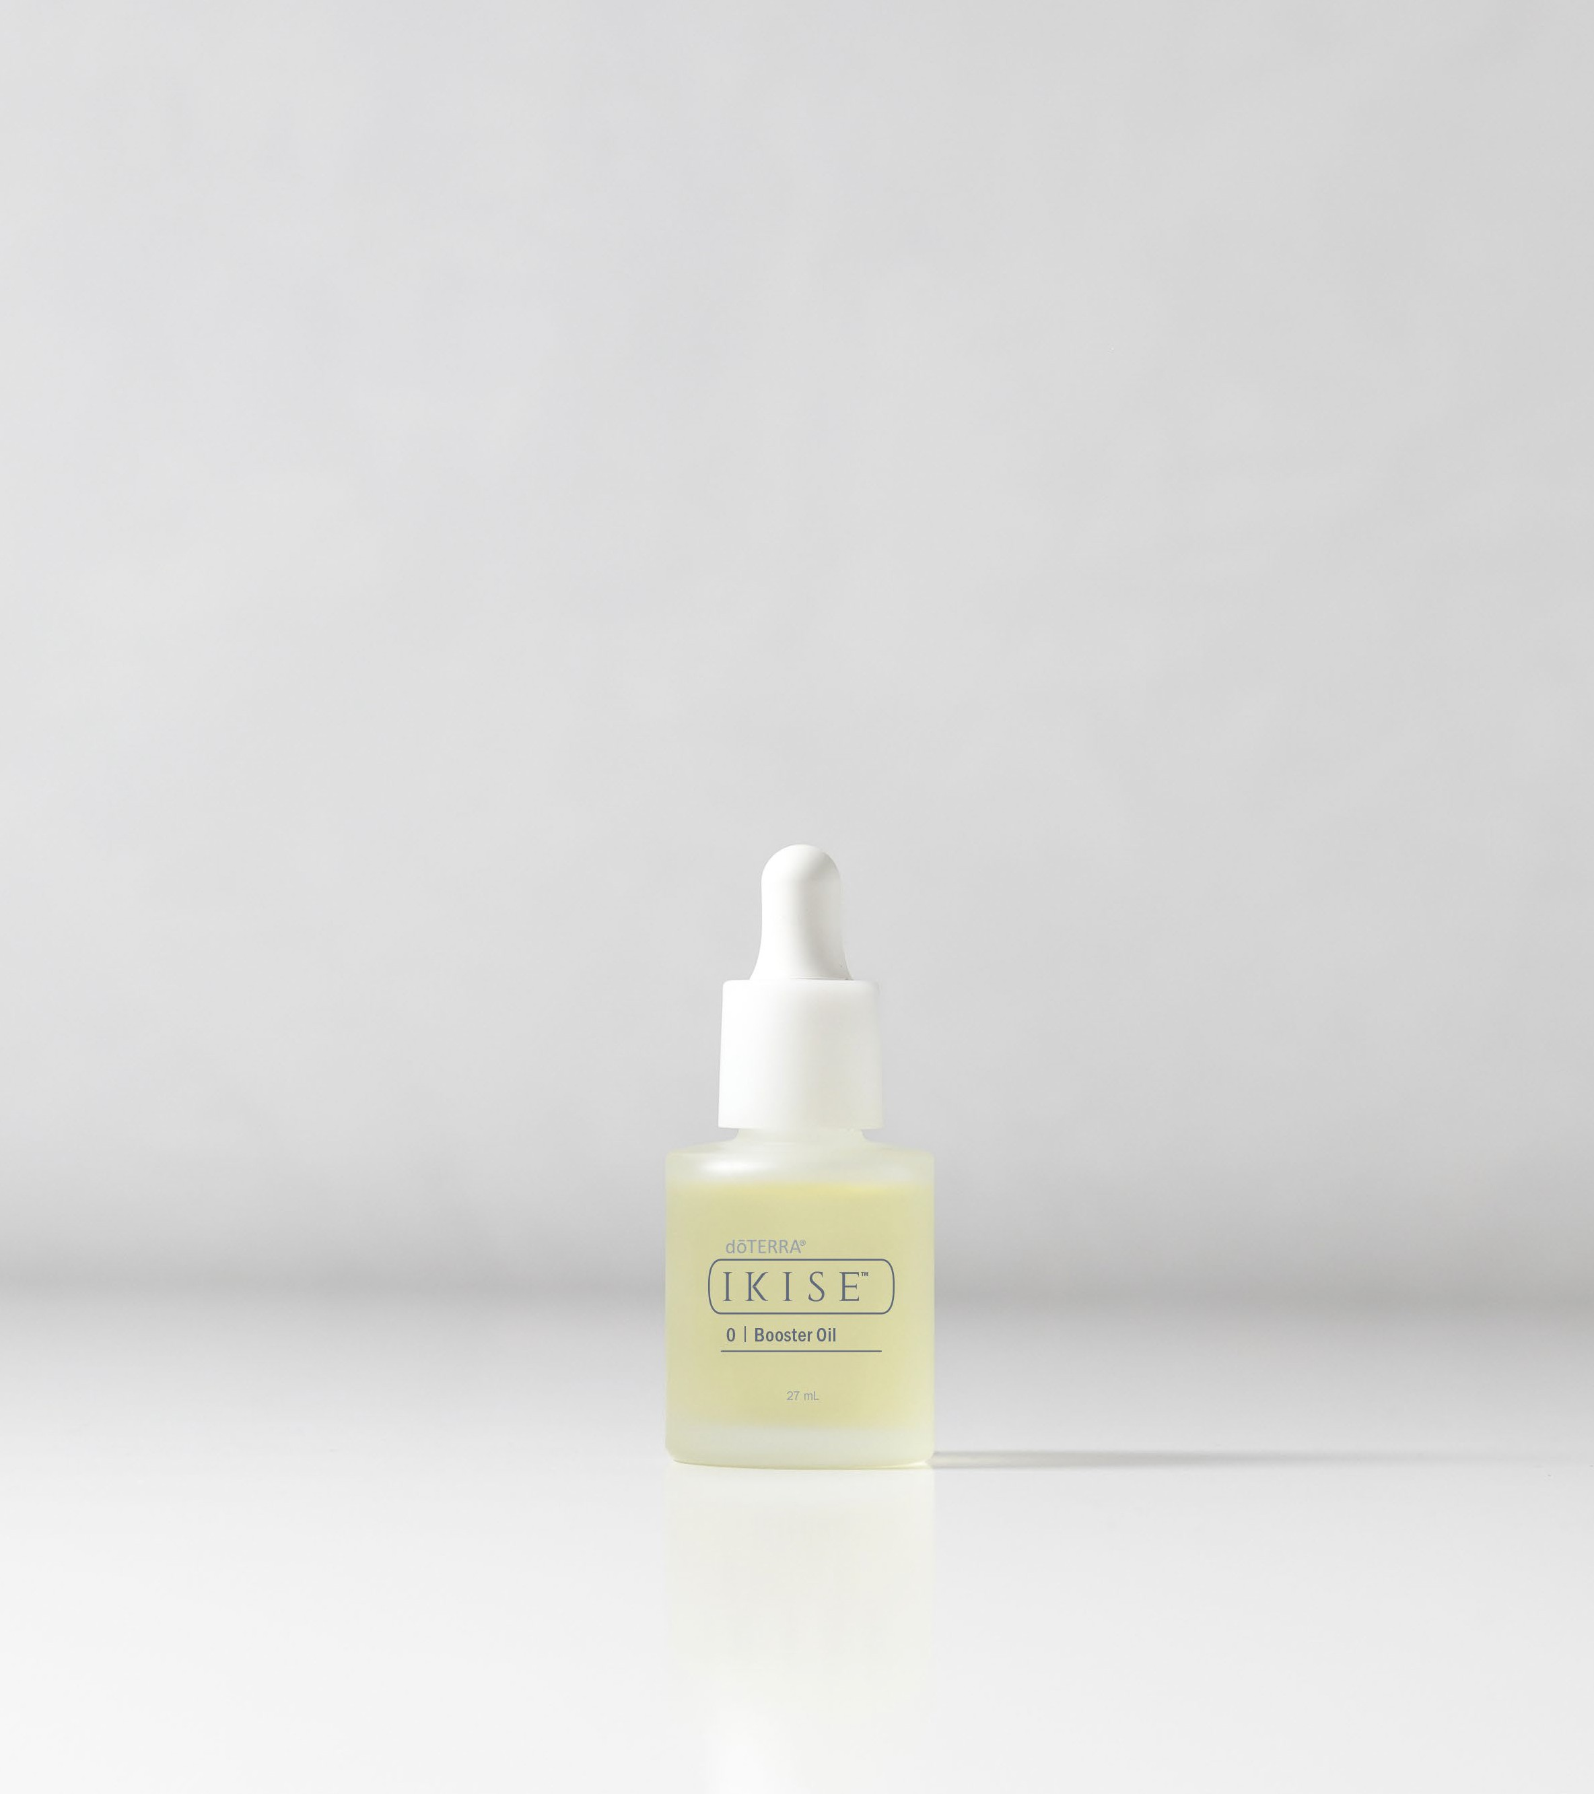
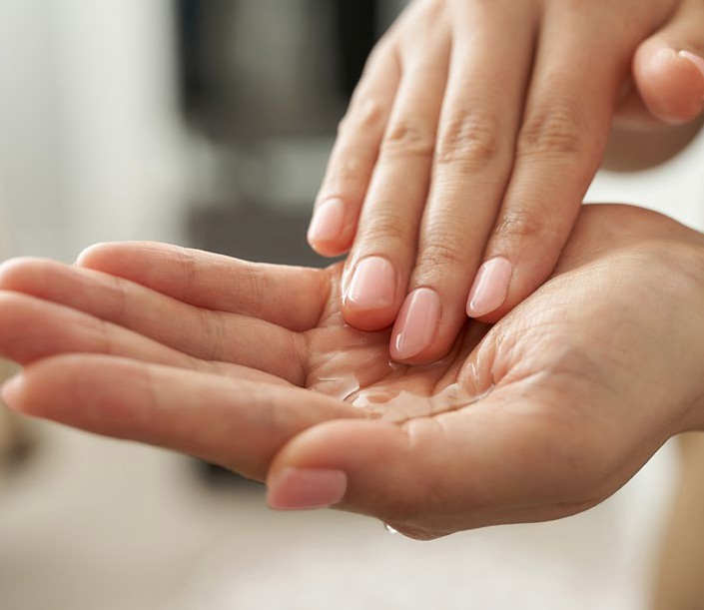
Step O Natural Origin Index 99%
Key Ingredients:
Vitamin E
Argan Oil
Zinc Gluconate
Safflower Seed Oil
Oryza Sativa (Rice) Bran Oil
Apricot Kernel Oil
Geranium Essential Oil
Copper Gluconate
Humic Shale
Ascorbic C (Vitamin C)
Ascorbyl Glucoside (Natural Vitamin C derivative)
What It Does:
Booster Oil
Delivers a boost of hydration with four skin loving oils.
Brightens and evens skin tone with Vitamin C.
Prepares the skin to fully receive the benefits of the skincare ritual.
Purpose: Prep, nourish, and activate the skin to enhance the absorption and efficacy of all products that follow.
Tips & Tricks:
Apply 1–2 drops to clean, damp skin before Lotion or Dual Serum.
Warm between your palms and gently press into skin.
Use on cuticles or dry patches for a hydration boost
Add a drop to your foundation for added glow
How to use:
Facial Pre-treatment:
Add to hair masque or conditioner for deeper conditioning.
Leave-In Hair Serum:
Apply 1–2 drops to clean, damp skin before Lotion or Dual Serum.
Press gently into skin, focusing on areas needing extra care.
Concentrate on fine lines or dry areas for an instant glow boost.
Rub a drop between palms and smooth onto dry ends for shine and frizz control post styling.
Body Moisturiser:
Hair & Scalp Treatment:
For hydration: Apply a few drops to damp hair and scalp.
Wrap in a warm, moist towel and leave for 30 minutes, then rinse and shampoo.
Massage into dry areas (elbows, knees, hands) morning and evening.
Enhance your body moisturiser by adding a few drops for an extra boost of hydration.
Notes:
Booster Oil is Step O (as in Oil) in the IKISE™ ritual - think of it as your skincare superhero
• Its purpose is to prep, nourish, and activate the skin, helping everything you layer on afterwards absorb better and work more effectively.
• It’s packed with skin-loving oils like Argan, Safflower, and Apricot Kernel, plus Vitamin C and E for brightening and antioxidant support.
• You only need 1–2 drops on clean, damp skin before applying your Lotion or Serum. Gently press it in, especially on areas like fine lines or dry patches.
• You can also use it beyond the face:
• On dry hands, cuticles, elbows.
• Mixed into your foundation for glow.
• Or even as a scalp or hair treatment for shine and hydration.
• It's versatile, nourishing, and a great way to boost hydration while giving your skin that lit-from-within glow.

Slide 23
Ingredients
INGREDIENT | SKIN BENEFITS | FOUND IN
Gluconolactone (PHA) | Gentle exfoliation, hydrates, supports smoother texture | Smooth & Rich Lotion, Dual Serum,
Zinc Gluconate | Calms blemishes, supports healing, regulates oil production | Booster Oil, Smooth & Rich Lotion, Dual Serum, Day & Night Face Cream, Eye Cream
Copper Gluconate | Boosts firmness and collagen support | Booster Oil, Smooth & Rich Lotion, Dual Serum, Day & Night Face Cream, Eye Cream
Squalane | Mimics natural skin oils, softens, improves elasticity | Dual Serum, Day & Night Face Cream, Eye Cream
Argan Oil | Deeply conditions, antioxidant-rich, softens skin | Booster Oil
Meadow Seed Oil | Seals in moisture, supports smooth texture | Day & Night Face Cream
Jojoba Oil | Balances oil production, soothes skin, mimics sebum | Face Wash
Apricot Kernel Oil | Softens and nourishes skin | Booster Oil
Shea Butter | Richly nourishes, soothes inflammation | Intensive Eye Cream
Beeswax | Creates a breathable barrier, locks in hydration | Cleansing Balm, Day & Night Face Cream, Eye Cream
Sunflower Seed Wax | Helps structure balm and soften skin barrier | Cleansing Balm
Glycerin | Attracts moisture, softens and hydrates | Smooth & Rich Lotion, Day & Night Face Cream, Face Wash, Eye Cream
Arnica | Calms puffiness and reduces signs of fatigue | Intensive Eye Cream
Cyanocobalamin (Vitamin B12) | Brightens, supports skin repair, gives pink hue | Dual Serum
Saccharomyces/ Camellia Ferment | Enhances absorption, soothes skin, supports renewal | Smooth & Rich Lotion, Day & Night Face Cream
Coix Seed Extract | Supports hydration and texture | Smooth & Rich Lotion, Dual Serum, Day & Night Face Cream
INGREDIENT | SKIN BENEFITS | FOUND IN
Humic Shale | Rich in minerals, detoxifies, supports skin renewal and clarity | Booster Oil, Smooth & Rich Lotion, Dual Serum, Day & Night Face Cream, Eye Cream, Cleansing Balm
Frankincense Essential Oil | Reduces fine lines, calms, supports cell regeneration | Smooth & Rich Lotion, Dual Serum
Geranium Essential Oil | Balances oil, tones skin, encourages glow | Booster Oil
Buntan Essential Oil | Purifies skin, promotes clarity, uplifts mood Furocoumarin-free, which makes it sun safe | Day & Night Face Cream
Lime Essential Oil | Brightens complexion, tones, offers an energising aroma | Cleansing Balm, Face Wash
Litsea Essential Oil | Clarifies, tones skin, antioxidant-rich | Cleansing Balm & Face Wash
Petitgrain Essential Oil | Balances sebum, calms the skin and mind | Cleansing Balm & Face Wash
Rose Essential Oil | Smooths texture, hydrates deeply, supports mature skin | Intensive Eye Cream
Ascorbic Acid (Vitamin C) | Brightens skin, supports collagen production, reduces signs of ageing | All products
Ascorbyl Glucoside (Natural Vitamin C) | Gentler on the skin—ideal for sensitive or reactive skin; brightens and supports skin tone | All products
Vitamin E (Tocopherol) | Antioxidant protection, nourishes deeply, supports skin repair | Booster Oil
Niacinamide (Vitamin B3) | Refines pores, evens tone, improves elasticity, soothes skin | Smooth & Rich Lotion, Dual Serum, Day & Night Face Cream
Hyaluronic Acid / Sodium Hyaluronate | Deep hydration, plumps skin, improves elasticity | Smooth & Rich Lotion, Dual Serum, Face Wash
Notes:
• You don’t need to be an expert or memorise every ingredient to confidently talk about these products.
• This ingredient table is here to help you understand what’s inside each formula and why it matters - making it easier to share with customers or team members.
• Each ingredient has a purpose, whether it’s calming, brightening, hydrating, or protecting the skin.
• You’ll see powerful botanicals like Frankincense, Rose, and Geranium alongside science-backed actives like Niacinamide and Hyaluronic Acid.
• Use this as a reference tool. It’s perfect for building product knowledge over time and giving you that extra confidence when questions come up.
• Think of it as your behind-the-scenes guide to the benefits that make IKISE™ so effective.

Slide 24



Real People, Real Results.
My skin feels hydrated all day, even in winter.
The dual serum is a game changer. My texture is smoother, and I love the natural glow.
It feels luxurious but also grounded in wellness. Finally, skincare that does both.
Notes:
These testimonials speak volumes.
We’re seeing both men and women using IKISE™ and experiencing real, visible results. It’s more than just a skincare line - it's a way people are choosing to invest in themselves.
From hydration that lasts all day, even in winter…
To smoother texture, radiant glow, and that luxurious-yet-grounded feel - IKISE™ is striking a powerful balance between performance and wellness.
These stories reflect what we all want: skincare that works, feels good, and supports us in showing up as our best selves.
Encourage your audience to ask themselves - “What could this look like for me?”

Slide 25
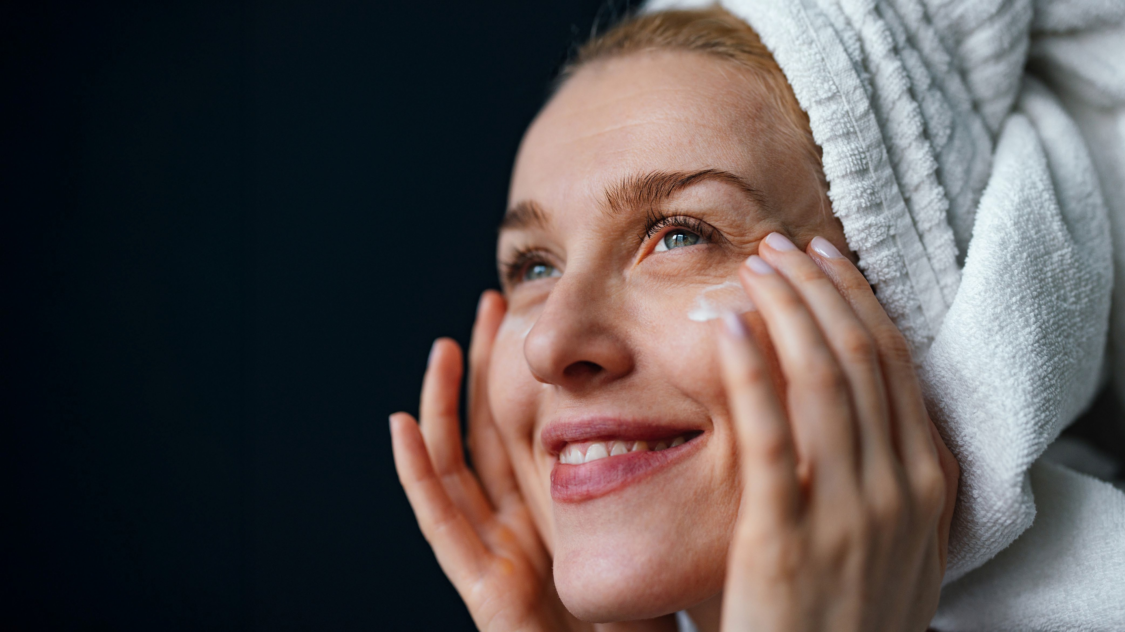
Embrace natural beauty and ageing gracefully, that ties in with the ethos of IKISE™ and the Alive Convention.
Ageing Better, Not Anti-Ageing
Let go of the pressure to turn back time. dōTERRA IKISE™ is here to help your skin evolve beautifully. This is skincare designed for vitality and confidence.
Let your radiance grow with every layer.
Notes:
This image captures what IKISE™ is all about - real people of all ages, glowing with confidence.
It’s not about perfection. It’s not about reversing time. It’s about showing up with vitality, authenticity, and skin that reflects how well you're caring for yourself.
Let’s release the pressure to look younger and instead focus on ageing better - with grace, intention, and self-respect.
IKISE invites you to embrace your natural beauty and let your radiance grow… with every layer.
Call to Action:
✨ So, what are you waiting for?
Start your IKISE ritual today and experience what skincare can feel like when it's aligned with your wellness values.

Slide 26
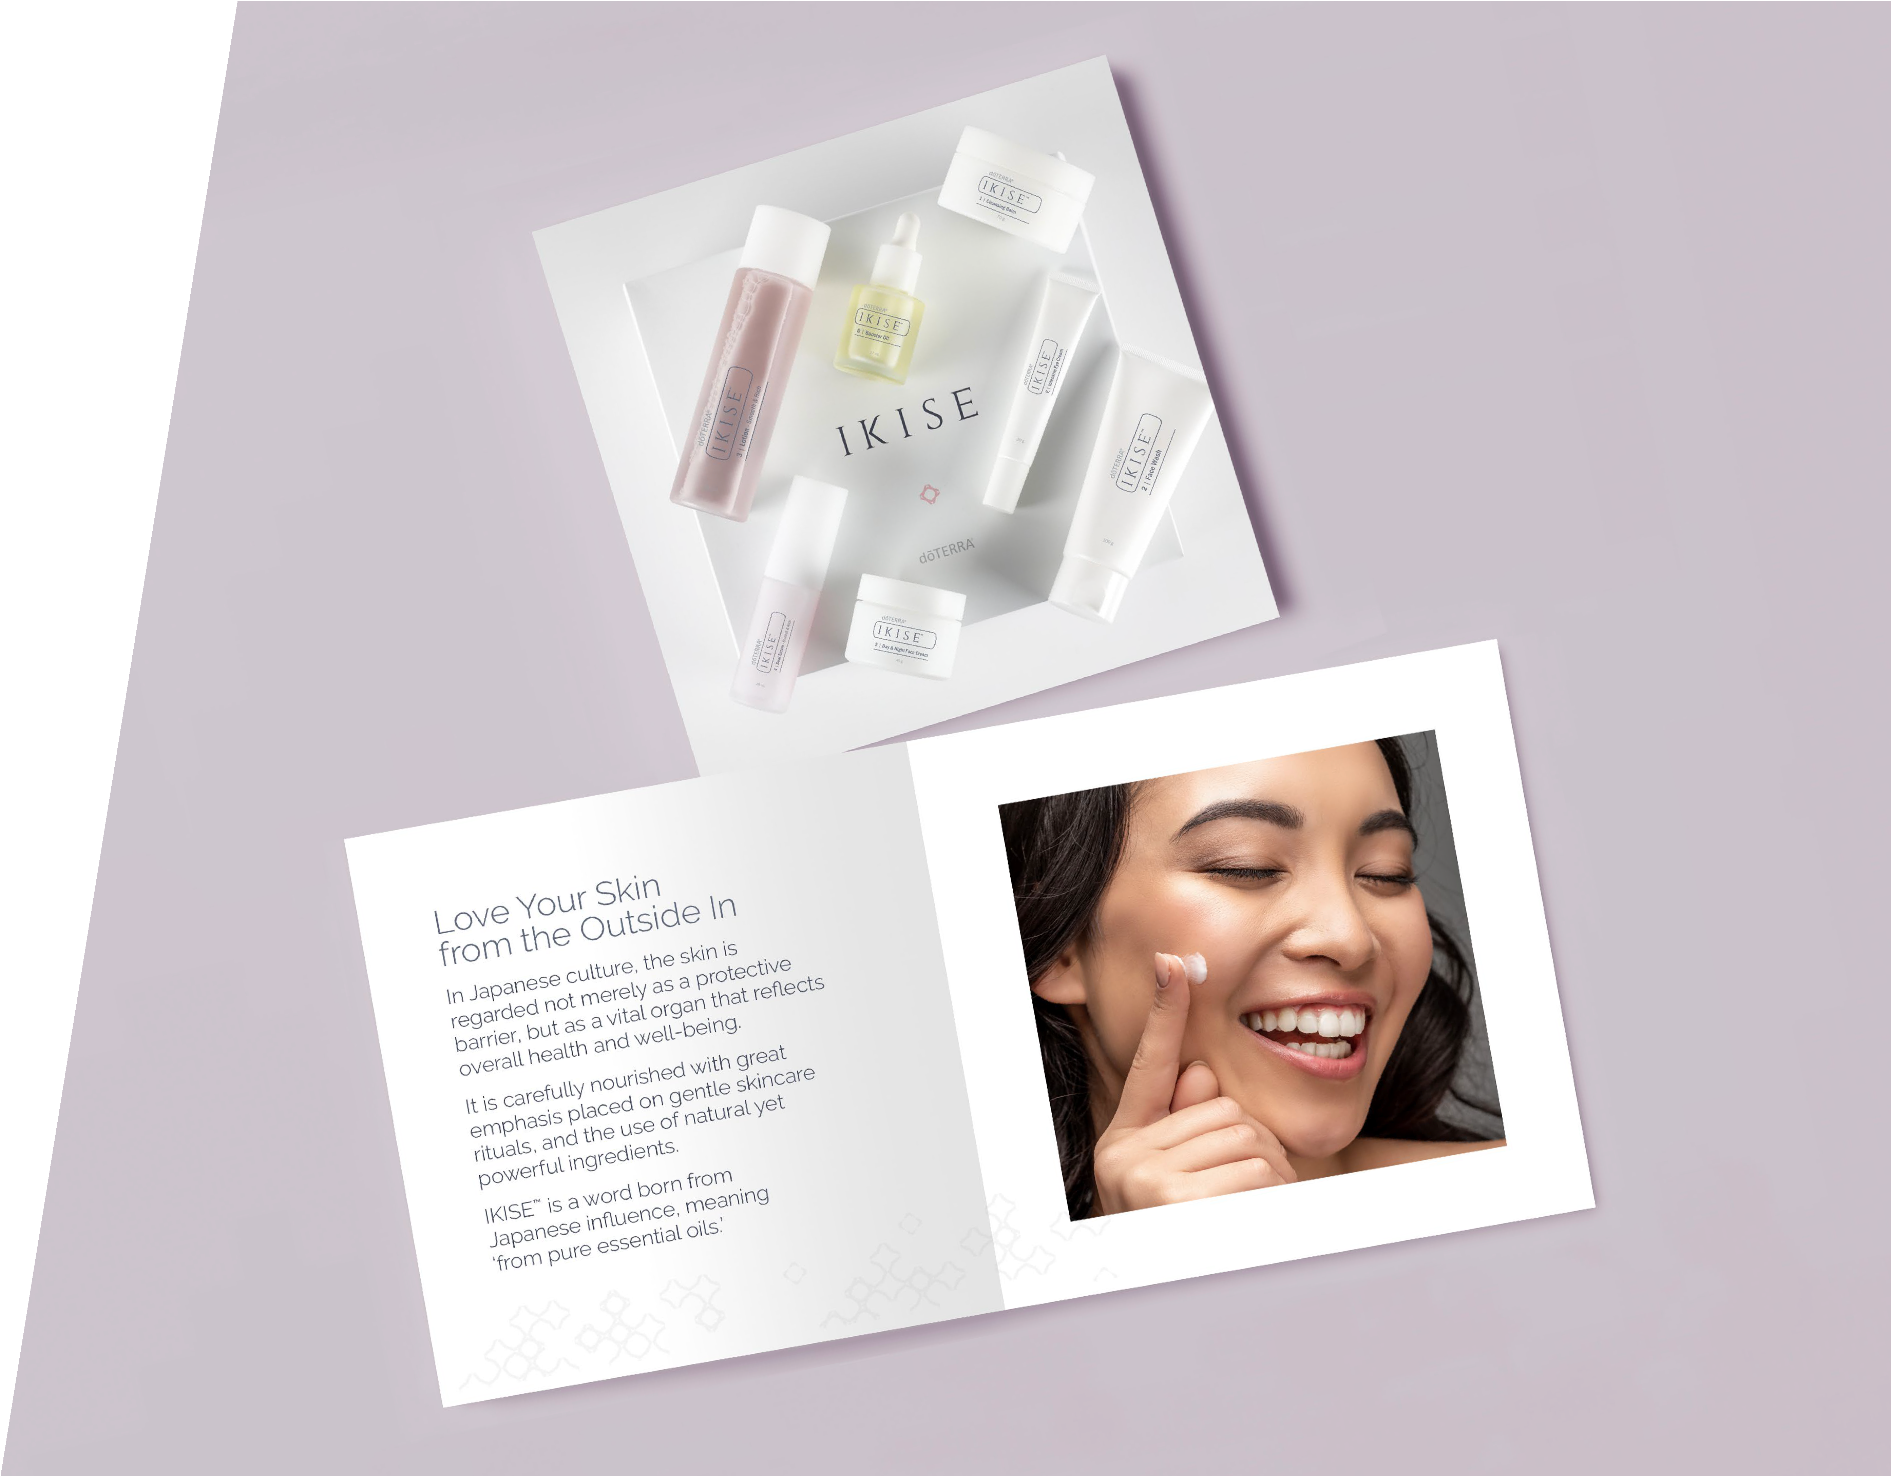
Download the IKISE™ ebook
Notes:
Once you start your IKISE™ journey, you’re not on your own - there’s plenty of support waiting for you.
You’ve got access to me, and dōTERRA has created a range of beautiful resources to guide you every step of the way.
You’ll also receive a digital eBook that recaps much of what we’ve covered today - perfect for when your products arrive and you're ready to begin your ritual with confidence.

