Slide 1


Notes:
Welcome to Launch Your Business!!
(Introduce yourself, include your history with oils)
We invite you to act on what you learn today and experience the results they bring. Commit to play full out. Be present. Be focused. Eliminate distractions. Have fun.
(Switch slide)

Slide 2
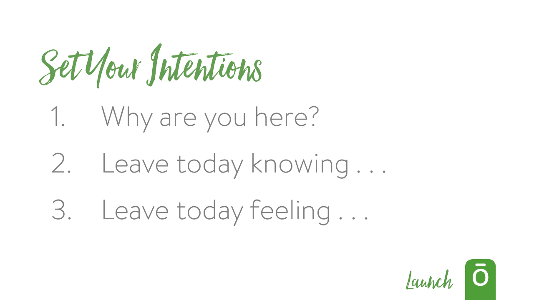
Notes:
To start off, I want you to ask yourself these questions:
Why are you here today?
What do you want to leave knowing today?
What do you want to leave feeling today?
You have two minutes to write down what your intentions are for these three questions.
Ready, Go! (Play music with no words.)
(Pause for 2 minutes. Preferably with nice calm music playing. )
(Bring everyone back into focus and call attention to the front of the room)
Ask them, how was that? Did anyone put down something that they thought was unexpected?
Now I want you to take one minute to get engaged. I want everyone to pair up. Start at the left side of the room and count off 1, 2, 1, 2, etc.
If you are a number 1, turn to the number 2 next to you and take one minute and introduce yourself.
Who are you?
Where are you from?
Why are you here?
What is the one thing that you want to take away from this today?
(Wait one minute)
Now share with them one of your intentions. What do you want to get out of this training? Make it the one that you feel is most important. Tell them why it means so much to you.
You have 30 seconds and then the other person will share with you. The person with the longest hair will start first.
Go!
(Wait 30 seconds)…. Now Switch!
(Wait 30 seconds)
(Switch slide)
How was that?

Slide 3
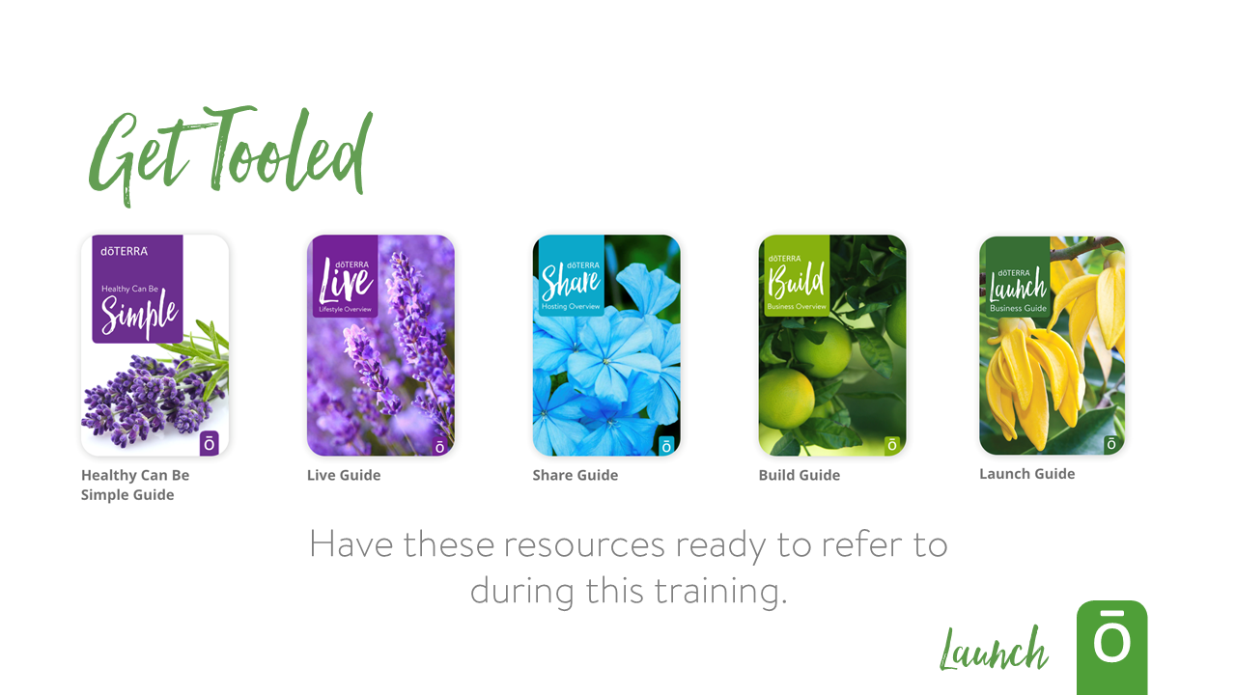




Notes:
As we meet together today make sure that you have these guides in front of you, ready to refer to during the training.
(Switch slide)

Slide 4


Notes:
Think about your commitment and why you’ve decided to be here today. Part of our goal with this camp is to make sure we can help anchor that commitment in a strong foundation. The Build guide is something that can facilitate this, so I’d like to walk through some key portions of the guide.
(Switch slide)

Slide 5


Notes:
On page 3 of the Build guide there’s an incredible compilation of data that shows “Why dōTERRA” and allows us each the opportunity to make an educated choice to partner with dōTERRA. When we’re partnering with dōTERRA we’re partnering with someone we can trust and with quality products.
(Highlight some of the facts on this page to show why dōTERRA is such a great company.)
This page shows us how we can be instrumental in sharing these products with people who need them, building our own business and creating that independence for ourselves, as well as benefiting those around the world who help grow and create these amazing oils.
(Share how this has impacted your life)
(Switch slide)

Slide 6

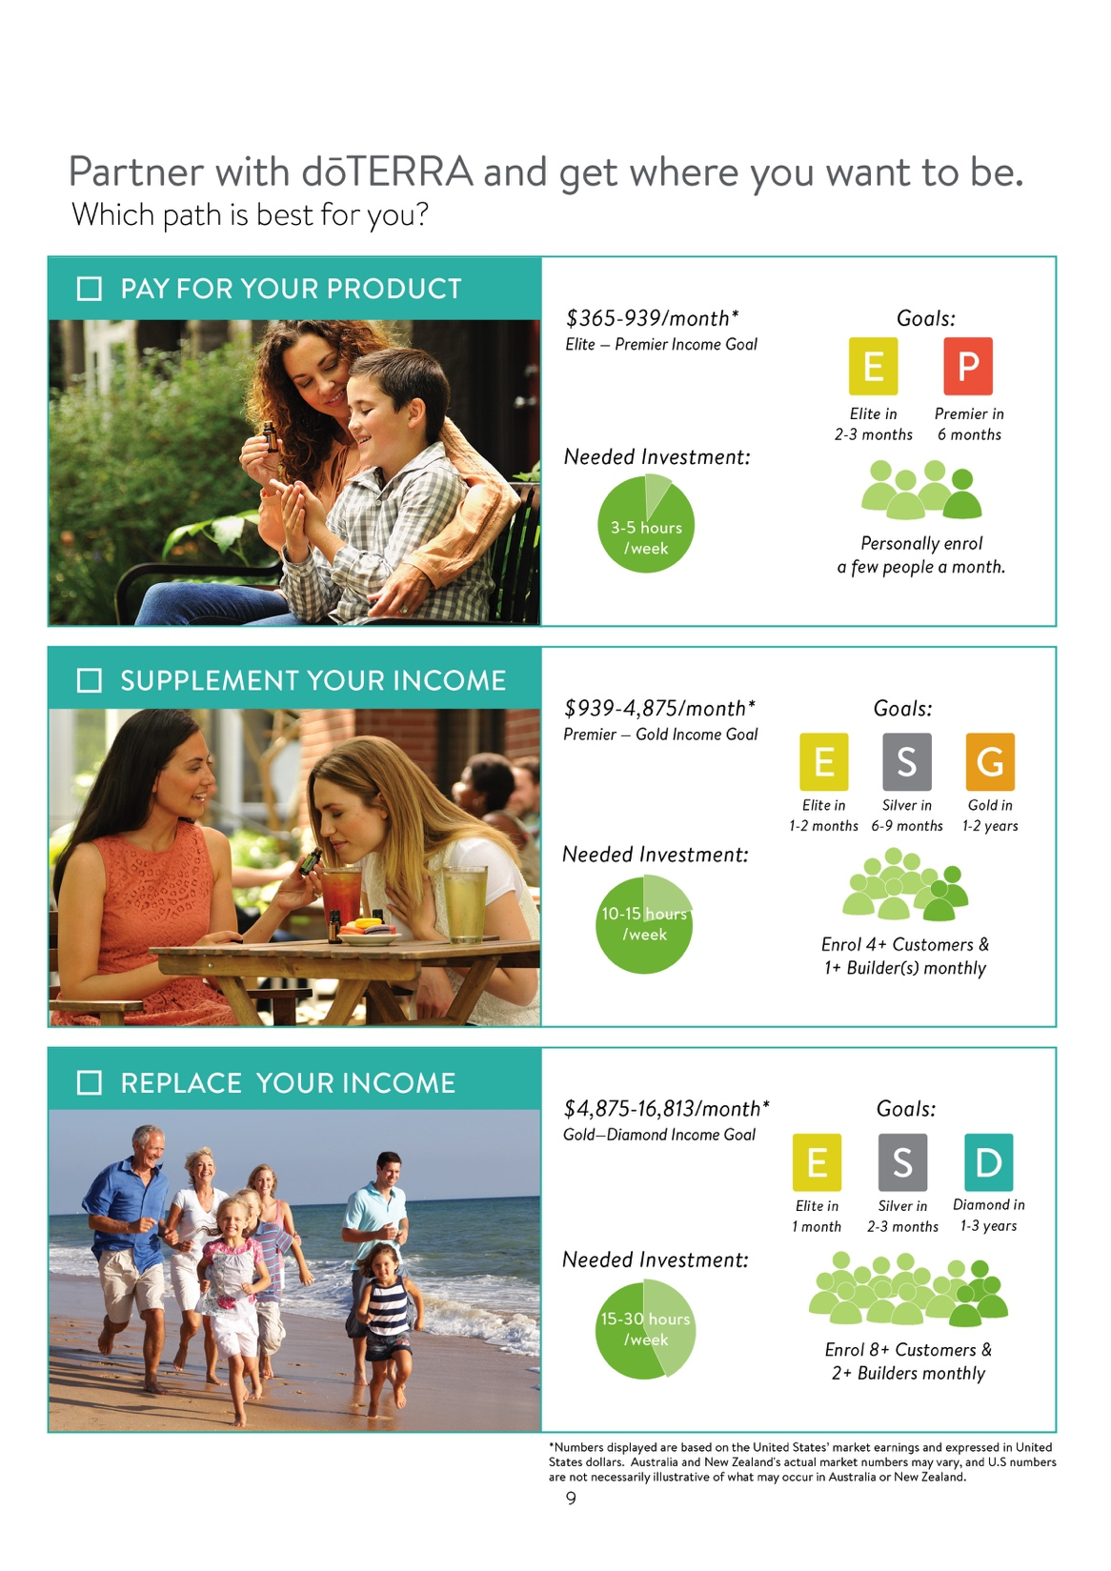
Notes:
This page is where prospective builders can choose their path; they can choose how they want to incorporate their partnership with dōTERRA into their lives. We can use this to make sure that each person we are working with feels like they have a path that works for them and then we can know where to focus our efforts and effectively help our builders.
(Highlight that each path has different time commitments and earning potential)
It’s important that each of us decides our level of commitment as well. I’d like to walk through a little exercise with you.
(Switch Slide)

Slide 7
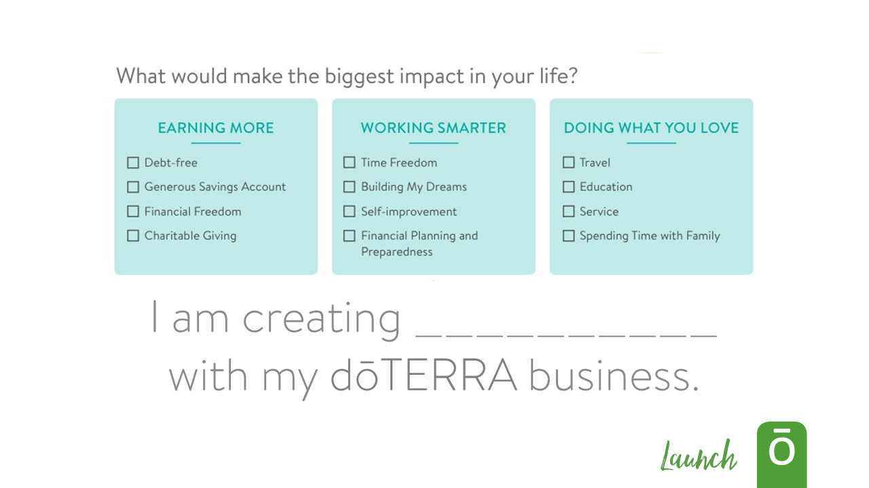
Notes:
Take a moment and consider these areas of “Earning More”, “Working Smarter”, and “Doing What You Love” and think about what would make the biggest impact in your life.
Your answer, your goal, and the possibility your dōTERRA business gives will drive you to do more and work harder.
So with your goal in mind complete the statement, “I am creating (blank) with my dōTERRA business.”
(Share a story of how having a clear goal and intention has helped you in building your business)
(Switch slide)

Slide 8
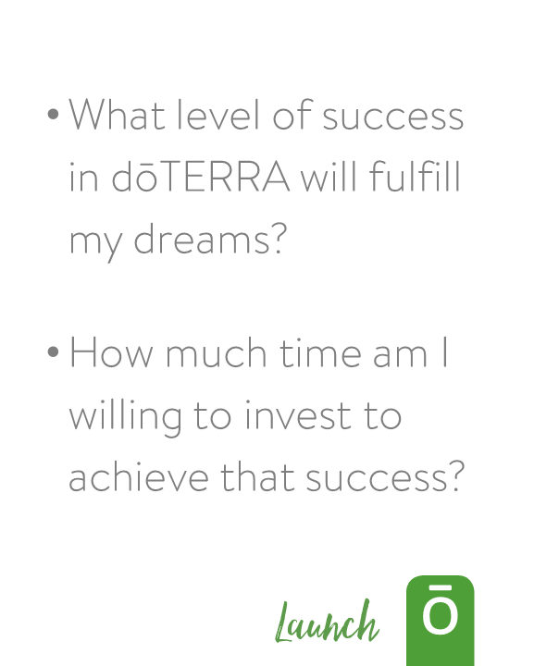
Notes:
With your dream in mind we can move on to the chart on the right side of the page and answer these two questions.
“What level of success in dōTERRA will fulfill my dreams?” and “How much time am I willing to invest to achieve that success?”
When you find the level that will fulfill your dream you understand the commitment that is required.
(Share a story of you or someone that you know that has used dōTERRA to fulfill their dream)
(Switch slide)

Slide 9
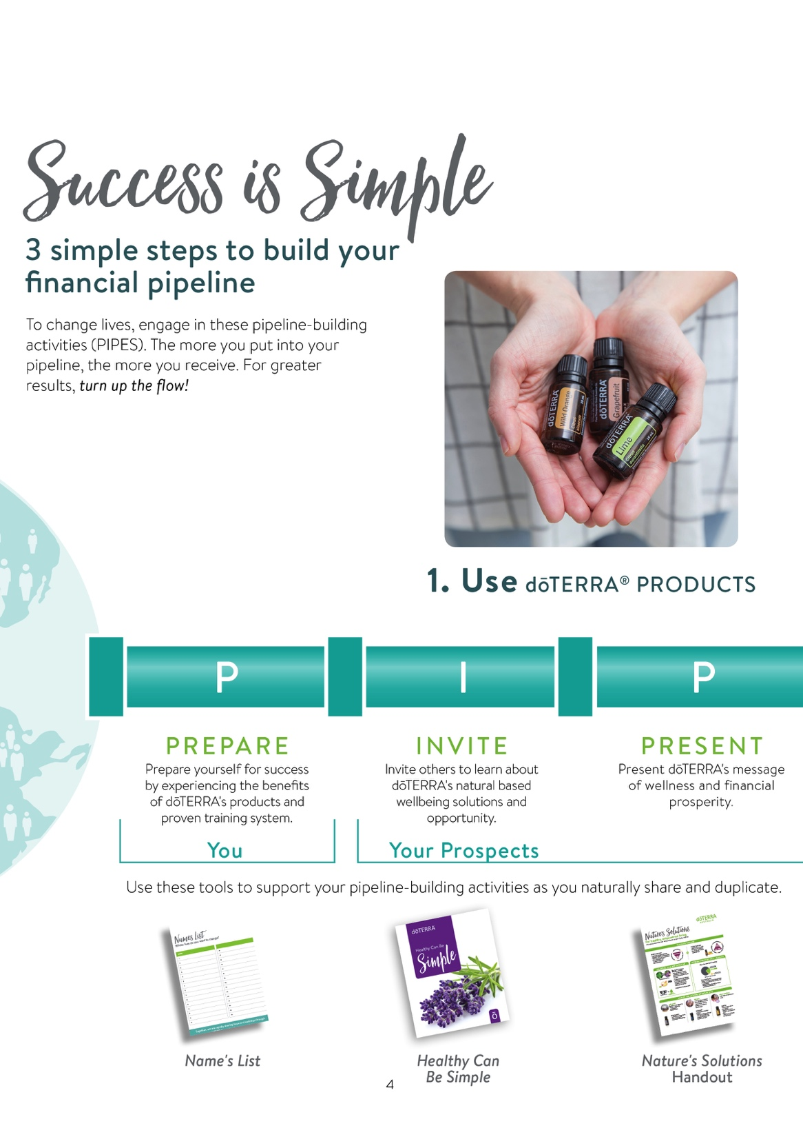
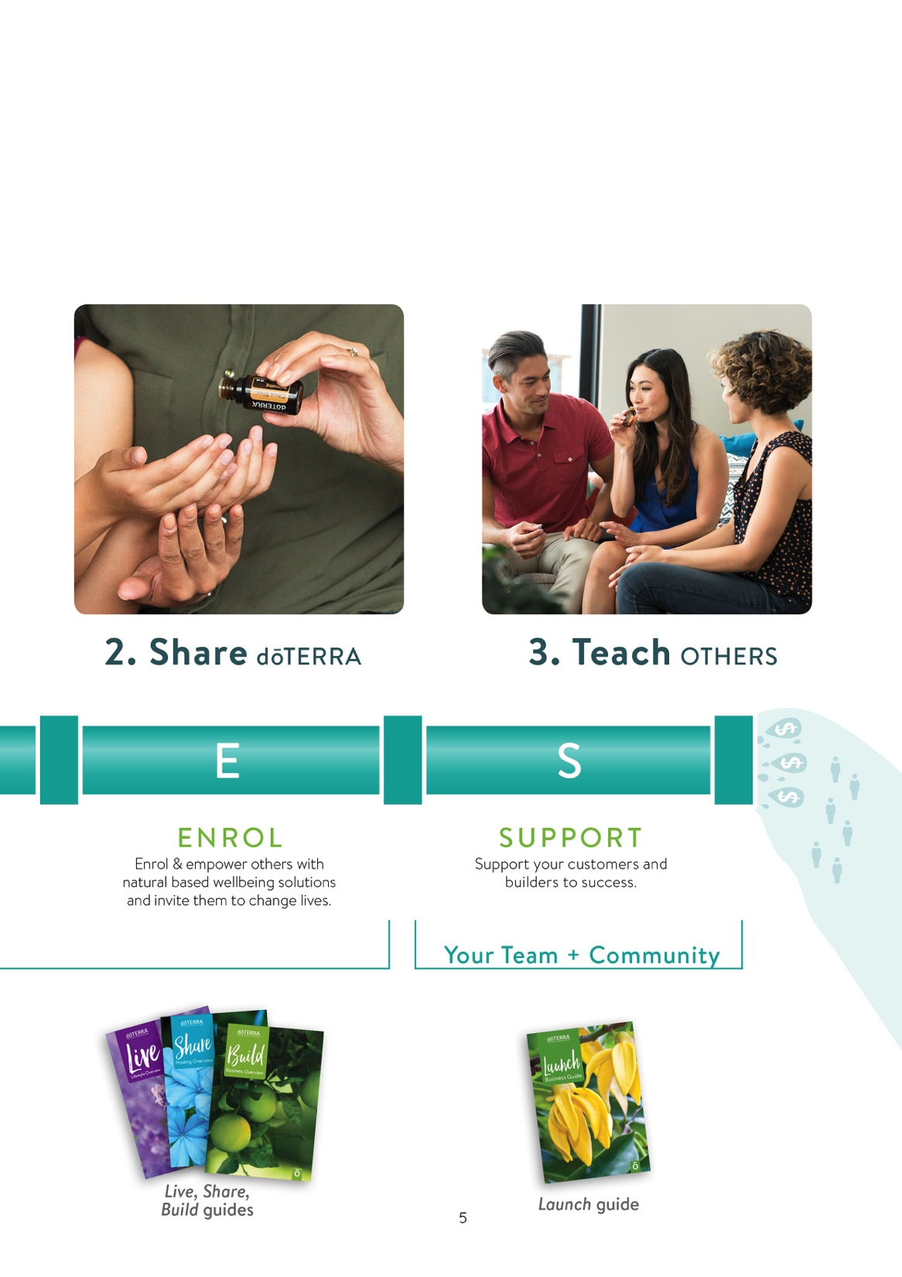
Notes:
The Build guide lays out a plan for you to build your business.
We call the activities necessary to build your business “PIPES Activities”
The first is “Prepare” – prepare yourself, prepare your schedule, prepare your product experiences.
The next section is “Invite, Present, and Enroll” – this part is key, this is what you do with your prospects; this is how you changes lives and how you build your business.
The last section is “Support” – follow-up is the section that is most often forgotten. After you enrol those people you have a responsibility to make sure that they have the resources to flourish.
The goal is to keep the people you enroll as lifetime customers, and offering consistent support is how you do that. When you support your customers and they stay with you, they can truly contribute to your residual income for years to come.
(Switch slide)

Slide 10
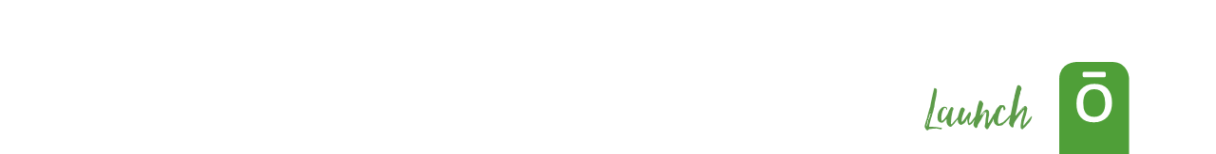
Notes:
So how do we enroll people?
The first thing we have to do is be our own best customer. Use the products, make sure that you have a commitment to the products themselves.
Second, you have to share the products.
And third, you have to teach others. Teach them about the products and the change the products can make in their lives.
It’s that simple. You follow these three steps and then you repeat. Use, share, teach, and repeat.
(Switch slide)

Slide 11

Notes:
When we share oils there is one key thing that we want to look for. We want to make sure whoever we shared with leaves the encounter thinking “I can do that!”
I have the same goal for all of you today. I want to make sure that after we finish today you are able to walk out of here thinking “I can do that!”
(Switch slide)

Slide 12

Notes:
So I showed you a slide of a few guides as well as a couple sections out of the Build guide. Together, all of the guides we have for you to build your business are called the Empowered Success program.
(Explain how you have used the Empowered Success program and why it’s been beneficial and effective.)
(Switch slide)

Slide 13
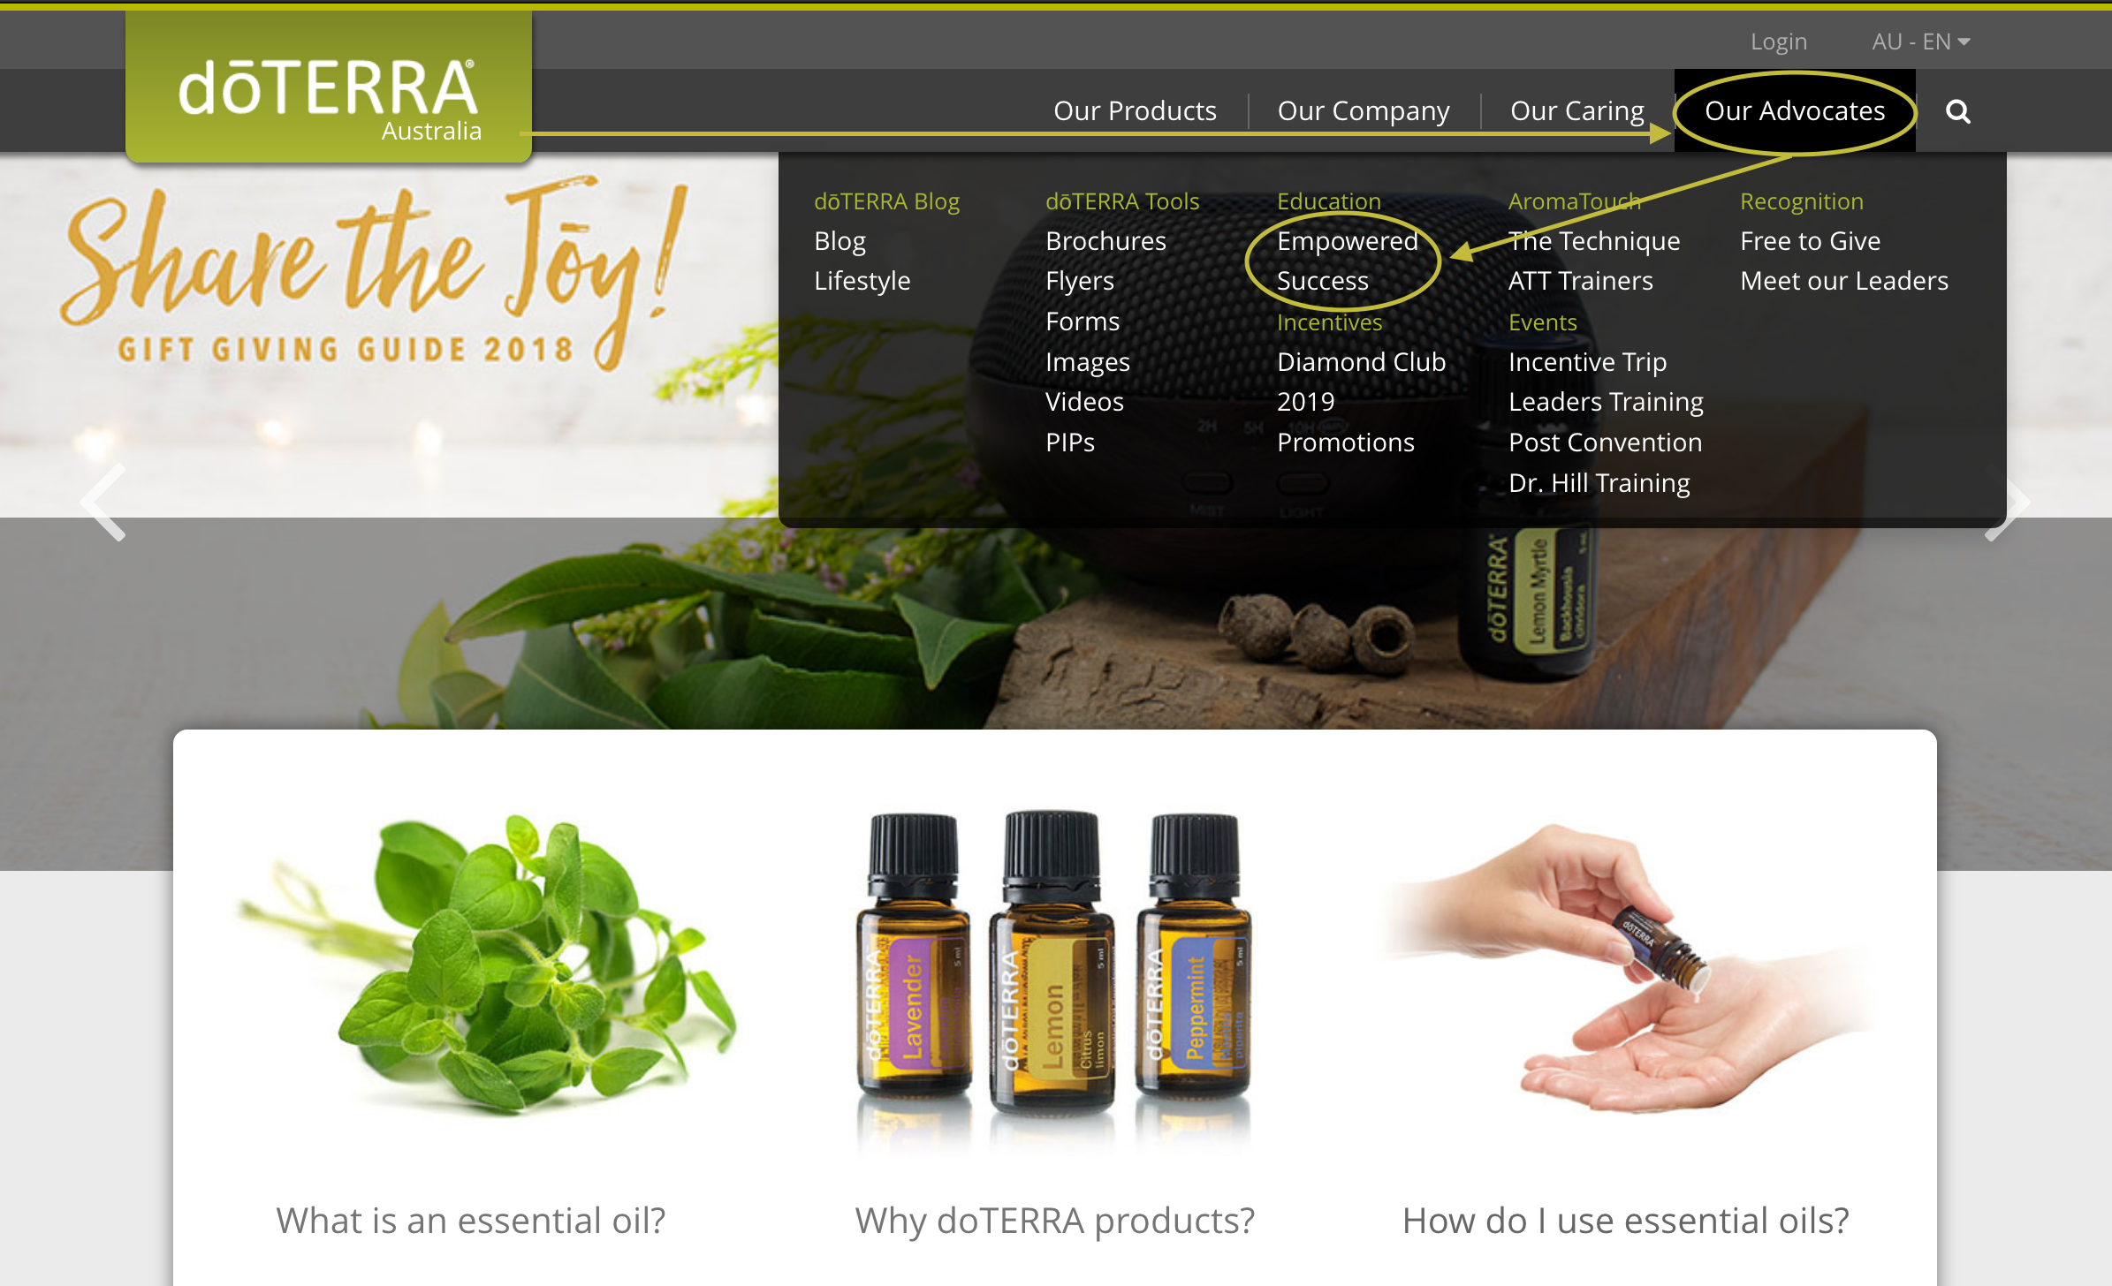
Notes:
All of the materials we have through Empowered Success are available as free digital copies on doterra.com under “Advocates” and “Empowered Success.”
(Switch slide)

Slide 14

Notes:
From this page you can access all of the materials. You can download them or purchase a print copy if you’d like.
(Switch slide)

Slide 15

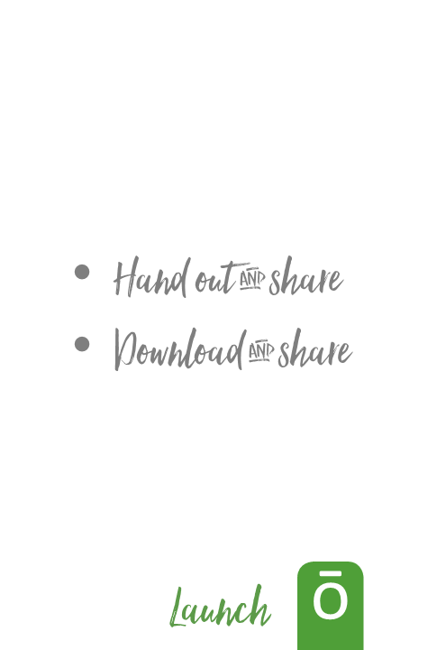
Notes:
These guides have been priced affordably because dōTERRA wants them used and wants them shared. You can buy them in packs of 10 and the Empower Kit has 30 Nature’s Solutions.
Share them with the people you meet, whether electronically or physically to make their conversation with you a tangible experience where they have something to take away at the end.
(Switch slide)

Slide 16
Notes:
Each of the guides are a part of your staff and has a specific job responsibility. “Hire” them to help you build your pipeline.
(Switch slide)

Slide 17

Nature’s Solutions
Notes:
We’re going to go through each guide briefly and talk about the job that it’s been hired to do.
(Go through the guides on this slide and read their job titles.)
(Switch slide)

Slide 18


Notes:
So in the Build guide we’ve reached the last couple of pages.
As a builder you want to make sure that you’ve had the experiences listed here, that you’ve seen a Natural Solutions presentation and that you’ve had a Lifestyle Overview.
We want to make sure that you’ve learned how to share with others. That you know how to build a names list and schedule presentations.
You will need to know this process and experience these aspects so that you’re able to walk your new customers through the same process.
And at the end of the Build guide the Launch guide is introduced because once you’ve learned how to build, you’re ready to launch.
(Switch slide)

Slide 19

Notes:
The purpose and job of the Launch guide is to get you to Elite and with the foundation of Live, Share, and Build you’re ready to launch.
(Switch slide)

Slide 20
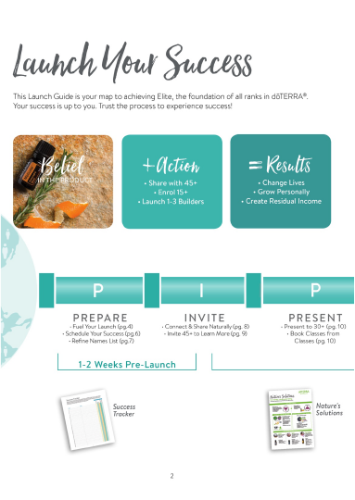
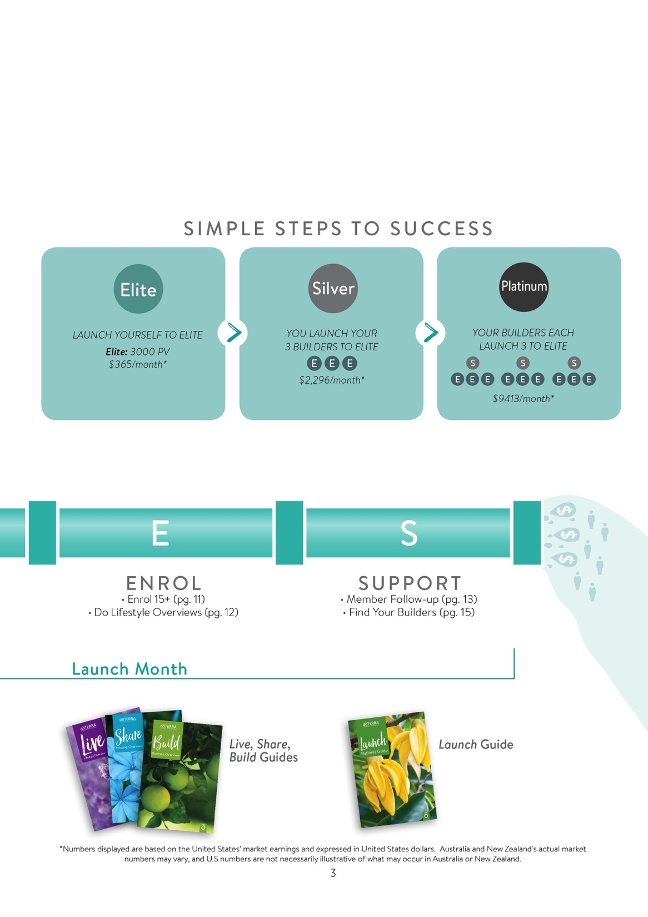
Notes:
On the first two pages of the Launch guide we have the PIPES spread again, which should look pretty familiar to all of you now, but there are a couple things that are different on this one.
Each PIPES spread in the rank guides also serves as the table of contents for the guide. So you can see under each of the PIPES activities the references for the sections that will help you with each task.
(Switch slide)

Slide 21
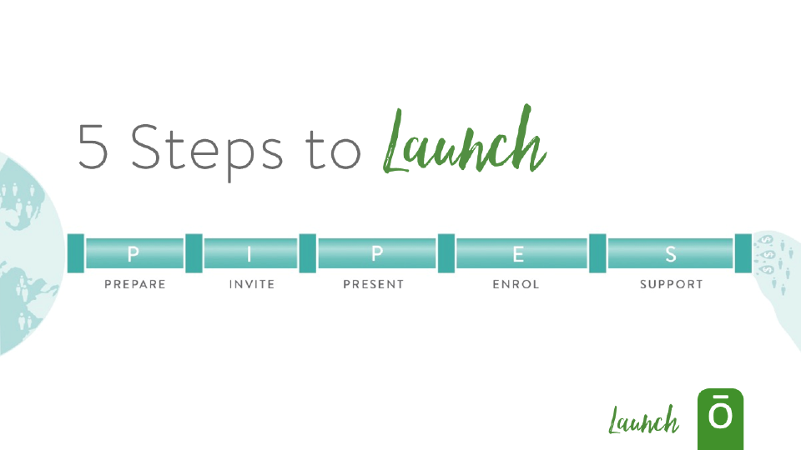
Notes:
The 5 steps of the PIPES process are the same 5 steps that the entire Empowered Success program is built on.
Prepare
Invite
Present
Enrol
Support
No matter what rank you’re working toward, these 5 steps are want you’re going to want to follow.
(Switch slide)

Slide 22

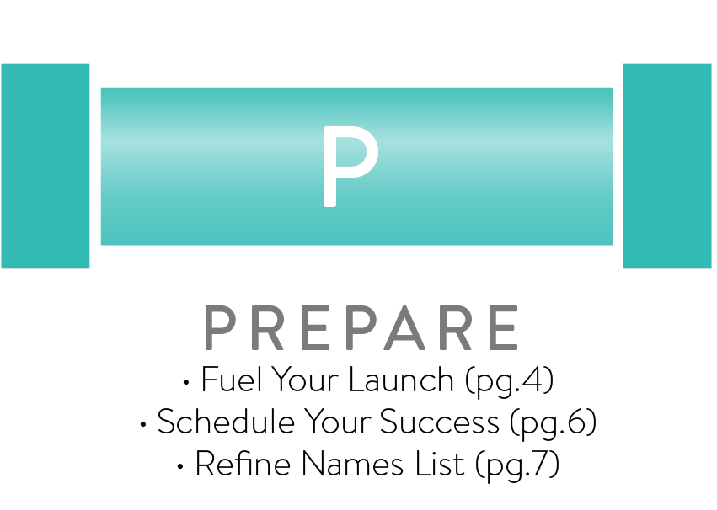
Notes:
The first step is to Prepare – This is where we are going to start talking about what you can do to prepare and ensure that you’re ready to build your business and make your dream come true.
(Switch slide)

Slide 23

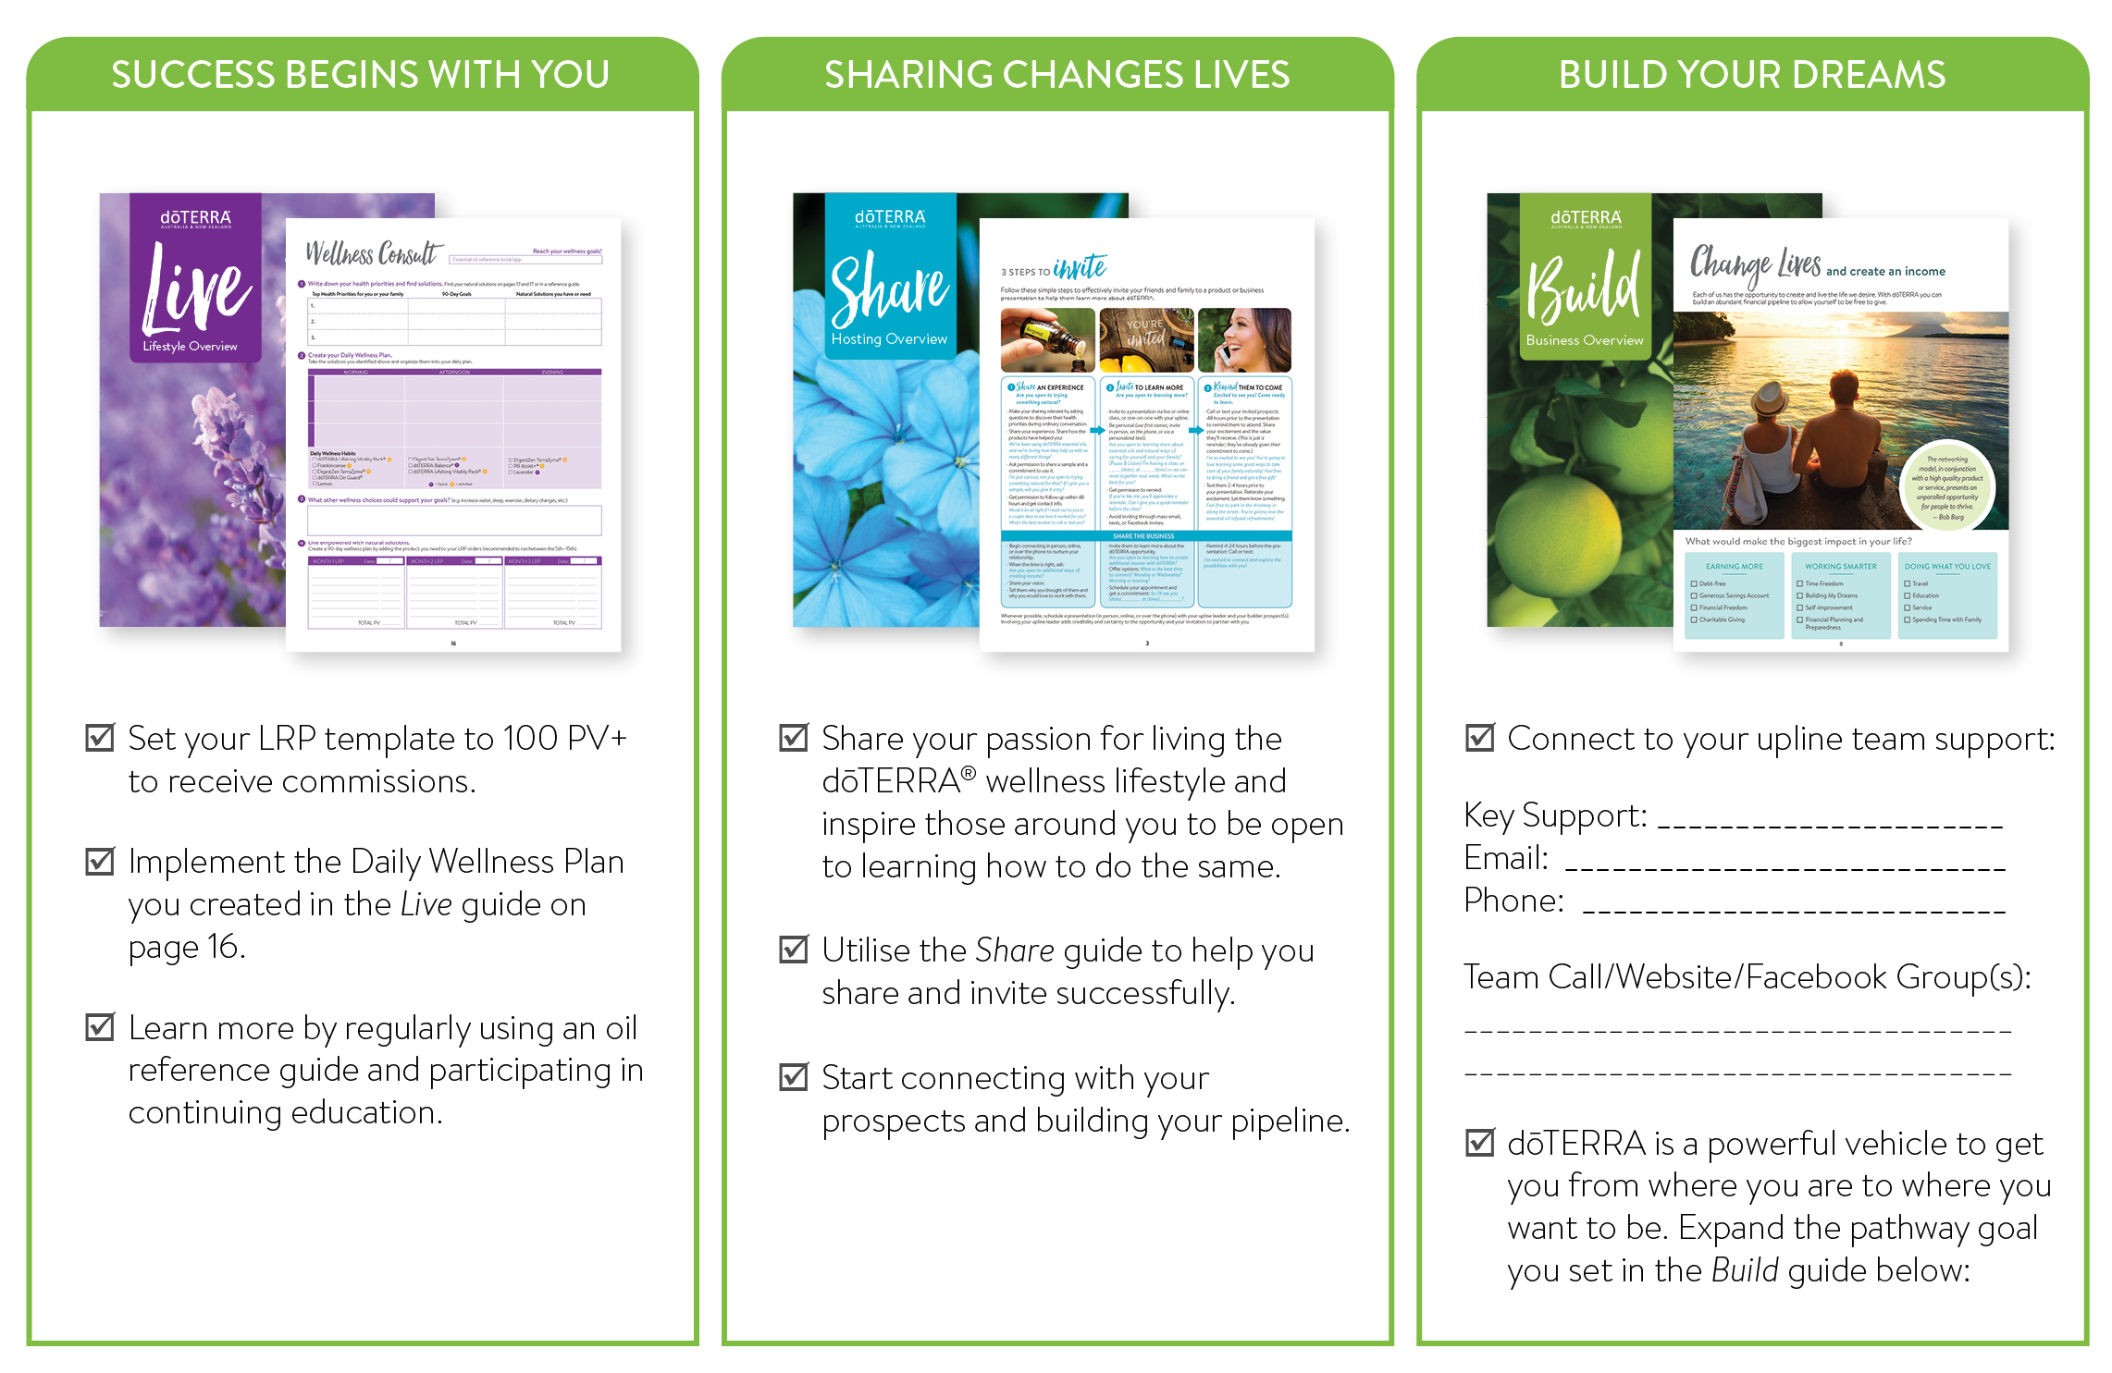
Notes:
This is how you Fuel Your Launch and understanding how to gain momentum is key in building your business.
Pay attention to the three columns on this page, they walk you through the key actions needed for success.
The first is Success Begins With You
Live
Set your LRP template to 100 PV+ to receive commissions
Implement the Daily Wellness Plan you created in the Live guide on page 16
Learn more by regularly using an oil reference guide and participating in continuing education.
(Switch slide)

Slide 24


Notes:
The Live guide walks you, and your new members, through setting up a daily wellness plan.
The Live guide, just like the Launch guide is part of your staff and the job that it does is helping people to enrol in the LRP.
(Switch slide)

Slide 25
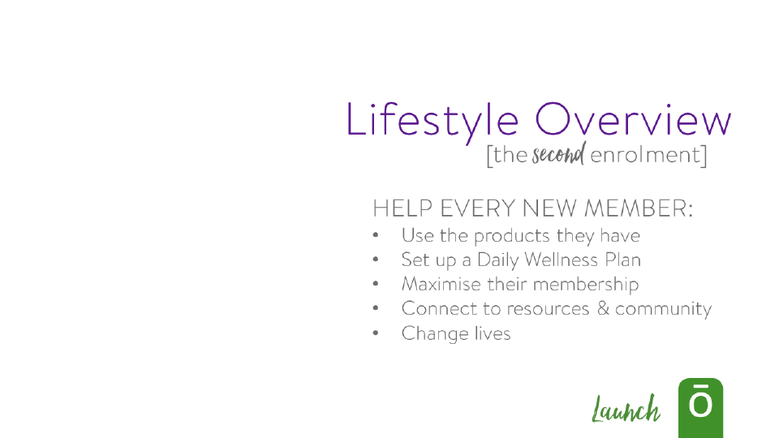

Notes:
We often call the Live guide the second enrolment. This process is a way to keep your retention high and build your residual income.
There are very specific things this guide is meant to help new members do: (read bulleted list) Let the Live guide do these things for you and then pay it forward by letting it do these things for each new member you enrol.
(Switch slide)

Slide 26



Notes:
The Live guide gives a step-by-step introduction to how you can bring dōTERRA products into your everyday life and it does that through the Wellness Pyramid.
(Switch slide)

Slide 27


Notes:
The Wellness Pyramid walks through aspects of wellness and allows your new member to rate themselves and find their areas of need.
Through the Live guide and the Wellness Pyramid you can sit down with a new member and:
Have them rate themselves
Expose them to the dōTERRA lifestyle
Invite them to create their product wish list
If you haven’t been through this process yourself, go through it. And, for those of you that maybe have established teams already, make sure that your team members have gone through the Live guide as well. Make sure they know what is in the guide and how to use it.
(Switch slide)

Slide 28
Notes:
Now let’s move into “Sharing Changes Lives”
Share
1. Share your passion
2. Use the Share guide
3. Connect with prospects
(Switch slide)

Slide 29


Notes:
The job of the Share guide is to commit someone to host a class, whether that’s yourself or someone you’ve enroled.
(Switch slide)

Slide 30


Notes:
We call the Share guide the soft launch guide. It’s going to help you make sure you’re committed to, and capable of, sharing. It will do the same for potential builders you’ve enroled.
(Switch slide)

Slide 31

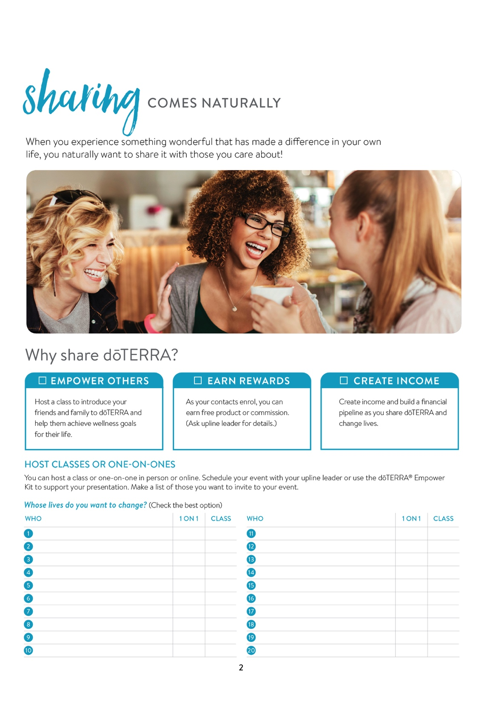

Notes:
Sharing should be easy and what makes it easy is that you’re sharing something you love with those you love.
dōTERRA has an incredible product that has the power to change lives and when we explain the power to others and how it’s made an impact in our life they will naturally want those same benefits.
The Share guide keeps sharing really simple and helps you organise the people that you want to try and schedule a one-on-one or a class with.
(Switch slide)

Slide 32

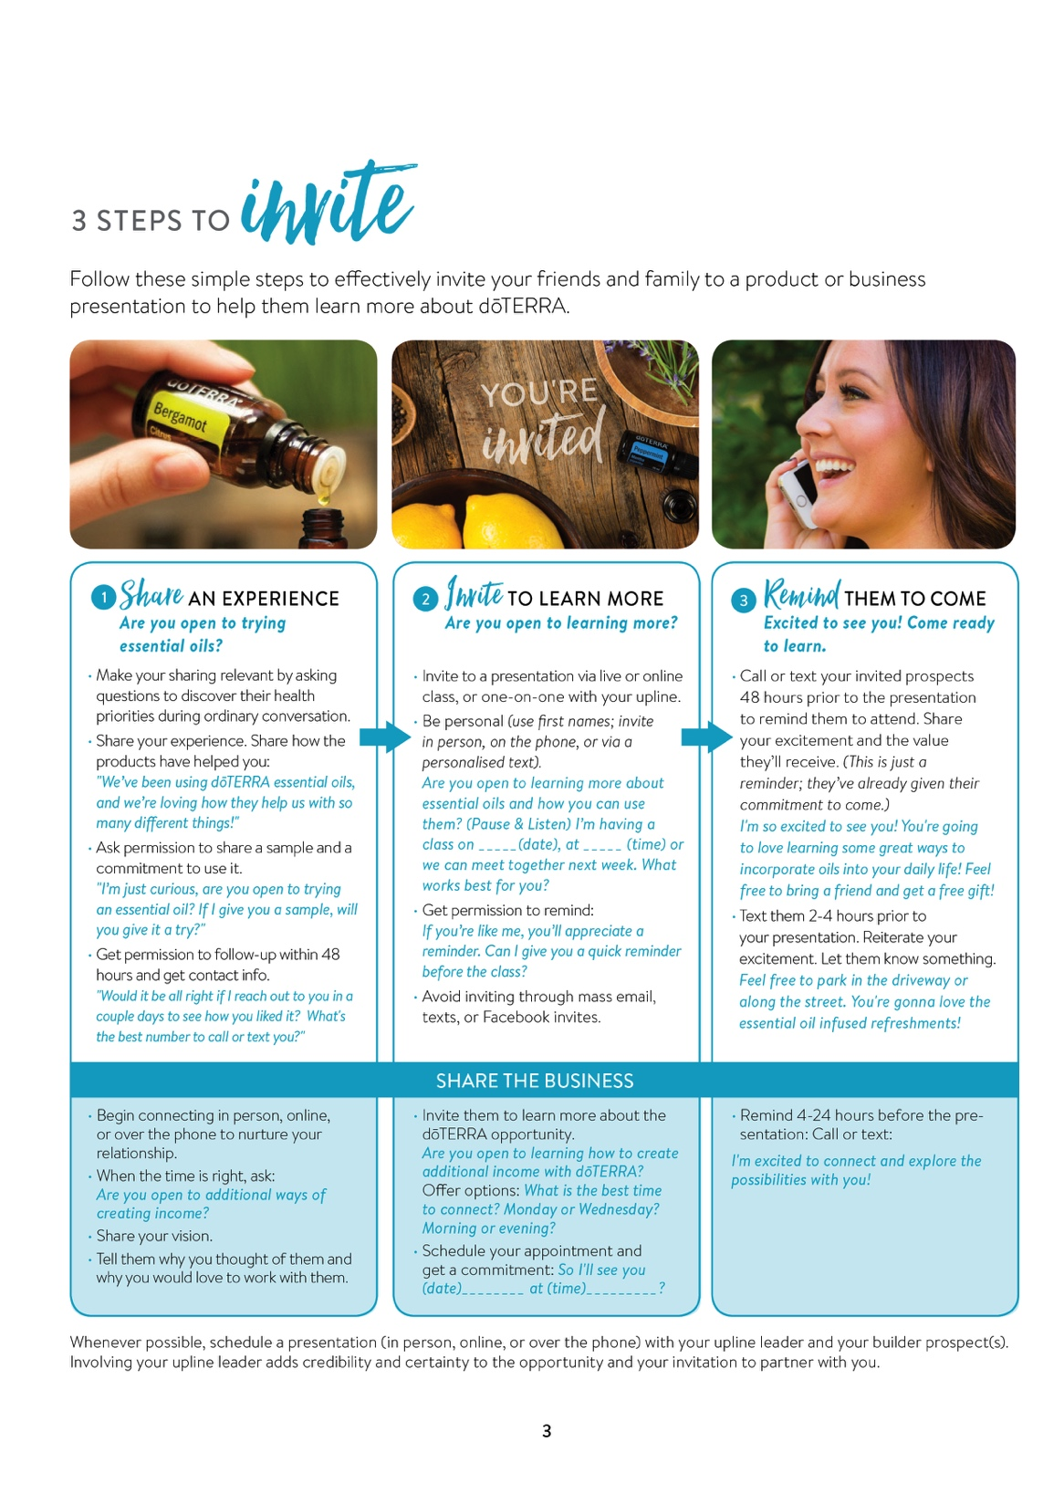
Notes:
The Share guide breaks down inviting people to learn about dōTERRA into three easy steps.
Share
Invite
Remind
It’s understandable that you might feel nervous about sharing at first. That’s why, on page 3 of the Share guide, you’ll see sample scripts for each of the three steps. You can personalise these scripts or you can use them word for word if you need to.
(Switch slide)

Slide 33

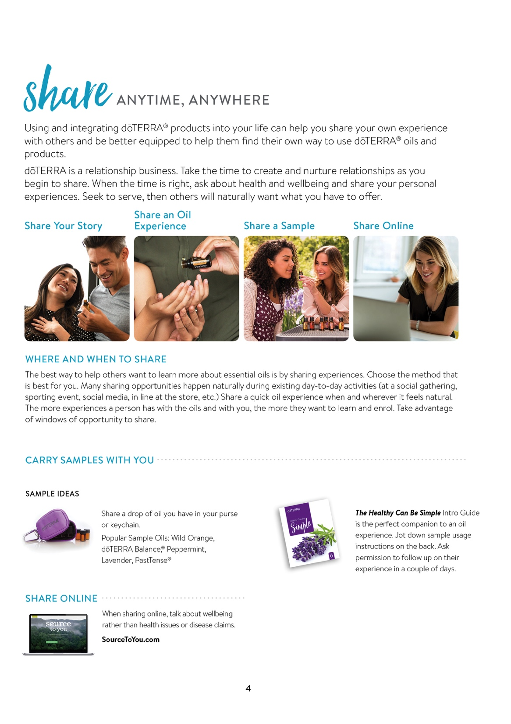
Notes:
One of the best ways to share is to listen for opportunities every day. People you interact with often share difficulties or challenges they are having in their lives and you have products that can help them with their challenges.
If you’re prepared, and if you have made connections and built trust with those around you, you can use those opportunities to share your experiences as well as share products that you have with you. That way they can see how the products can help them with the challenges they have.
The greatest skills that you can master in this business are inviting and sharing and dōTERRA has come up with some tools to help you.
(Switch slide)

Slide 34

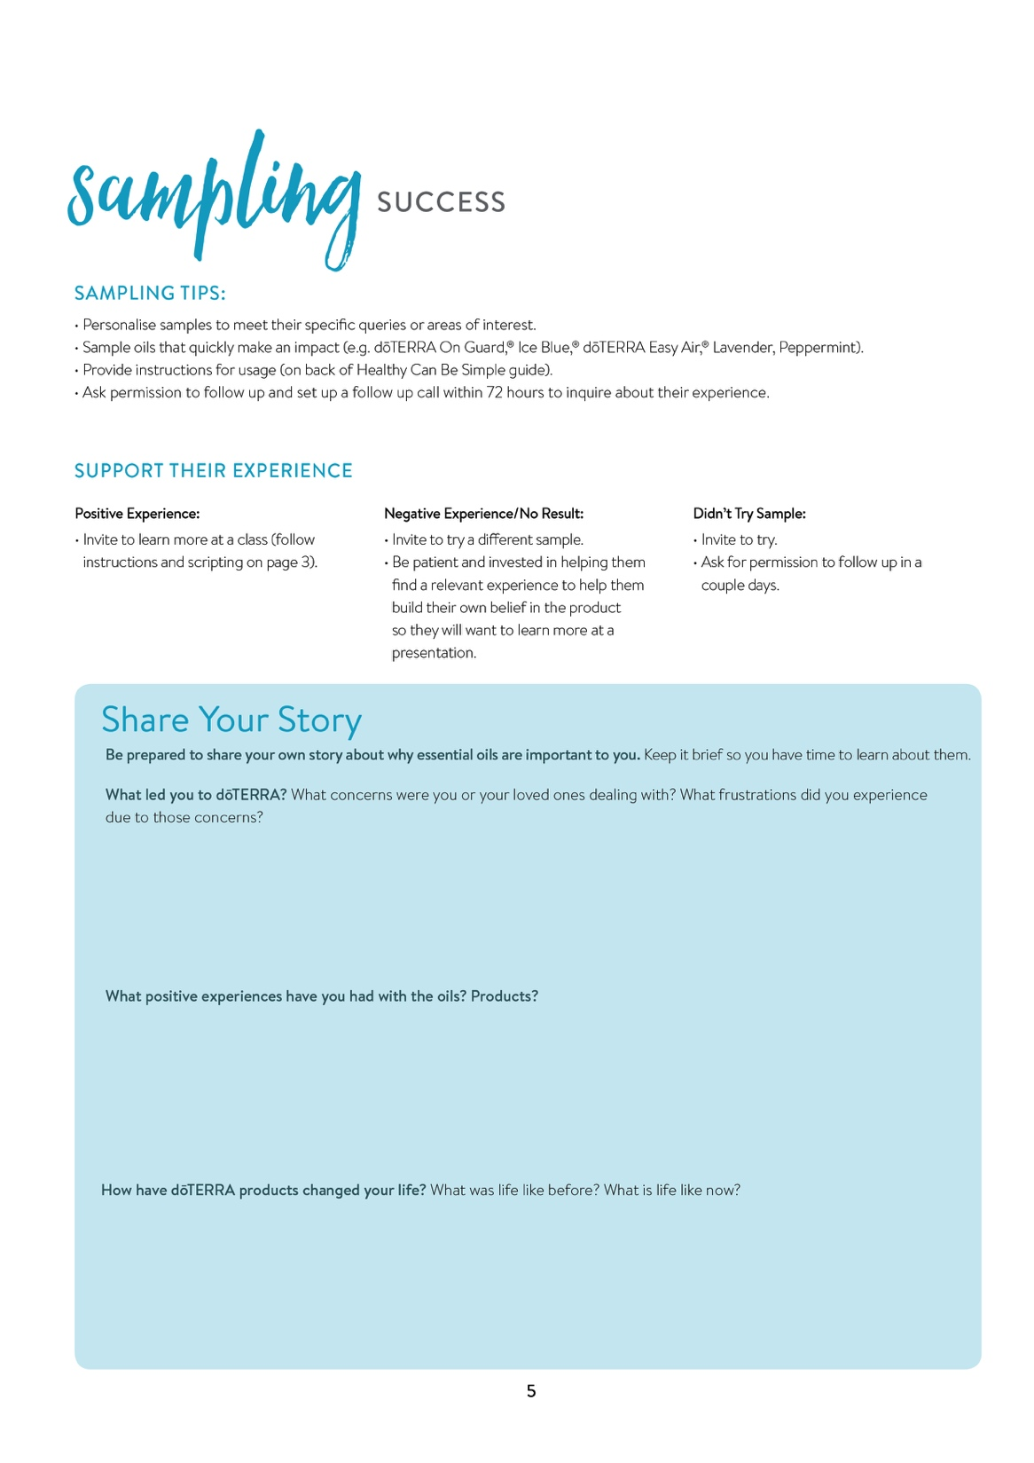

Notes:
One of the most important parts of sharing is sharing YOUR story. This is what has power. Telling about your breakthroughs, and the effect dōTERRA products have had on your life can make the biggest impact.
(Switch slide)

Slide 35
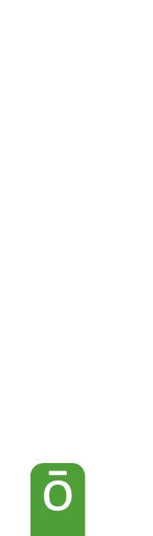
Notes:
This page in the Share guide walks you through how to shape your story by having you answer a few simple questions.
We’re going to take this opportunity to have each of you shape your own story.
Take 6 minutes and write out your story. This is your moment to do it.
When you are done, you should be able to tell this story in 1 minute.
Answer these questions.
(Give everyone six minutes)
(Switch slide)

Slide 36
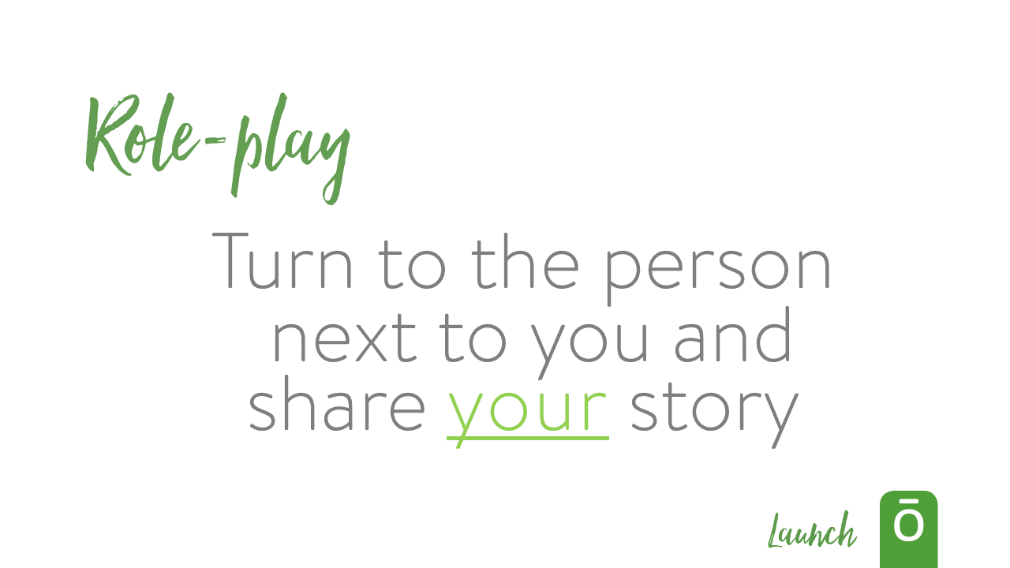
Notes:
Now that you have your story, pair off with a new person, not the same one you shared with earlier, and share your story.
Remember, this should only take 1 minute.
Now the person telling it is going to talk. The person listening cannot talk during the story. I know that you will want to jump in and say you agree, but do not. This is the storyteller’s opportunity to vocalize their story. Let them. I promise, you will get your chance to talk.
You have 60 seconds and then we will switch. This time, I want the person wearing the darkest color shoes to start.
Go!
(Wait 60 seconds)…. Now Switch!
(Wait 60 seconds)
How was that?
(Switch slide)

Slide 37

Notes:
Who would love to share their story with the group?
(Switch slide)

Slide 38

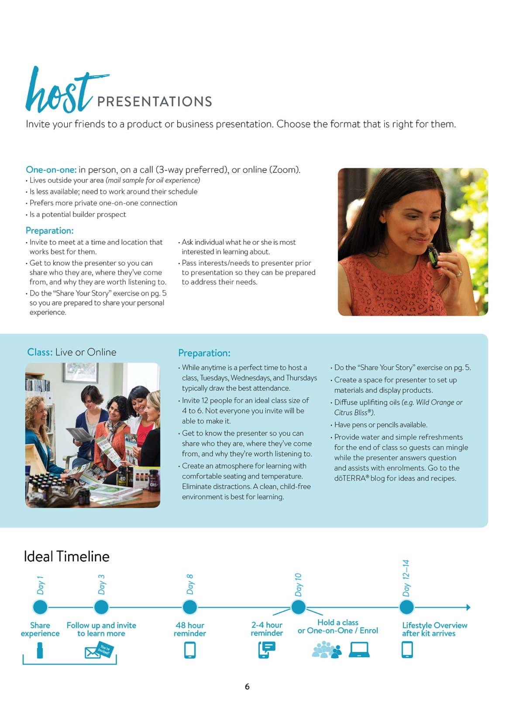
Notes:
So what is your part? Maybe your part right now is not to present the whole class but to introduce the presenter and share your personal story for the class or the person you’re meeting with. This page walks you through how to prepare for the class or the one-on-one and down at the bottom gives you a timeline of when to share experiences, invite, and follow-up with those you invite.
(Switch slide)

Slide 39


Notes:
When you’re hosting presentations, some of them might be product presentations and some might be business presentations. This page walks you through your part is in each type of presentation, how to invite to enrol, and how to follow-up for each type of enrolment.
(Switch slide)

Slide 40

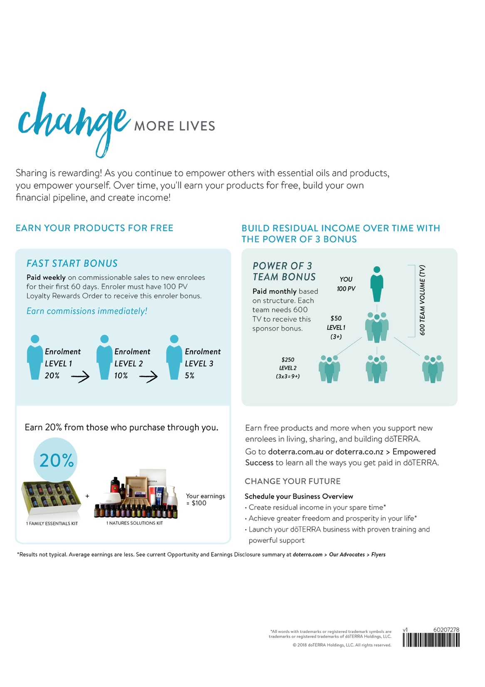
Notes:
The final page of the Share guide invites you to change more lives and provides a simple walkthrough of how the compensation plan works.
(Switch slide)

Slide 41
Notes:
Now that we’ve gone into these first two steps and built a foundation, the next step is to Build Your Dreams.
What are some steps that you can take in order to make sure that you are building your dreams?
ANSWERS:
Connect to your upline team support
Name
Email
Phone
Attend Team Calls and connect to Facebook Groups
Get the Build guide
(Switch slide)

Slide 42

Notes:
Now that we are ready to Fuel Your Launch, let’s take a moment and set a goal. What is your goal to reach Elite?
If you are an Elite, how about the next Rank that you need to obtain? How much money do you want to make at the end of 90 days? How about in one year?
Take a minute and think about this. Write down your goals.
(Give everyone a minute to write their goals)
(Switch slide)

Slide 43
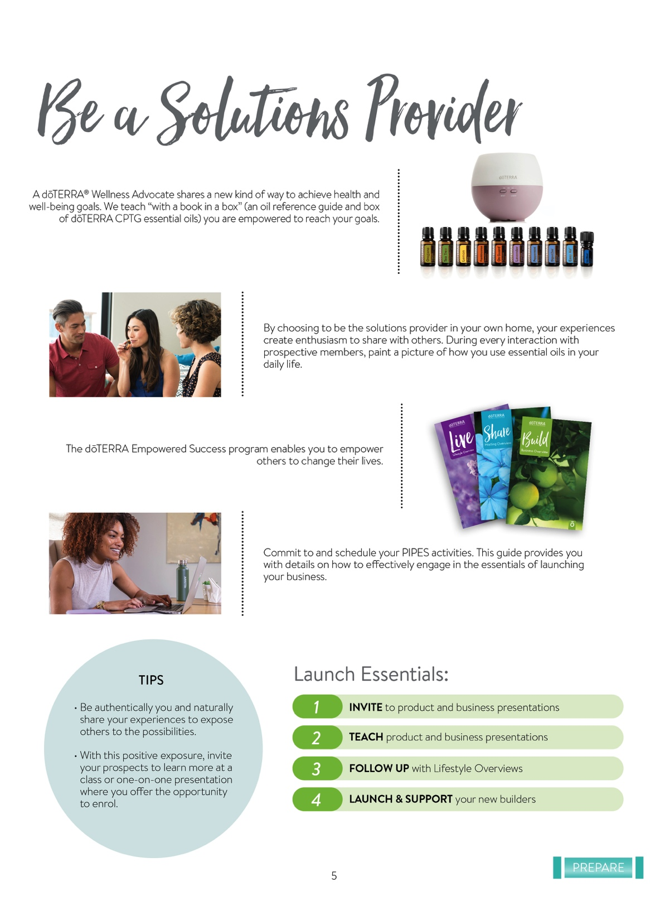
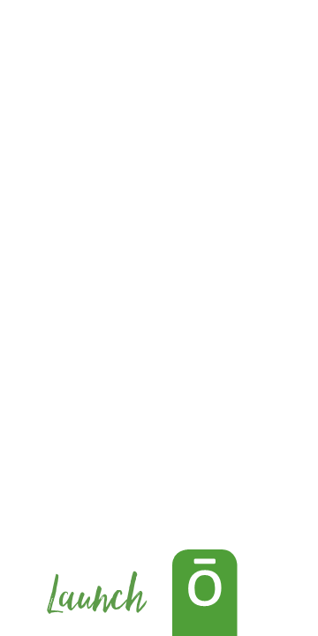
Notes:
Now as a dōTERRA Wellness Advocate, each of you is a solutions provider. Your job is to teach and to educate those you come in contact with and provide them with solutions to the challenges they’re facing.
(Switch slide)

Slide 44
Notes:
A doTERRA Wellness Advocate shares a new kind of healthcare. We teach “with a book and a box” (an oil reference guide and box of doTERRA CPTG© essential oils), that you are prepared to address about 80 percent of your health priorities at home.
(Switch slide)

Slide 45
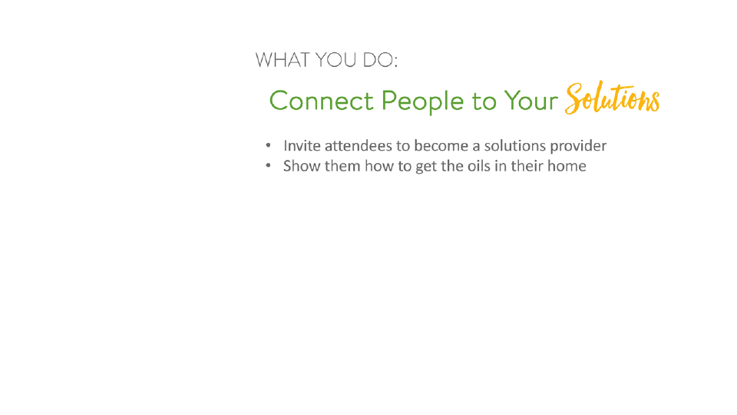

Notes:
By choosing to be the solutions provider in your own home, your experiences create enthusiasm to share with others. During every interaction with prospective members, paint a picture of self-directed wellness. They can feel empowered knowing that if they get these oils they can use them in so many aspects of their lives.
(Switch slide)

Slide 46
Notes:
The Empowered Success program enables you to become that solutions provider. Commit to, and schedule, your PIPES activities. This guide provides you with details on how to effectively engage in the essentials of launching your business.
(Switch slide)

Slide 47
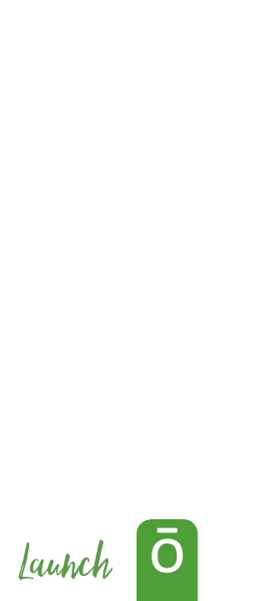
Notes:
A couple of tips for connecting authentically.
1. Be authentically you and naturally share your experiences to expose others to the possibilities.
2. With this positive exposure, invite your prospects to learn more at a class or one-one-one presentation where you offer the opportunity to enrol.
(Switch slide)

Slide 48
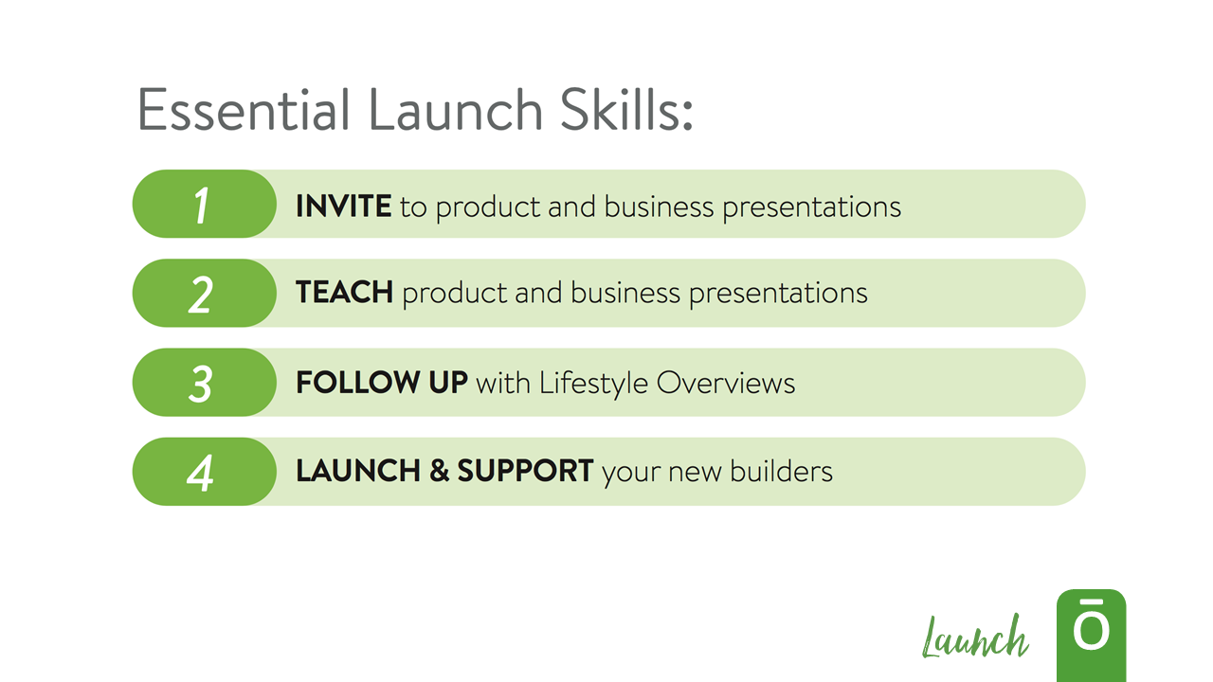
Notes:
There are four essential skills to help you launch.
(go over skills listed)
(Switch slide)

Slide 49
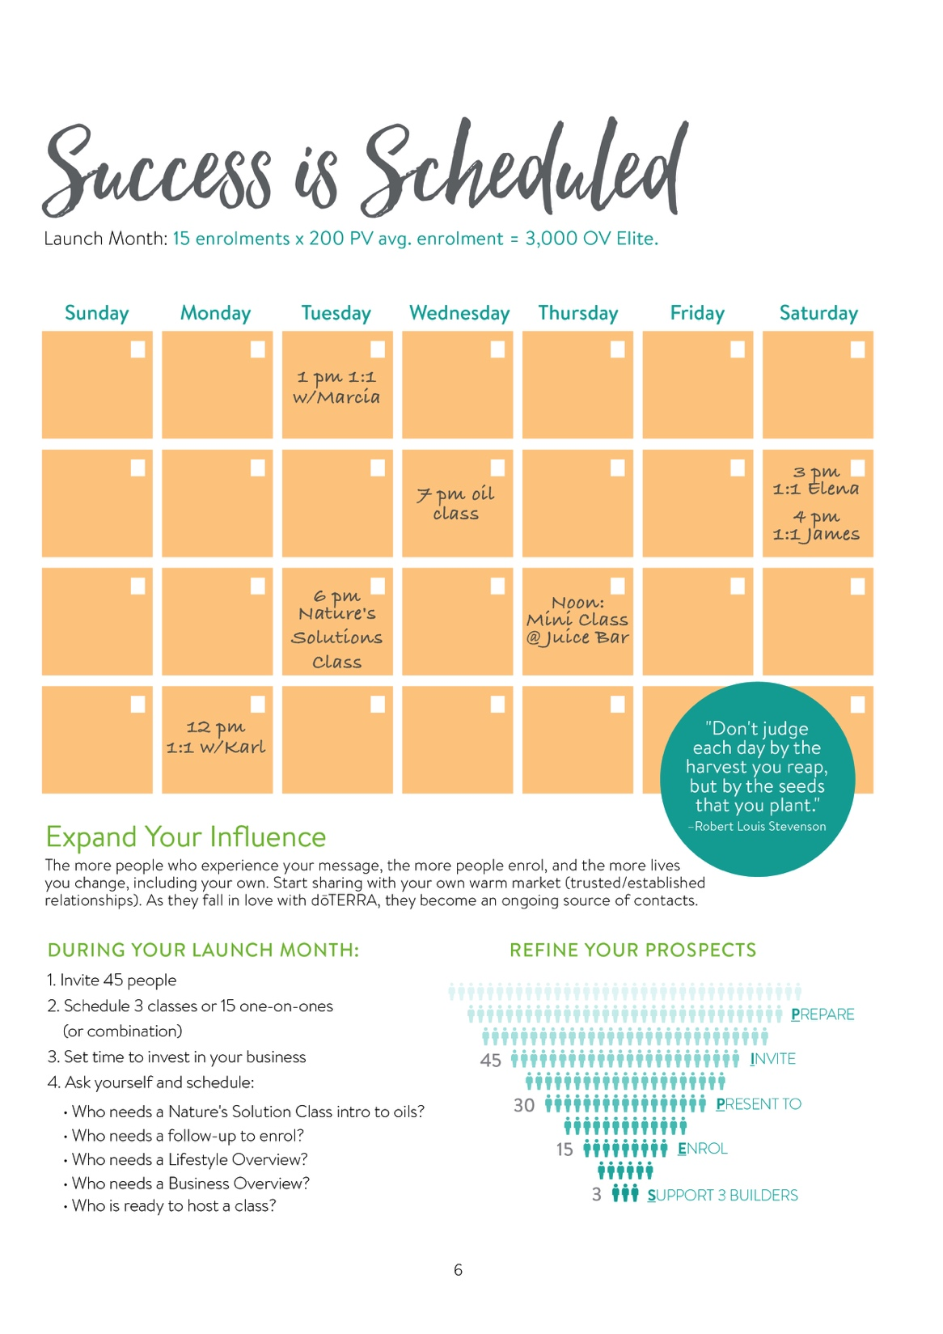
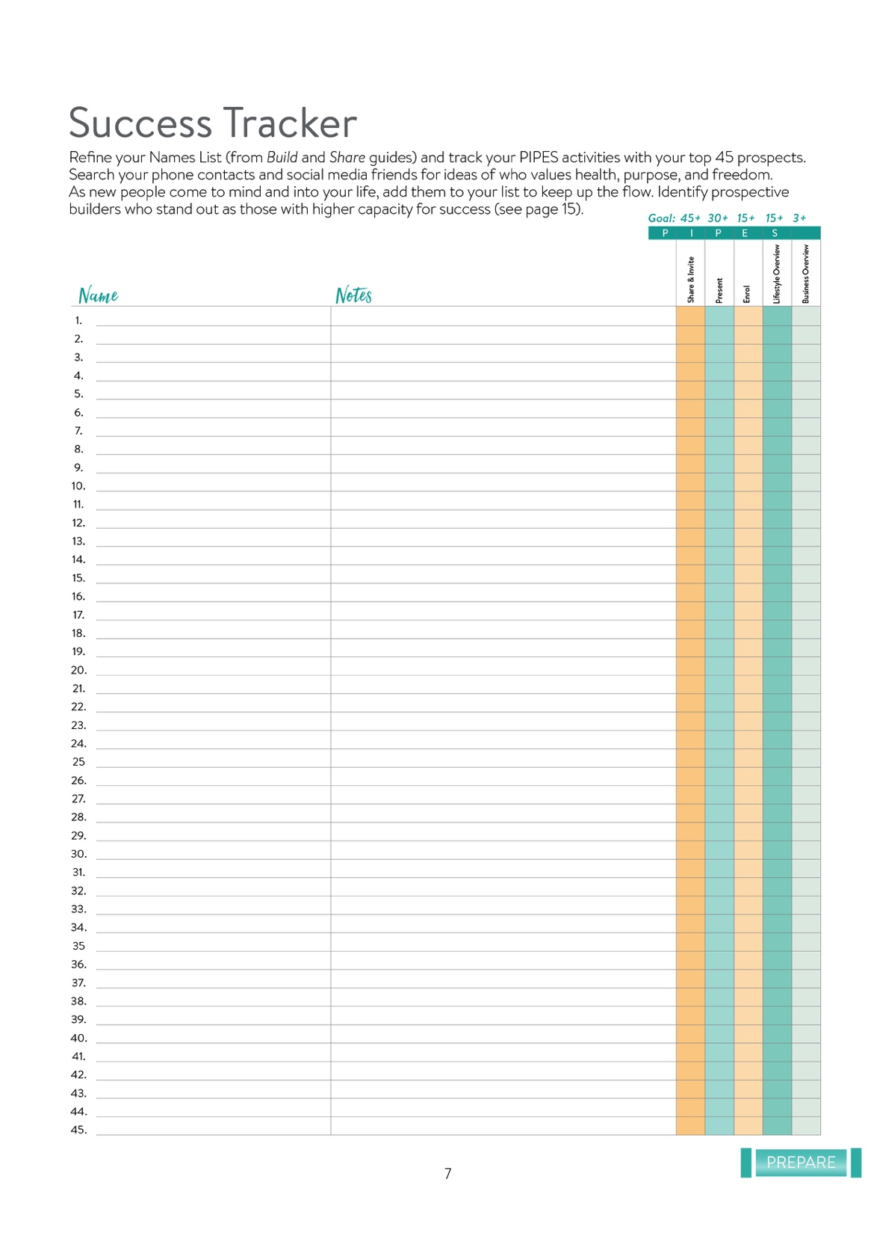
Notes:
Next we’re going to look into scheduling your time and how it can set you up for success.
(Switch slide)

Slide 50
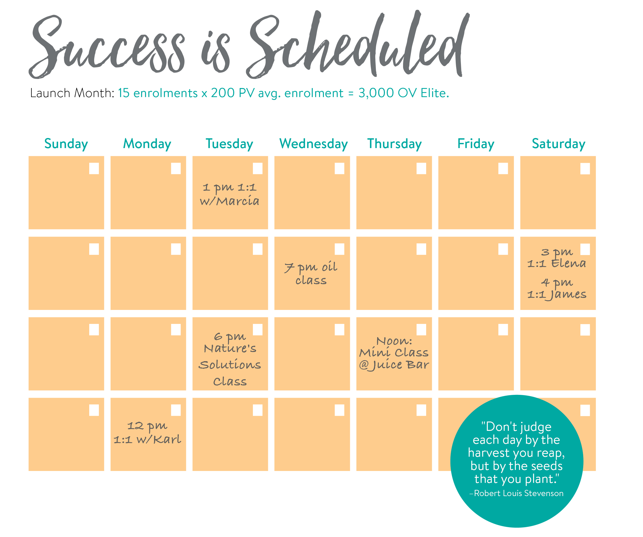
Notes:
Quote: “Don’t judge each day by the harvest you reap, but by that seeds that you plant.” – Robert Louis Stevenson
We need to make sure that we understand that Success is Scheduled.
When scheduling, keep your 30 day goal in mind as well as anything that might get in the way of meeting that goal – holidays, vacation, etc.
So let’s talk about how you can schedule success into your calendar each day that you are planning on building this business. What ideas do you have?
(Give time for feedback and comments)
(Switch slide)

Slide 51
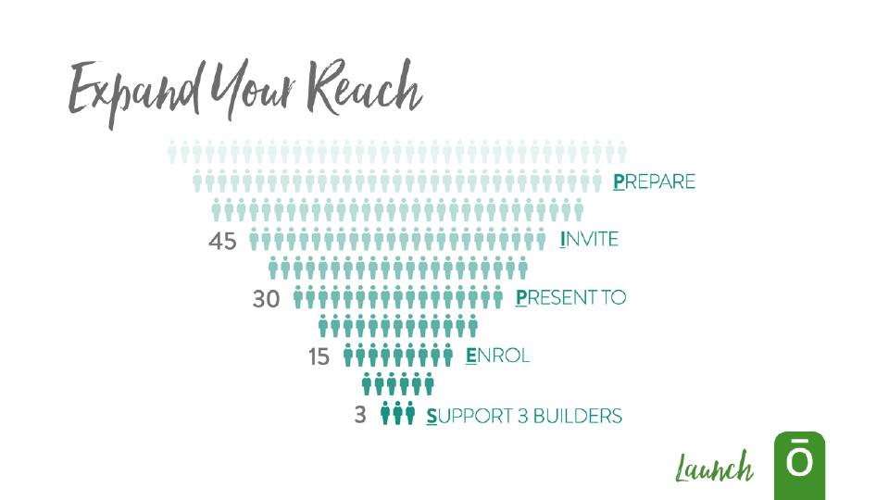
Notes:
As more people experience your message, more people will enrol, and you will change more lives.
Start sharing with your own warm market of trusted and established relationships. As they fall in love with dōTERRA, they naturally become an ongoing source of contacts.
(Switch slide)

Slide 52
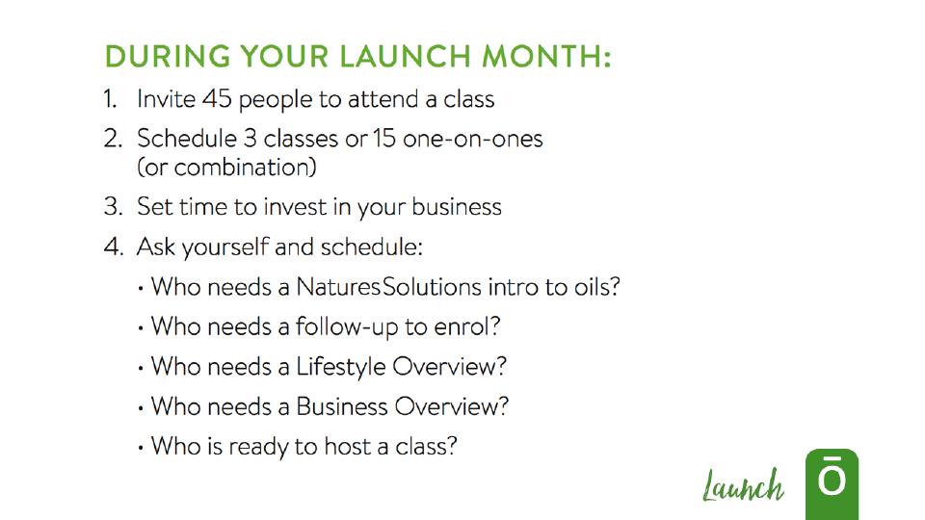
Notes:
This month, you need to commit to do these three things.
If you do these three things, Success will happen.
So focus on these three things in your first month.
Invite 45 People
Schedule 3 classes or 15 one-on-ones
Set time to invest in your business
Is there anything else you think that you can do to be successful during your launch month?
(Wait for responses)
(Switch slide)

Slide 53
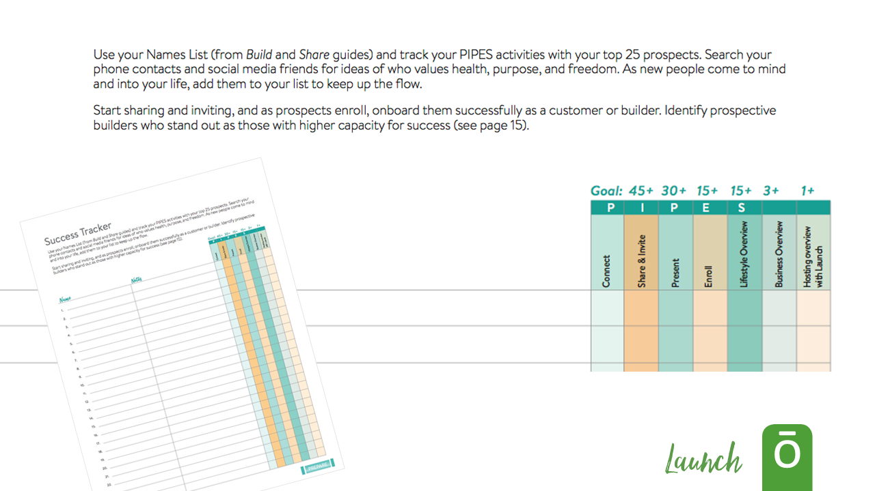
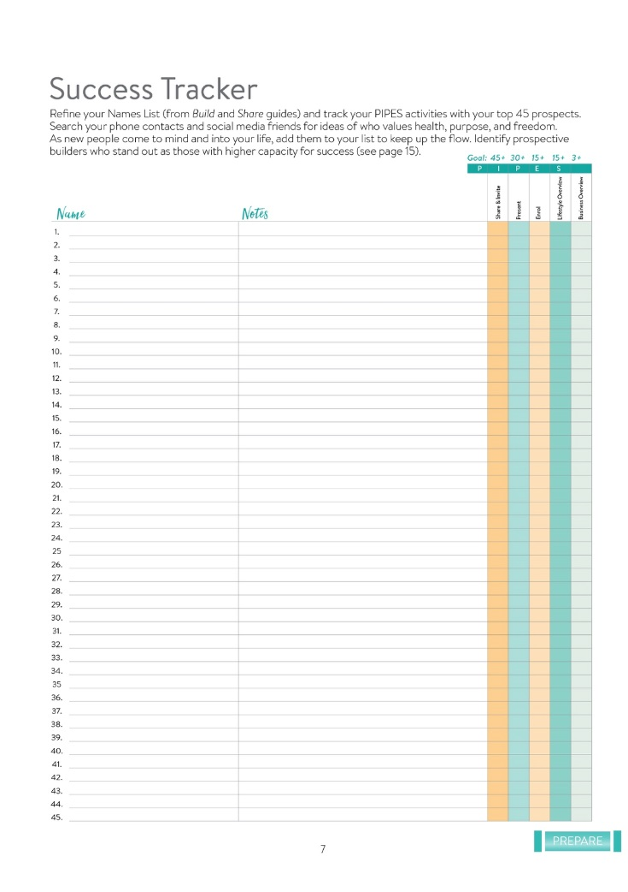
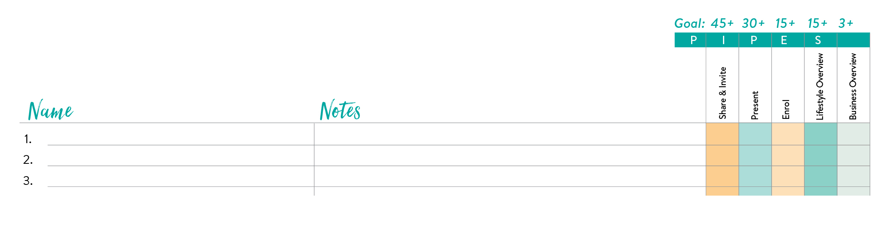
Notes:
You want to Refine Your Prospects so we are going to do that next. (You can explain how to filter your list down as shown in the image.)
(Switch slide)

Slide 54
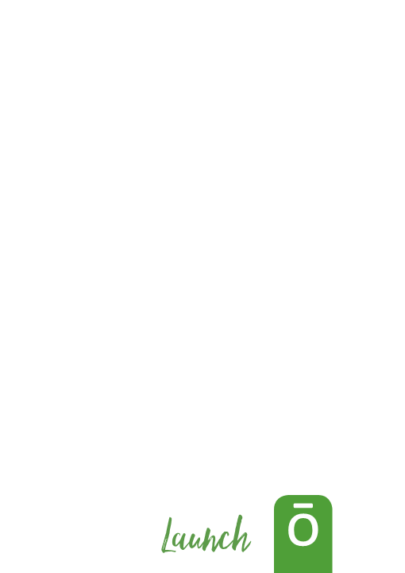
Notes:
Let’s refine your list from the Build and Share guides and track your PIPES activities with your top 25 prospects. This is the first and only time I am going to tell you to take out your phones and search for contacts, social media friends and ideas for people you know who values health, purpose, and freedom.
As new people come to mind and into your life, add them to your list to keep up the flow. Identify builders who stand out as those with higher capacity for success.
We are going to take 6 minutes for you to sit there and think about these people. Right them down.
Remember, today is your moment to Launch this business. Do not be shy. In fact, I just remembered that I met a great person, (Fill in someone that you as the presenter wants to share with in the next week.)
So don’t wait, get started right now.
Ready, Go! (Wait 6 minutes and play music with no words.)
Ok, I want to know how many of you were able to put down more than 10 names? More than 15? More than 20? How about all 25? That is incredible! Now I know that you are ready to go.
So that is the first step - Prepare. Now we are going to move on to the next step in the PIPES process.
(Switch slide)

Slide 55

Notes:
The second step in the PIPS process is, Invite – This is where we are going to start talking about specific action steps that you can take to fulfill the vision that you have written down.
(Switch slide)

Slide 56
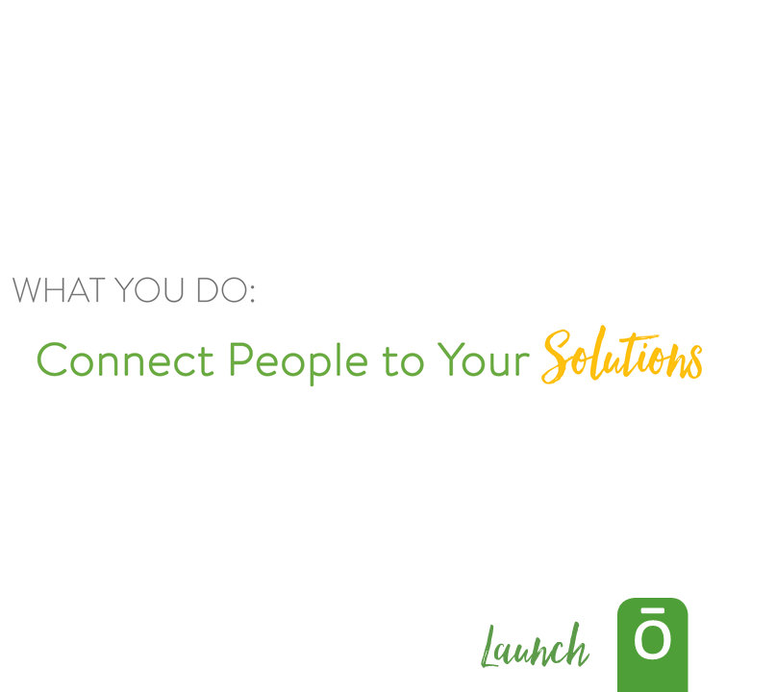
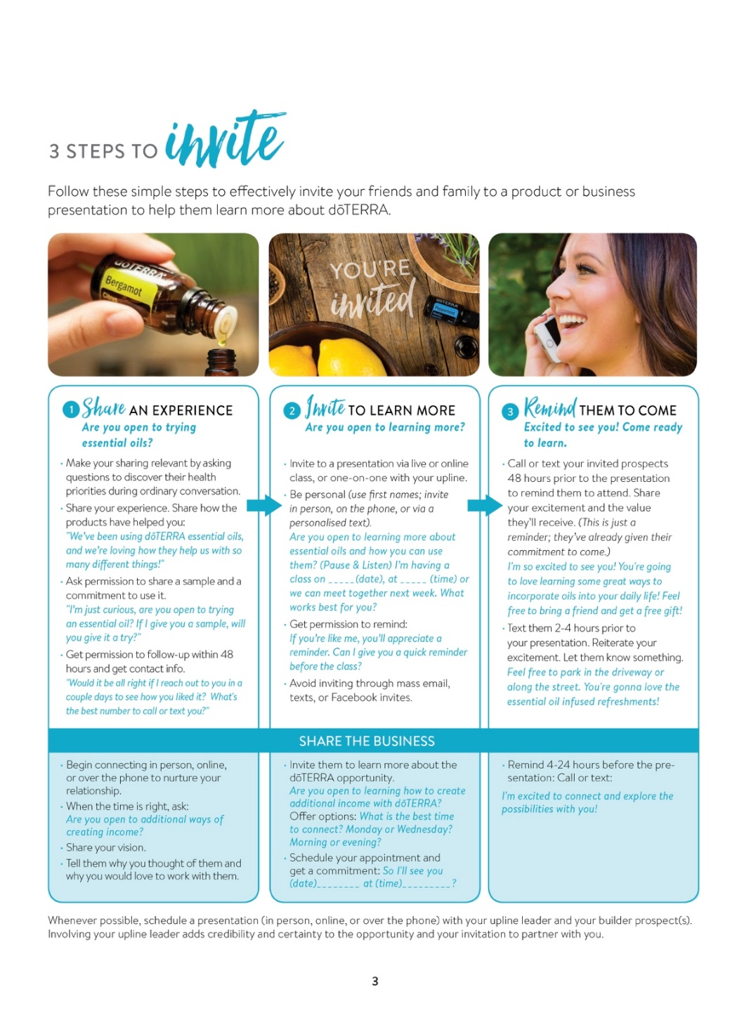

Notes:
Let’s go back to something that we already learned today. We learned what we do and what we do is provide solutions.
We don’t just have health solutions but we can share the prospect with the individuals we talk to that they can become their own solutions provider and they don’t just have to rely on us.
(Switch slide)

Slide 57

Notes:
dōTERRA® is a relationship business. Anchor your attitude in the belief that caring is the most important gift you give everyone you connect with. Whether with an existing relationship or someone new, build trust in every interaction. Seek to change lives by sharing what you love, no matter where you are or who you are with.
(Switch slide)

Slide 58
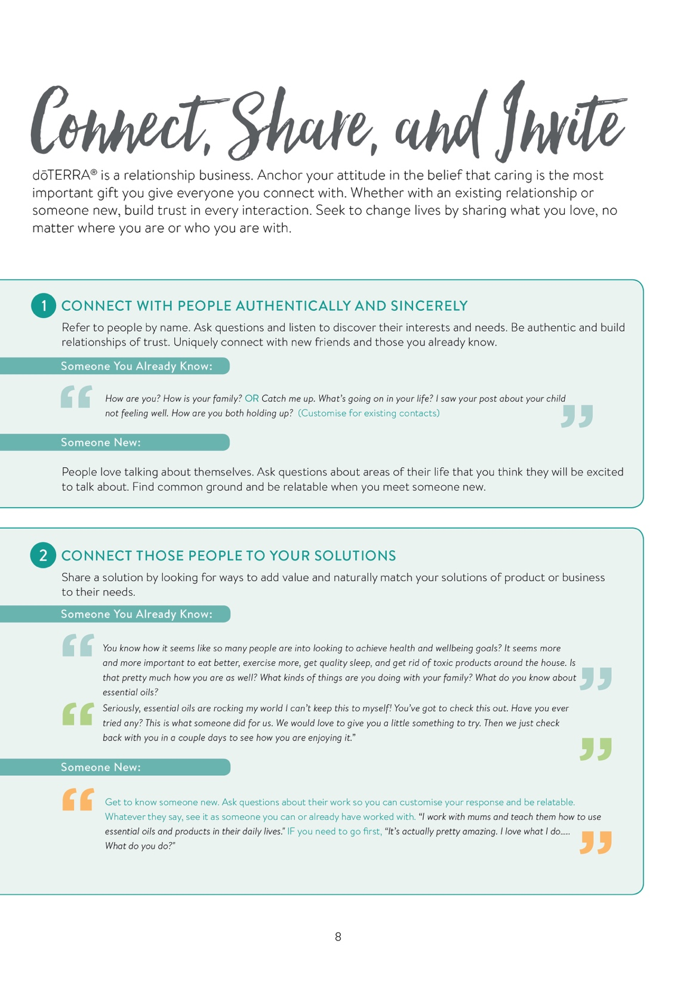
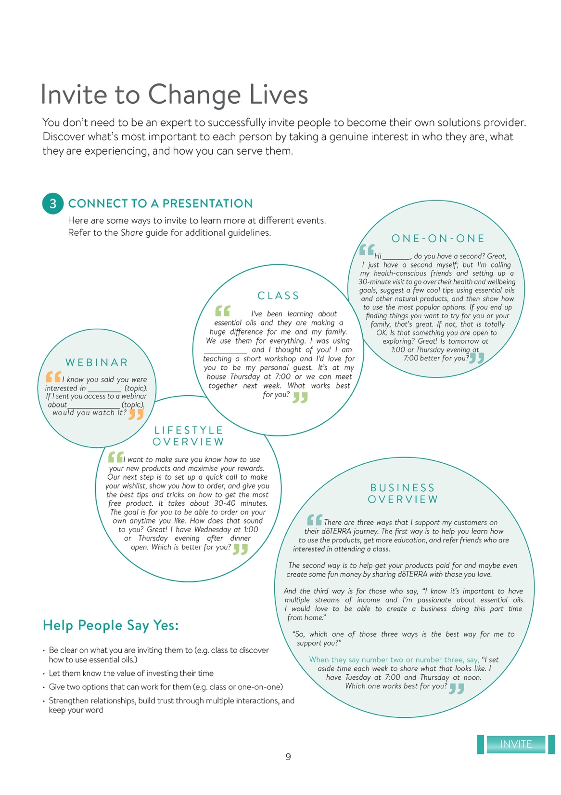
Notes:
This is a three step process and in the Launch guide it walks you through each step. We’ve already talked a little bit about connecting with the people you talk to and now we’re going to move into step 2.
(Switch slide)

Slide 59

Notes:
We’re going to practice this through a role play. Pick someone new that you haven’t worked with yet. Get up and move if you need to. You have 30 seconds to find someone. (wait 30 seconds for the participants to pair up) Great.
Now I want the person wearing the lightest colored shirt to start. You will be inviting the other person with one of the invitations on Page 8. Now the other person, when you get invited, I want you to give the rudest response ever. (You can say something funny like, ”No swearing”) Trust me, it will be ok. But I need you to be totally mean when you say that you are not interested. Is anyone scared about this activity yet? (Laugh a little) You have 1 minute to invite and reject. Go!
(Wait one minute)
Stop.
Was that scary? Did it kill you? Now switch. The roles are reversed and the first group gets their revenge. Remember you need to reject their offer. You have 1 minute. Go! (Wait one minute)
Stop.
Was that scary? Did it kill you? How bad was it? (Get some responses. Try to reinforce the fact that they are not damaged and when they hear No, they can think, Next.)
Ok Let’s try this one more time. This time you have to accept the invitation and be excited!
Ready first person? Use one of these prompts in Page 8 and this time the other person will accept your offer. You have 1 minute. Go! (Wait 1 minute)
Stop. How was that? Did it feel good? (Get some responses.)
Now switch. You have 1 minute. The person being offered will have to accept your invitation. Go! (Wait 1 minute)
Stop. How was that? Did it feel good? (Get some responses.)
(Switch slide)

Slide 60

Notes:
You don’t need to be an expert to successfully invite people to become their own solutions provider. Discover what’s most important to each person by taking a genuine interest in who they are, what they are experiencing, and how you can serve them.
(Switch slide)

Slide 61
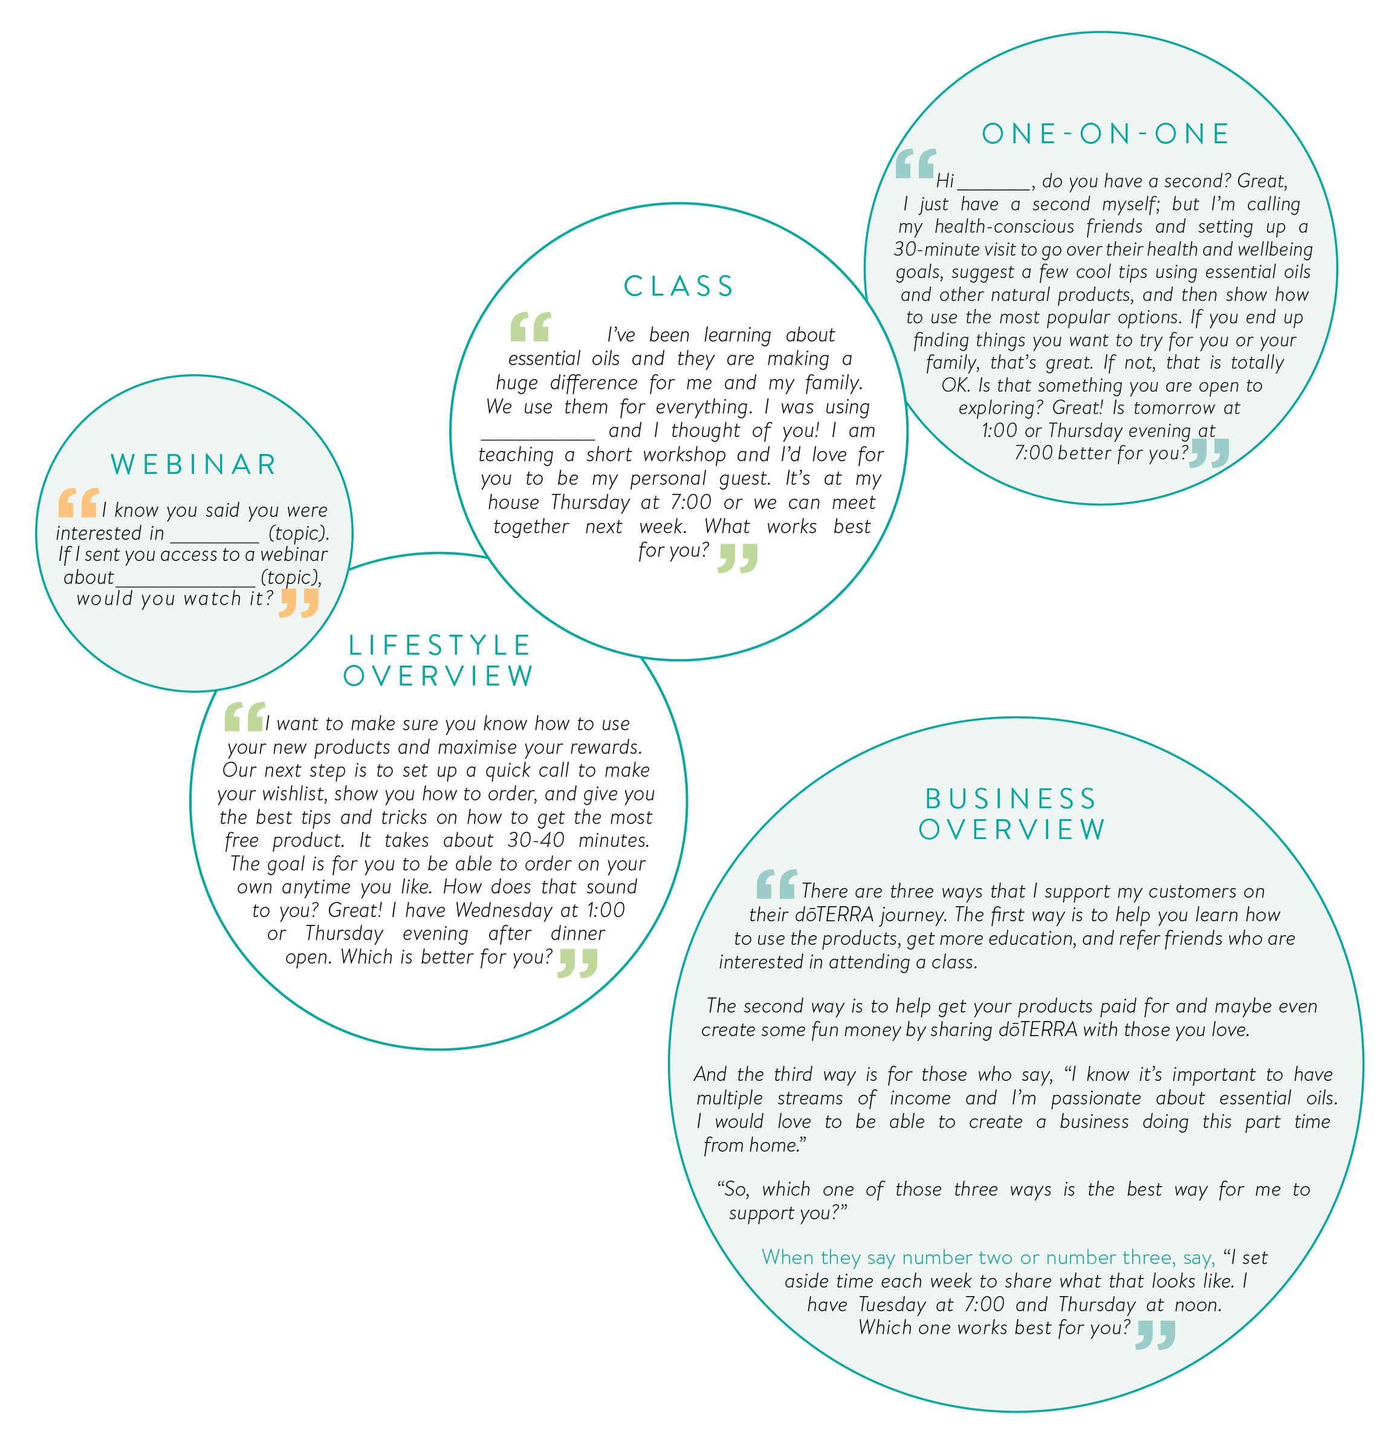
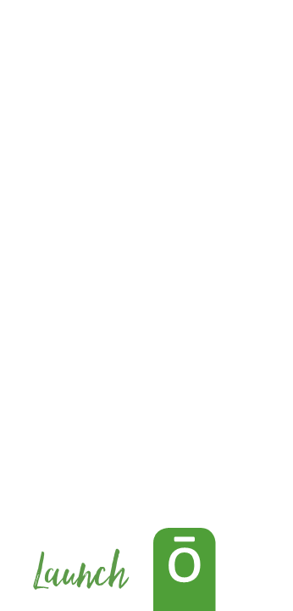
Notes:
From there you can connect them to a presentation where they can learn more.
There are so many different ways that people can learn more and everyone will connect with different types of learning. So decide what would work best for them, a class, a one-on-one, having them watch a webinar etc. Look at the scripts that we’ve provided for inviting them and decide how to use them for you.
(Switch slide)

Slide 62
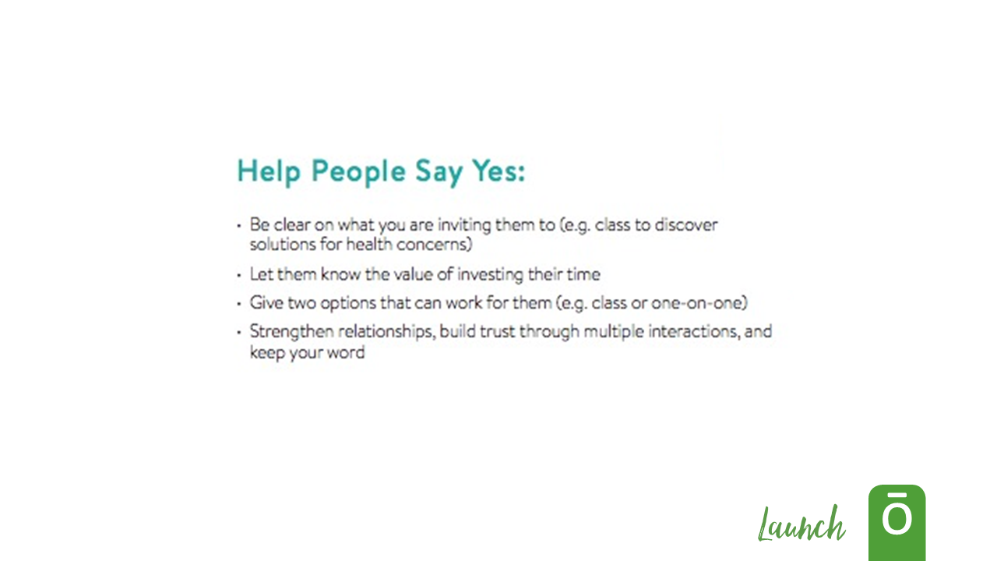
Notes:
We want to make sure that we’re doing all that we can to help people say yes and here we can see a few key tips to do that.
(Switch slide)

Slide 63
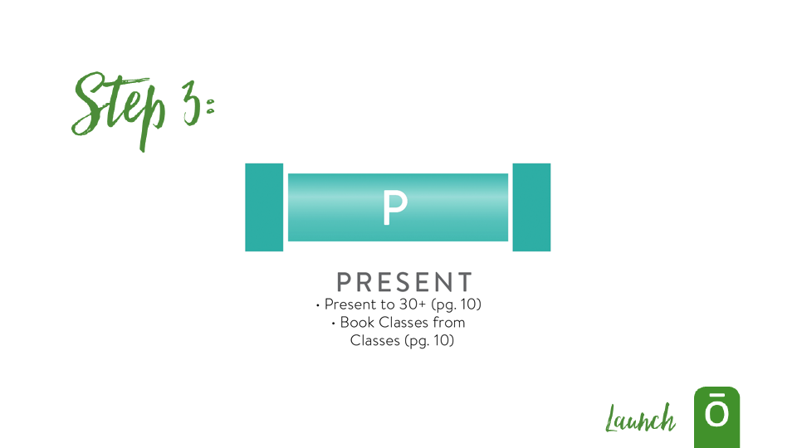
Notes:
The third step in the PIPES process is to Present – The next step for your prospects, after being invited to learn more, is to experience the message about the life-changing products and income-producing opportunity dōTERRA offers.
(Switch slide)

Slide 64
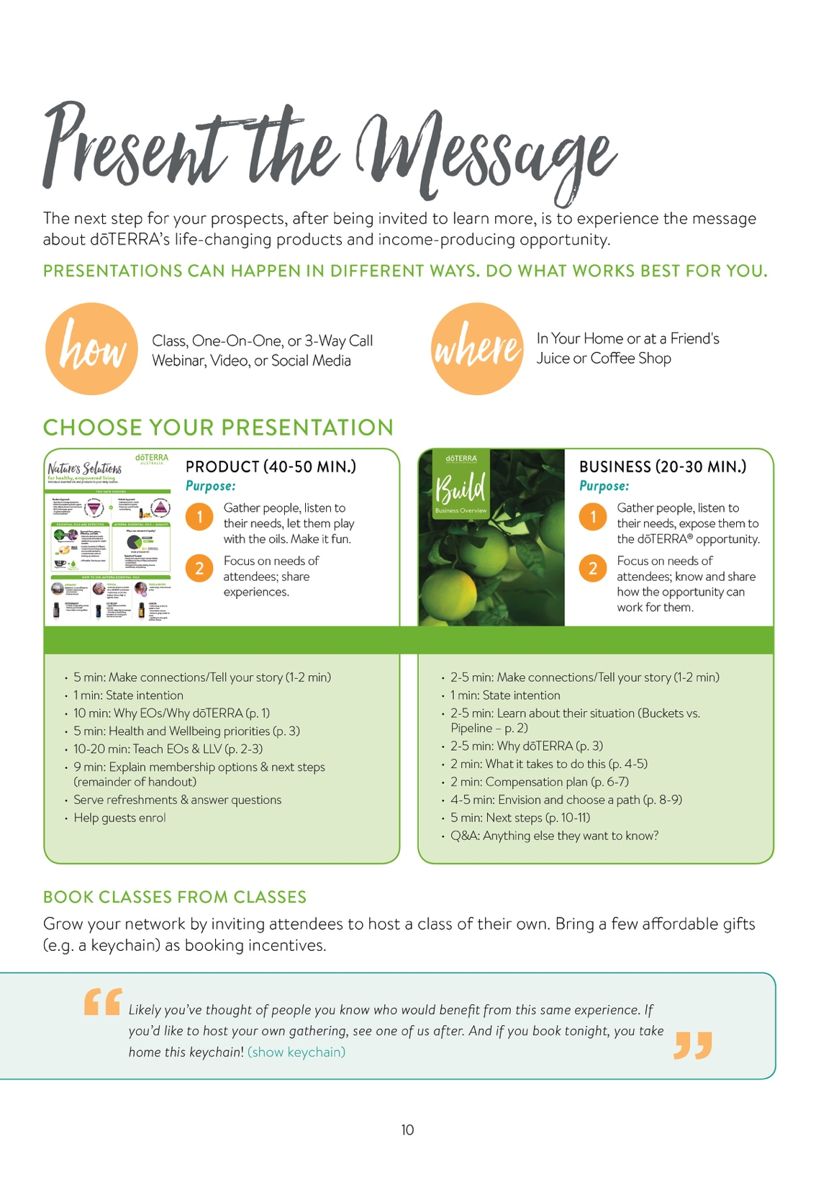
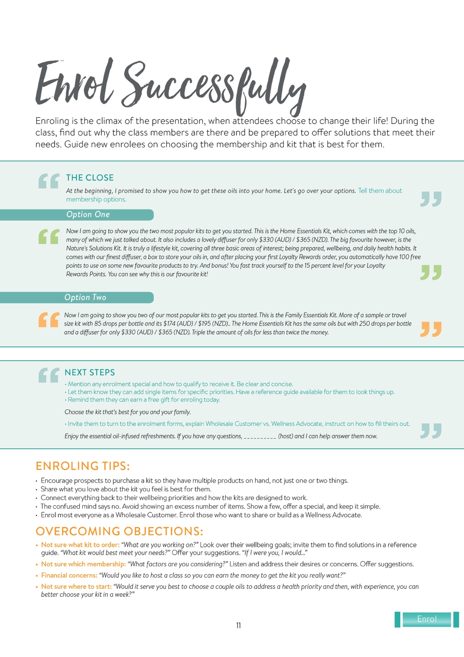
Notes:
Now we’re doing to look into how to present a class and how to teach.
(Switch slide)

Slide 65
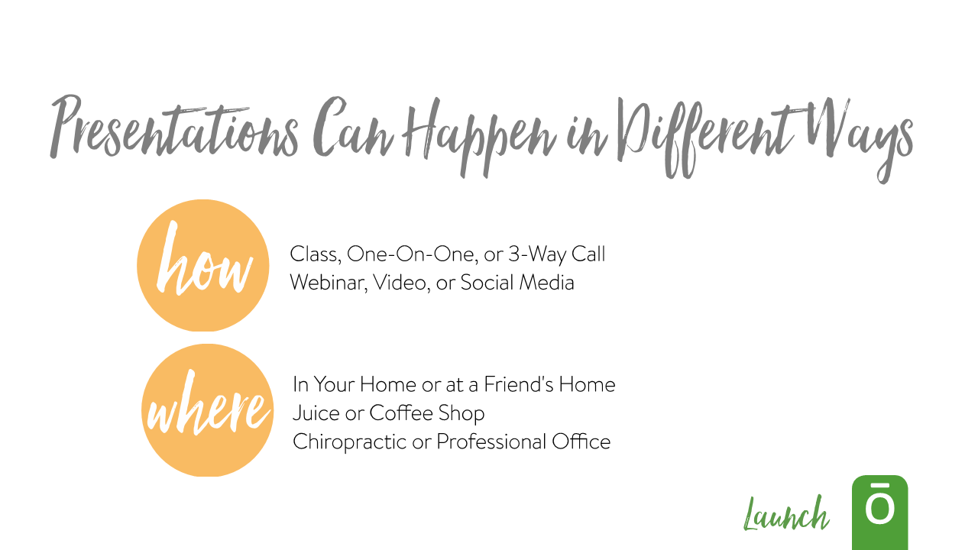
Notes:
There are many different ways that a presentation can happen (talk about examples on slide). Find what works best for you and what works best for the people you’re teaching.
(Switch slide)

Slide 66

Notes:
The next section on the page walks you through two different types of presentations: product presentations and business presentations.
(explain some of the differences between the two types of classes)
(Switch slide)

Slide 67


Notes:
As you teach:
Draw from your experiences
Do what others can duplicate
Share the value of opening a dōTERRA wholesale account
(Switch slide)

Slide 68


Notes:
The Nature’s Solutions class is the one that dōTERRA has prepared for you and its job is to enrol prospects.
(Switch slide)

Slide 69

Notes:
Keep it simple when you’re presenting to someone for the first time. The Nature’s Solutions class focuses on three things.
1. What is an essential oil
2. How to use them
3. How to get them in your home
(Switch slide)

Slide 70
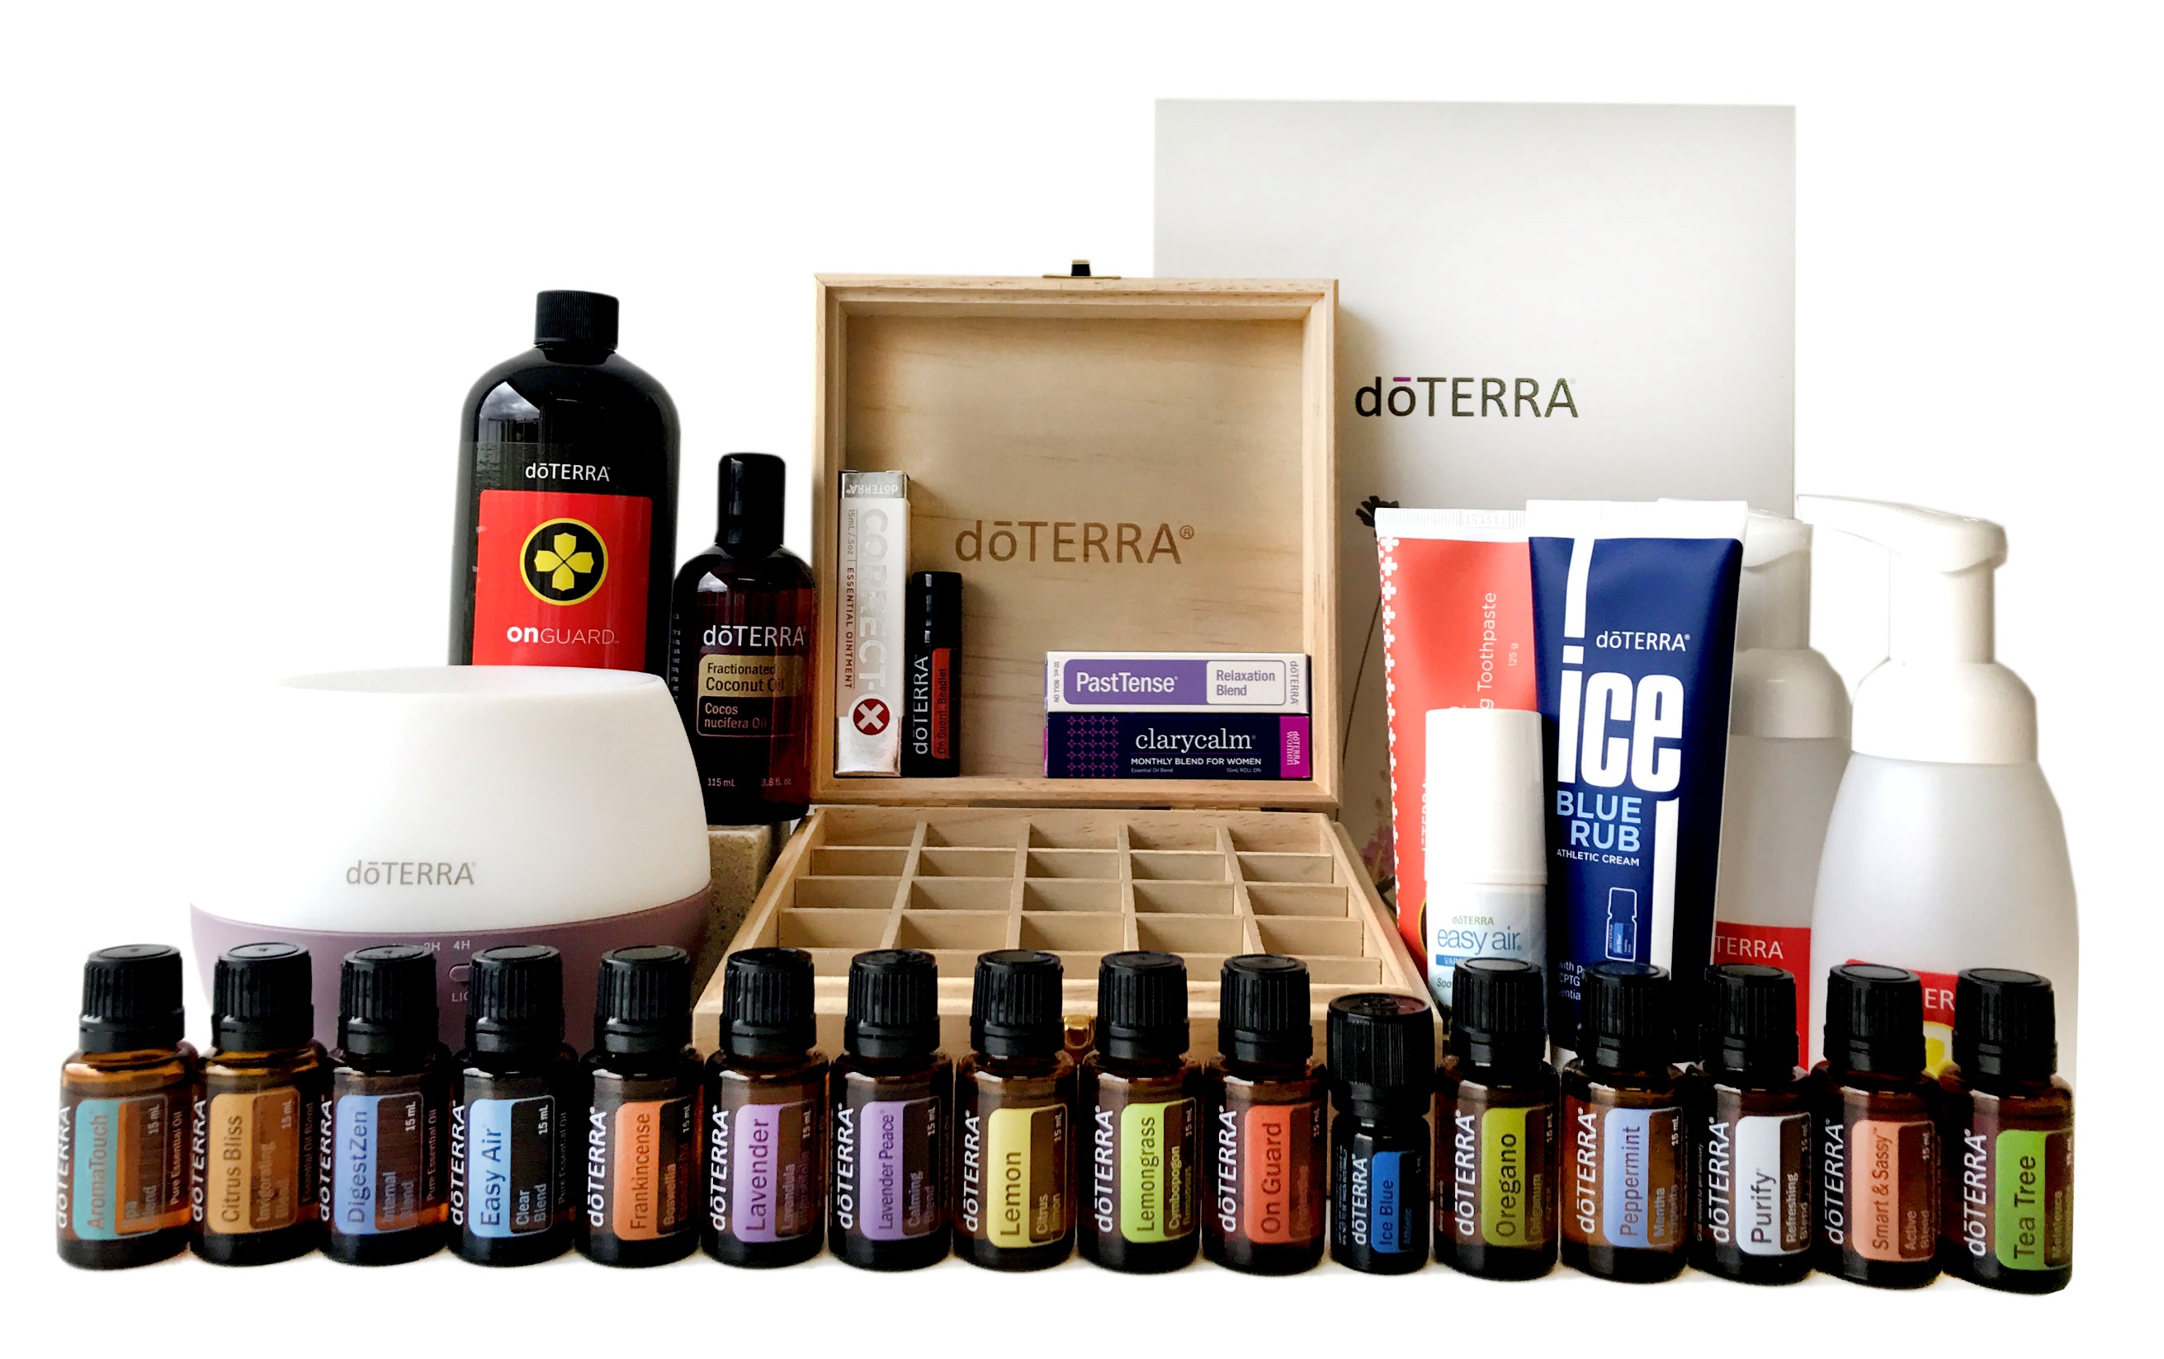
Notes:
dōTERRA has also created the Empower Kit which contains everything you would need to host a successful class. This can enable you to get the basics for hosting a class and then you can make it your own and make sure it works for you.
(Switch slide)

Slide 71


Notes:
Part of the purpose of having the class is to continue the pattern. Give the people who attend your class an opportunity to host their own class and present the message to the people they know.
(Switch slide)

Slide 72
Notes:
The other half of hosting a class is making sure you can successfully enrol people, which is a key skill when starting your business.
(Switch slide)

Slide 73

Notes:
The fourth step in the PIPES process is Enrol – Enroling is the apex of the presentation, when attendees choose to change their life by purchasing the products. During the class, find out why the class members are there and be prepared to offer solutions that meet their needs. Guide new enrolees on choosing the membership and kit that is best for them.
(Switch slide)

Slide 74

Notes:
Now let’s talk about how to close. If you look on Page 11 of the Launch guide you will see that there are two great options to use when building a close.
Of course, we are going to practice this today so that you are completely prepared.
(Switch slide)

Slide 75

Notes:
Ok, let’s pair up and try this. Let’s stay with your last partner and Person B will start with the invitation this time. You will have 3 minutes to get through a close. If you finish early, just start again and use a different option this time.
Let me demonstrate. Do I have a volunteer?
(Go through the entire close from the top to the bottom.)
Are there any questions? (If there are objections, let them know that we will cover that topic next.)
Ready, Go! (Wait 3 minutes)
Now switch. And remember, stick to the script. Ready, Go! (Wait 3 Minutes)
Ok, let’s get back together.
(Switch slide)

Slide 76
Notes:
While you’re talking with people keep these enroling tips in mind (go through bulleted list of tips).
If you run into objections as you’re going through your close we have some tips for overcoming them. We’ve listed out some of the most common objections that come up and questions to help resolve and address their concerns.
(Switch slide)

Slide 77

Notes:
As you address objections you can draw from the experiences you’ve had with others who might have had the same objections. Or, if you had some of the same objections when you were first introduced to dōTERRA you could share how you overcame your hesitation.
(Switch slide)

Slide 78

Notes:
The fifth and final step in the PIPES process is Support.
(Switch slide)

Slide 79

Notes:
Seek to serve the needs of your enrolees and earn the right to keep them as customers going forward.
(Switch slide)

Slide 80


Notes:
New members enrol first with a kit and second in the Loyalty Rewards Program (LRP). This second enrolment is what builds your financial pipeline and as we talked about earlier, we do that through the Lifestyle Overview.
(Switch slide)

Slide 81
Notes:
Make sure to keep it simple. If you’re looking for help on doing a Lifestyle Overview there are resource videos to accompany the Live guide on doterra.com under Empowered Success.
Here is a checklist of what you need to do during a Lifestyle Overview. There are four steps, and by the end your new member should understand how to use the oils they just purchased.
Step 1 is to Introduce the doTERRA lifestyle & Wellness Pyramid. This is where they rate themselves on a scale of 1-10 in each area of the Wellness Pyramid, learn about the doTERRA lifestyle and how the products can help them reach their wellness goals, and they create their wish list of products.
Step 2 is to conduct a Wellness Consult. This is where you help them create their 90 day customized plan of action, teach them about the benefits of LRP, and help them set up their first order online.
Step 3 is to Connect them to education and community. Recommend your favorite reference guide and app to support further learning, introduce tools to help them learn how the products support their 90 day goals (such as Empowered Life Series, Daily Drop App and Living magazine). Be sure to connect with them 2-3 times in their first month and check in periodically after that.
(Switch slide)

Slide 82

Notes:
Step four in this process is the New Member Follow-up.
(Switch slide)

Slide 83
Notes:
The New Member Follow Up is where you can invite them to share or build dōTERRA and if they have interest in either you can give them the guides that will support them. For example, if they are interested in hosting a class or getting their product paid for, give them a Share guide and have them schedule a class of their own. Commit them to host a class and get it scheduled on both your calendars. If they are interested in earning additional income, invite them to have a conversation with you about the Build guide.
(Switch slide)

Slide 84


Notes:
This presentation doesn’t go in great detail about each of the guides available but we do want you to look into these guides in your own time and learn the resources that dōTERRA offers.
(Switch slide)

Slide 85


Notes:
One of the final pages in the Launch guide covers Placement Strategy and gives you some guidance as you begin to build.
(Switch slide)

Slide 86

Notes:
First it goes into some tips for all new enrolees as well as tips for overall team structures.
(highlight some of the points on the page)
(Switch slide)

Slide 87
Notes:
Next we move into Wholesale Customers. They have a couple different aspects to keep in mind when thinking about Placement Strategy, such as the possibility of upgrading to a Wellness Advocate at a later time.
(Switch slide)

Slide 88

Notes:
The Launch guide also gives an example of what a successful team structure might look like. The pace of building a team structure varies. Depending on when your builders or business partners are enroled and engaged determines the rate at which you launch each new leg. For example, some start with one builder and grow from there while others may start with three (for example, perhaps they began with a larger network or previously established relationships)
(Switch slide)

Slide 89

Notes:
Now let’s discuss the differences between an Enroler and a Sponsor.
Enroler:
• The person who brought the enrollee to dōTERRA®. (Whose contact is it? Who invited them?)
• Receives Fast Start bonuses on their new enrolee’s purchases for their first 60 days after their enrolment.
• Works with sponsor (if different) to determine who does Lifestyle Overview, follow-up, and other support.
• Enrolee counts for enroler’s rank advancement (one per leg).
• The enroler can change a new enrollee's sponsor once during their first 14 days of enrolment via the back office.
Always keep enrolership of your enrolees until it makes sense to transfer to their sponsor or another builder for rank advancement.
(Switch slide)

Slide 90

Notes:
Sponsor:
• Person under whom the enrolee is directly placed (also referred to as their direct upline).
• Benefits from Power of 3 and Unilevel bonuses.
• Assists with the Lifestyle Overview and other follow-up needs (depending on arrangements made).
(Switch slide)

Slide 91


Notes:
The final page of the Launch guide addresses the question, “How do I find builders?”
(Switch slide)

Slide 92

Notes:
Finding builders is a numbers game and the more people you’re enroling the higher chance you have of finding builders to work with.
(Switch slide)

Slide 93

Notes:
Look at your current customers and identify those that could possibly be builders. (Read the final paragraph)
(Switch slide)

Slide 94

Notes:
Once you have potential builders enroled under you, make sure that they are committed and capable. You will know that a person is committed if they complete the three steps in the Build guide.
You will know if they are capable if they enrol someone on their own in the first 14 days of committing to build.
(Switch slide)

Slide 95

Notes:
As you’re looking for potential builders there are a few traits to look for. (read bulleted list)
(Switch slide)

Slide 96
Notes:
You can even use your Names List that we worked on earlier to identify potential builders.
(Switch slide)

Slide 97

Notes:
With that in mind, I want each of you to take a moment and think about three potential business partners.
Go to your Success Tracker on page 7. Rate your prospects by placing tally marks for each quality listed above. Jot down the names with the most tally marks from the previous descriptions.
You have five minutes to go through your list. Think about the qualities found on Page 15. Compare them with the names that you have identified. Ready, Go!
(Wait 5 minutes)
(Switch slide)

Slide 98


Notes:
Once you find your builders make sure to take them through the Business Overview in the Build guide to ensure that they feel prepared to start building their own business.
(Switch slide)

Slide 99


Notes:
So now what? Provide a Launch Overview for each of your new builders. Check in with them weekly to see how they are progressing and find out how you can support them.
Like that last sentence says, “Ultimately, supporting them in reaching their goals helps you reach yours.”
(Switch slide)

Slide 100

Notes:
We’ve now gone through the five steps to Launch. The PIPES model is your key to success.
Prepare
Invite
Present
Enrol
Support
(Switch slide)

Slide 101
Notes:
Remember that in the beginning I asked you to evaluate your commitment? Well, as we’ve gone through this course I hope you’ve had that in mind. Now that you’ve had an in depth look at the business I would invite you to take some time to reassess your commitment. Maybe you’re ready to do more than you originally thought.
(Switch slide)

Slide 102

Notes:
We have covered a lot of material today and it might take some time to sink in. For now I challenge you to focus on these three steps for the next 30 – 90 days. Do not get distracted by other things. If you focus on this, if you make achieving this your goal, you will be successful.
(Switch slide)

Slide 103


Results not typical. Average earnings are less. See doTERRA Opportunity and Earnings Disclosure Summary on doterra.com.
Notes:
Thank you so much for spending some time with us here at this camp.
As Justin Harrison says, “We use oils, we share oils, and we teach others to do the same.” It really is that simple. We are in the business of changing lives, one drop of oil at a time. Thank you for spending some time with us here at this Launch camp.
Now go launch your business.

